Slide 1
The study will begin at 7:30 PM
THE BOOK OF REVELATION
BIBLE STUDY

Slide 2
Let us Pray and then start the Bible study..

Slide 3
Let us start the Bible study..

Slide 4
Last Week Bible Study, we look at:
Living in Heaven
And
The New Jerusalem City

Slide 5
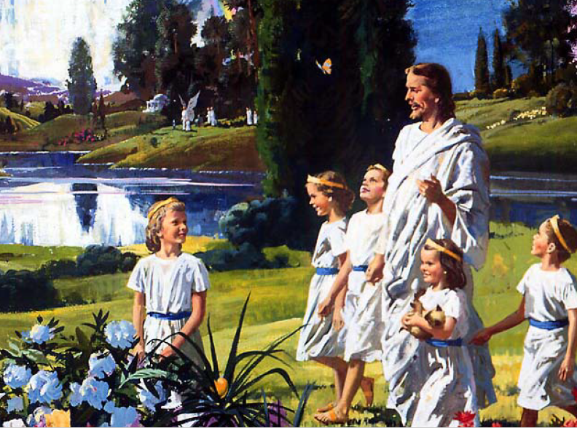

Slide 6
Tonight’s Bible Study:
The four horsemen
of
Revelation

Slide 7
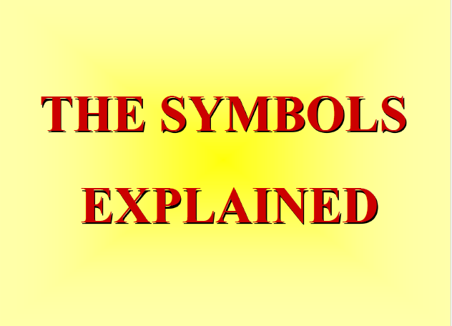

Slide 8
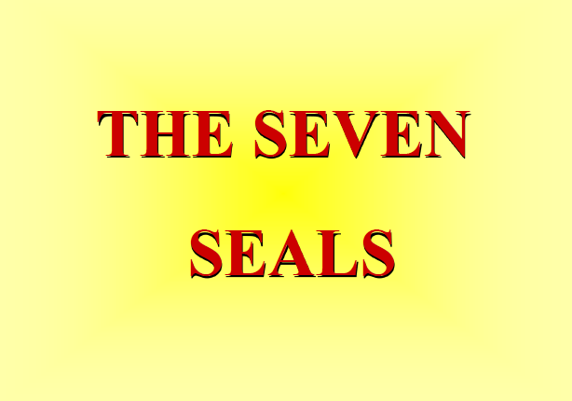

Slide 9
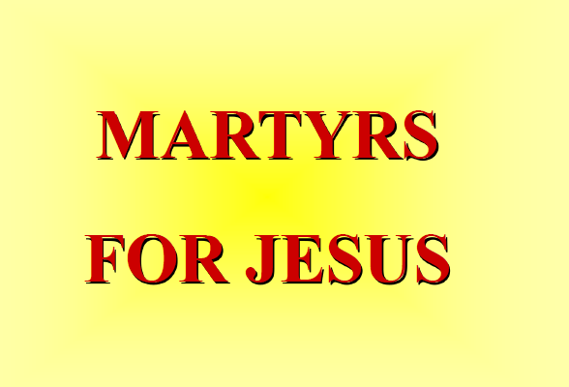

Slide 10
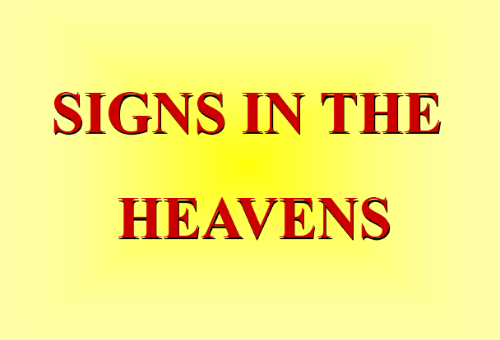

Slide 11


Slide 12
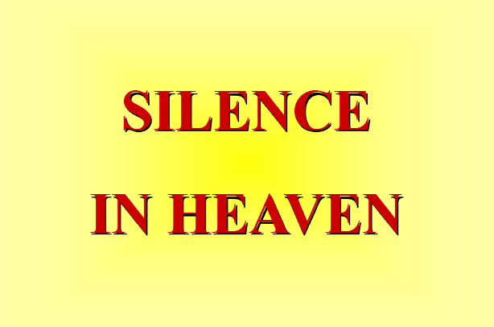

Slide 13
The first lesson for tonight:

Slide 15
Zechariah 1:8-10 (NLT)
8 In a vision during the night, I saw a man sitting on a red horse that was standing among some myrtle trees in a small valley. Behind him were riders on red, brown, and white horses.

Slide 16
Zechariah 1:8-10 (NLT)
9 I asked the angel who was talking with me, “My lord, what do these horses mean?” “I will show you,” the angel replied.

Slide 17
Zechariah 1:8-10 (NLT)
10 The rider standing among the myrtle trees then explained, “They are the ones the Lord has sent out to patrol the earth.”

Slide 18
Zechariah 6:2-5 (NLT)
2 The first chariot was pulled by red horses, the second by black horses, 3 the third by white horses, and the fourth by powerful dappled-gray horses.

Slide 19
Zechariah 6:2-5 (NLT)
4 “And what are these, my lord?” I asked the angel who was talking with me.

Slide 20
Zechariah 6:2-5 (NLT)
5 The angel replied, “These are the four spirits of heaven who stand before the Lord of all the earth. They are going out to do his work.

Slide 21
Revelation 6:1 (NLT)
6 As I watched, the Lamb broke the first of the seven seals on the scroll. Then I heard one of the four living beings say with a voice like thunder, “Come!”

Slide 22
Revelation 6:3 (NLT)
3 When the Lamb broke the second seal, I heard the second living being say, “Come!”

Slide 23
Revelation 6:5 (NLT)
5 When the Lamb broke the third seal, I heard the third living being say, “Come!” I looked up and saw a black horse, and its rider was holding a pair of scales in his hand.

Slide 24
Revelation 6:7 (NLT)
7 When the Lamb broke the fourth seal, I heard the fourth living being say, “Come!”

Slide 26
Revelation 6:2 (NLT)
2 I looked up and saw a white horse standing there. Its rider carried a bow, and a crown was placed on his head. He rode out to win many battles and gain the victory.

Slide 27
Revelation 6:4 (NLT)
4 Then another horse appeared, a red one. Its rider was given a mighty sword and the authority to take peace from the earth. And there was war and slaughter everywhere.

Slide 28
Acts 26:18 (NLT)
18 to open their eyes, so they may turn from darkness to light and from the power of Satan to God. Then they will receive forgiveness for their sins and be given a place among God’s people, who are set apart by faith in me.’

Slide 29
John 12:35 (NLT)
35 Jesus replied, “My light will shine for you just a little longer. Walk in the light while you can, so the darkness will not overtake you. Those who walk in the darkness cannot see where they are going.

Slide 30
Revelation 6:5, (NLT)
5 When the Lamb broke the third seal, I heard the third living being say, “Come!” I looked up and saw a black horse, and its rider was holding a pair of scales in his hand.

Slide 31
Revelation 6:6 (NLT)
6 And I heard a voice from among the four living beings say, “A loaf of wheat bread or three loaves of barley will cost a day’s pay. And don’t waste the olive oil and wine.”

Slide 33
Revelation 6:8 (NLT)
8 I looked up and saw a horse whose color was pale green. Its rider was named Death, and his companion was the Grave. These two were given authority over one-fourth of the earth, to kill with the sword and famine and disease and wild animals.

Slide 34
Revelation 6:9 (NLT)
9 When the Lamb broke the fifth seal, I saw under the altar the souls of all who had been martyred for the word of God and for being faithful in their testimony.

Slide 35
Revelation 6:10 (NLT)
10 They shouted to the Lord and said, “O Sovereign Lord, holy and true, how long before you judge the people who belong to this world and avenge our blood for what they have done to us?”

Slide 36
Revelation 6:11 (NLT)
11 Then a white robe was given to each of them. And they were told to rest a little longer until the full number of their brothers and sisters—their fellow servants of Jesus who were to be martyred—had joined them.

Slide 38
Revelation 6:12 (NLT)
12 I watched as the Lamb broke the sixth seal, and there was a great earthquake. The sun became as dark as black cloth, and the moon became as red as blood.

Slide 39
Revelation 6:13 (NLT)
13 Then the stars of the sky fell to the earth like green figs falling from a tree shaken by a strong wind.

Slide 40
Revelation 6:14-17 (NLT)
14 The sky was rolled up like a scroll, and all of the mountains and islands were moved from their places.

Slide 41
Revelation 6:14-17 (NLT)
15 Then everyone—the kings of the earth, the rulers, the generals, the wealthy, the powerful, and every slave and free person—all hid themselves in the caves and among the rocks of the mountains.

Slide 42
Revelation 6:14-17 (NLT)
16 And they cried to the mountains and the rocks, “Fall on us and hide us from the face of the one who sits on the throne and from the wrath of the Lamb. 17 For the great day of their wrath has come, and who is able to survive?”

Slide 44
Revelation 7:2 (NLT)
2 And I saw another angel coming up from the east, carrying the seal of the living God. And he shouted to those four angels, who had been given power to harm land and sea,

Slide 45
Revelation 7:3 (NLT)
3 “Wait! Don’t harm the land or the sea or the trees until we have placed the seal of God on the foreheads of his servants.”

Slide 46
Revelation 14:6 (NLT)
6 And I saw another angel flying through the sky, carrying the eternal Good News to proclaim to the people who belong to this world—to every nation, tribe, language, and people.

Slide 47
Matthew 24:14 (NLT)
14 And the Good News about the Kingdom will be preached throughout the whole world, so that all nations will hear it; and then the end will come.

Slide 48
Revelation 14:14 (NLT)
14 Then I saw a white cloud, and seated on the cloud was someone like the Son of Man. He had a gold crown on his head and a sharp sickle in his hand.

Slide 49
Matthew 24:36 (NLT)
36 “However, no one knows the day or hour when these things will happen, not even the angels in heaven or the Son himself. Only the Father knows.

Slide 50
Matthew 24:33 (NLT)
33 In the same way, when you see all these things, you can know his return is very near, right at the door.

Slide 52
Revelation 8:1 (NLT)
8 When the Lamb broke the seventh seal on the scroll, there was silence throughout heaven for about half an hour (7 ½ days).

Slide 53
Luke 21:28 (NLT)
28 So when all these things begin to happen, stand and look up, for your salvation is near!”

Slide 54
Jude 24 (NLT)
24 Now all glory to God, who is able to keep you from falling away and will bring you with great joy into his glorious presence without a single fault.

Slide 55
Jude 25 (NLT)
25 All glory to him who alone is God, our Savior through Jesus Christ our Lord. All glory, majesty, power, and authority are his before all time, and in the present, and beyond all time! Amen.

Slide 56
END -
I am ready to answer any question you may have.

Slide 57
Let us Pray to close the Bible study.

Slide 58
Don’t Be Afraid to Follow Jesus!
“If you love Him, keep His commandments”

