Slide 1
The study will begin at 7:30 PM
THE BOOK OF REVELATION
BIBLE STUDY

Slide 2
Let us Pray and then start the Bible study..

Slide 3
Let us start the Bible study..

Slide 4
Last Bible Study, we look at:
Millennium – 1000 years
Before, During, and After

Slide 5
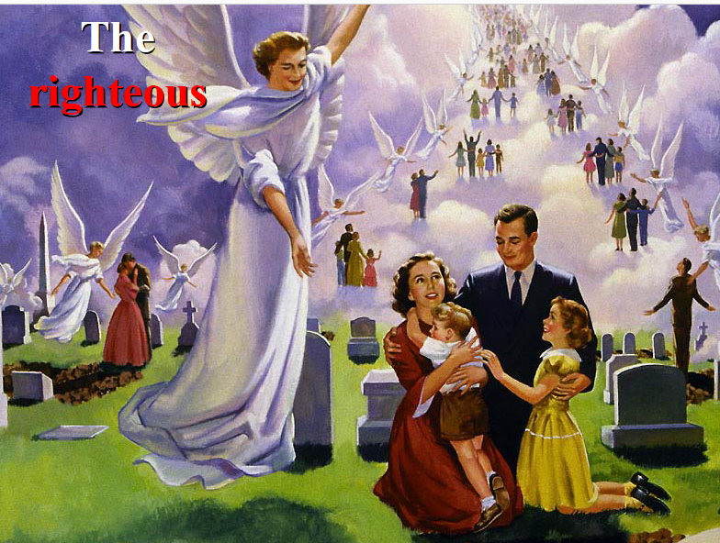

Slide 7
Tonight’s Bible Study:
Revelation’s Amazing Space City

Slide 14
The first lesson for tonight:

Slide 16
Hebrews 11:16 (NLT)
16 But they were looking for a better place, a heavenly homeland. That is why God is not ashamed to be called their God, for he has prepared a city for them.

Slide 17
Revelation 3:12 (NLT)
12 All who are victorious will become pillars in the Temple of my God, and they will never have to leave it. And I will write on them the name of my God, …

Slide 18
Revelation 3:12 (NLT)
… and they will be citizens in the city of my God—the new Jerusalem that comes down from heaven from my God. And I will also write on them my new name.

Slide 19
Revelation 21:2 (NLT)
2 And I saw the holy city, the new Jerusalem, coming down from God out of heaven like a bride beautifully dressed for her husband.

Slide 20
Revelation 21:10 (NLT)
10 So he took me in the Spirit[a] to a great, high mountain, and he showed me the holy city, Jerusalem, descending out of heaven from God.

Slide 21
Zechariah 14:1, 4, 5, 10 (NLT)
14:1 Watch, for the day of the Lord is coming when your possessions will be plundered right in front of you!

Slide 22
Zechariah 14:1, 4, 5, 10 (NLT)
14:4 On that day his feet will stand on the Mount of Olives, east of Jerusalem. And the Mount of Olives will split apart, making a wide valley running from east to west. Half the mountain will move toward the north and half toward the south.

Slide 23
Zechariah 14:1, 4, 5, 10 (NLT)
14:5 You will flee through this valley, for it will reach across to Azal.[a] Yes, you will flee as you did from the earthquake in the days of King Uzziah of Judah. Then the Lord my God will come, and all his holy ones with him.

Slide 24
Zechariah 14:1, 4, 5, 10 (NLT)
14:10 All the land from Geba, north of Judah, to Rimmon, south of Jerusalem, will become one vast plain. But Jerusalem will be raised up in its original place…

Slide 25
Zechariah 14:1, 4, 5, 10 (NLT)
…and will be inhabited all the way from the Benjamin Gate over to the site of the old gate, then to the Corner Gate, and from the Tower of Hananel to the king’s winepresses.

Slide 26
Revelation 21:16 (NLT)
16 When he measured it, he found it was a square, as wide as it was long. In fact, its length and width and height were each 1,500 miles.
1 mile = 8 furlongs

Slide 28
Revelation 21:10-27 (NLT)
10 So he took me in the Spirit to a great, high mountain, and he showed me the holy city, Jerusalem, descending out of heaven from God. 11 It shone with the glory of God and sparkled like a precious stone—like jasper as clear as crystal.

Slide 29
Revelation 21:10-27 (NLT)
12 The city wall was broad and high, with twelve gates guarded by twelve angels. And the names of the twelve tribes of Israel were written on the gates. 13 There were three gates on each side—east, north, south, and west.

Slide 30
Revelation 21:10-27 (NLT)
14 The wall of the city had twelve foundation stones, and on them were written the names of the twelve apostles of the Lamb.15 The angel who talked to me held in his hand a gold measuring stick to measure the city, its gates, and its wall.

Slide 31
Revelation 21:10-27 (NLT)
16 When he measured it, he found it was a square, as wide as it was long. In fact, its length and width and height were each 1,500 miles. 17 Then he measured the walls and found them to be 216 feet thick (according to the human standard used by the angel).

Slide 32
Revelation 21:10-27 (NLT)
18 The wall was made of jasper, and the city was pure gold, as clear as glass. 19 The wall of the city was built on foundation stones inlaid with twelve precious stones: the first was jasper, the second sapphire, the third agate, the fourth emerald,

Slide 33
Revelation 21:10-27 (NLT)
20 the fifth onyx, the sixth carnelian, the seventh chrysolite, the eighth beryl, the ninth topaz, the tenth chrysoprase, the eleventh jacinth, the twelfth amethyst.21 The twelve gates were made of pearls—each gate from a single pearl! And the main street was pure gold, as clear as glass.

Slide 34
Revelation 21:10-27 (NLT)
22 I saw no temple in the city, for the Lord God Almighty and the Lamb are its temple. 23 And the city has no need of sun or moon, for the glory of God illuminates the city, and the Lamb is its light.

Slide 35
Revelation 21:10-27 (NLT)
24 The nations will walk in its light, and the kings of the world will enter the city in all their glory. 25 Its gates will never be closed at the end of day because there is no night there.

Slide 36
Revelation 21:10-27 (NLT)
26 And all the nations will bring their glory and honor into the city. 27 Nothing evil will be allowed to enter, nor anyone who practices shameful idolatry and dishonesty—but only those whose names are written in the Lamb’s Book of Life.

Slide 37
Revelation 22:1 (NLT)
22:1 Then the angel showed me a river with the water of life, clear as crystal, flowing from the throne of God and of the Lamb.

Slide 38
Genesis 3:24 (NLT)
24 After sending them out, the Lord God stationed mighty cherubim to the east of the Garden of Eden. And he placed a flaming sword that flashed back and forth to guard the way to the tree of life.

Slide 39
Revelation 22:2 (NLT)
2 It flowed down the center of the main street. On each side of the river grew a tree of life, bearing twelve crops of fruit,[a] with a fresh crop each month. The leaves were used for medicine to heal the nations.

Slide 40
Genesis 3:22 (NLT)
22 Then the Lord God said, “Look, the human beings[a] have become like us, knowing both good and evil. What if they reach out, take fruit from the tree of life, and eat it? Then they will live forever!”

Slide 41
Romans 8:18 (NLT)
18 Yet what we suffer now is nothing compared to the glory he will reveal to us later.

Slide 43
Revelation 20:9 (NLT)
9 And I saw them as they went up on the broad plain of the earth and surrounded God’s people and the beloved city. But fire from heaven came down on the attacking armies and consumed them.

Slide 44
2 Peter 3:10 (NLT)
10 But the day of the Lord will come as unexpectedly as a thief. Then the heavens will pass away with a terrible noise, and the very elements themselves will disappear in fire, and the earth and everything on it will be found to deserve judgment.

Slide 45
Revelation 21:1 (NLT)
Then I saw a new heaven and a new earth, for the old heaven and the old earth had disappeared. And the sea was also gone.

Slide 46
2 Peter 3:13 (NLT)
13 But we are looking forward to the new heavens and new earth he has promised, a world filled with God’s righteousness.

Slide 47
Revelation 21:3 (NLT)
3 I heard a loud shout from the throne, saying, “Look, God’s home is now among his people! He will live with them, and they will be his people. God himself will be with them.

Slide 48
John 14:2-3 (NLT)
2 There is more than enough room in my Father’s home. If this were not so, would I have told you that I am going to prepare a place for you? 3 When everything is ready, I will come and get you, so that you will always be with me where I am.

Slide 50
Philippians 3:20, 21 (NLT)
20 But we are citizens of heaven, where the Lord Jesus Christ lives. And we are eagerly waiting for him to return as our Savior.

Slide 51
Philippians 3:20, 21 (NLT)
21 He will take our weak mortal bodies and change them into glorious bodies like his own, using the same power with which he will bring everything under his control.

Slide 52
Luke 24:36-43 (NLT)
36 And just as they were telling about it, Jesus himself was suddenly standing there among them. “Peace be with you,” he said. 37 But the whole group was startled and frightened, thinking they were seeing a ghost!

Slide 53
Luke 24:36-43 (NLT)
38 “Why are you frightened?” he asked. “Why are your hearts filled with doubt? 39 Look at my hands. Look at my feet. You can see that it’s really me. Touch me and make sure that I am not a ghost, because ghosts don’t have bodies, as you see that I do.” 40 As he spoke, he showed them his hands and his feet.

Slide 54
Luke 24:36-43 (NLT)
41 Still they stood there in disbelief, filled with joy and wonder. Then he asked them, “Do you have anything here to eat?” 42 They gave him a piece of broiled fish, 43 and he ate it as they watched.

Slide 55
Isaiah 65:17, 21, 22 (NLT)
“Look! I am creating new heavens and a new earth, and no one will even think about the old ones anymore.

Slide 56
Isaiah 65:17, 21, 22 (NLT)
In those days people will live in the houses they build and eat the fruit of their own vineyards.

Slide 57
Isaiah 65:17, 21, 22 (NLT)
Unlike the past, invaders will not take their houses and confiscate their vineyards. For my people will live as long as trees, and my chosen ones will have time to enjoy their hard-won gains.

Slide 58
1 Corinthians 2:9 (NLT)
9 That is what the Scriptures mean when they say, “No eye has seen, no ear has heard, and no mind has imagined what God has prepared for those who love him.

Slide 60
Isaiah 35:5-6 (NLT)
And when he comes, he will open the eyes of the blind and unplug the ears of the deaf.6 The lame will leap like a deer, and those who cannot speak will sing for joy! Springs will gush forth in the wilderness, and streams will water the wasteland.

Slide 61
Revelation 21:4 (NLT)
4 He will wipe every tear from their eyes, and there will be no more death or sorrow or crying or pain. All these things are gone forever.”

Slide 62
Isaiah 65:25 (NLT)
The wolf and the lamb will feed together. The lion will eat hay like a cow. But the snakes will eat dust. In those days no one will be hurt or destroyed on my holy mountain. I, the Lord, have spoken!”

Slide 63
Isaiah 11:6 (NLT)
In that day the wolf and the lamb will live together; the leopard will lie down with the baby goat. The calf and the yearling will be safe with the lion, and a little child will lead them all.

Slide 64
Isaiah 65:17 (NLT)
“Look! I am creating new heavens and a new earth, and no one will even think about the old ones anymore.

Slide 66
Isaiah 35:1 (NLT)
Even the wilderness and desert will be glad in those days. The wasteland will rejoice and blossom with spring crocuses.

Slide 67
Isaiah 33:24 (NLT)
The people of Israel will no longer say, “We are sick and helpless,” for the Lord will forgive their sins.

Slide 68
Isaiah 60:18 (NLT)
Violence will disappear from your land; the desolation and destruction of war will end. Salvation will surround you like city walls, and praise will be on the lips of all who enter there.

Slide 69
1 Corinthians 13:12 (NLT)
12 Now we see things imperfectly, like puzzling reflections in a mirror, but then we will see everything with perfect clarity. All that I know now is partial and incomplete, but then I will know everything completely, just as God now knows me completely.

Slide 70
Psalm 16:11 (NLT)
You will show me the way of life, granting me the joy of your presence and the pleasures of living with you forever.

Slide 71
1 John 3:2 (NLT)
2 Dear friends, we are already God’s children, but he has not yet shown us what we will be like when Christ appears. But we do know that we will be like him, for we will see him as he really is.

Slide 72
Revelation 14:4 (NLT)
4 They have kept themselves as pure as virgins, following the Lamb wherever he goes. They have been purchased from among the people on the earth as a special offering to God and to the Lamb.

Slide 73
1 John 1:7-8 (NLT)
7 But if we are living in the light, as God is in the light, then we have fellowship with each other, and the blood of Jesus, his Son, cleanses us from all sin. 8 If we claim we have no sin, we are only fooling ourselves and not living in the truth.

Slide 74
Revelation 1:5 (NLT)
5 …. Jesus Christ. He is the faithful witness to these things, the first to rise from the dead, and the ruler of all the kings of the world. All glory to him who loves us and has freed us from our sins by shedding his blood for us.

Slide 75
END - I am ready to answer any question you may have.

Slide 76
Let us Pray to close the Bible study.

Slide 77
Don’t Be Afraid to Follow Jesus! “If you love Him, keep His commandments”

