Slide 1
The study will begin at 7:30 PM
THE BOOK OF REVELATION
BIBLE STUDY

Slide 2
Let us Pray and then start the Bible study..

Slide 3
Let us start the Bible study..

Slide 4
Last Bible Study, we look at:
The Return of Jesus Christ

Slide 5
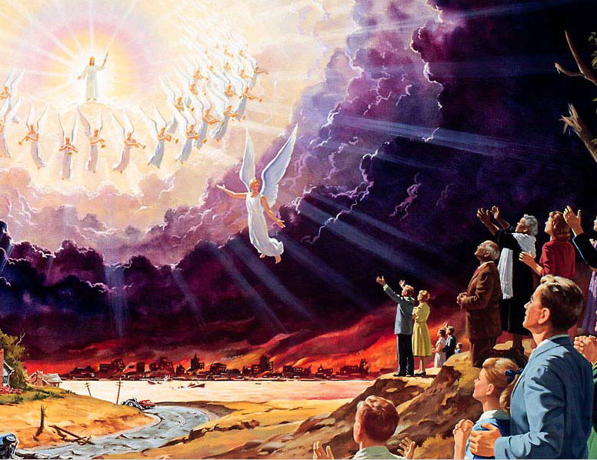

Slide 6
Tonight’s Bible Study:
The devil is chained in
the bottomless pit

Slide 7


Slide 8


Slide 9
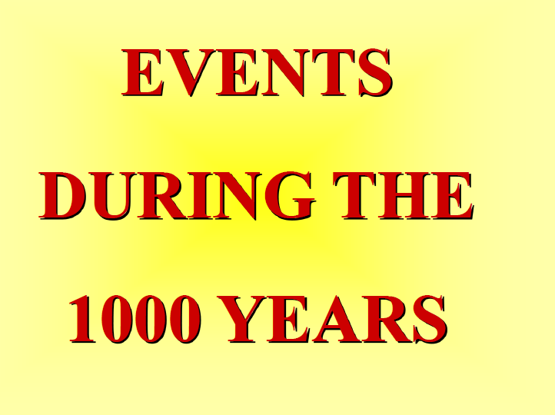

Slide 10


Slide 11


Slide 12
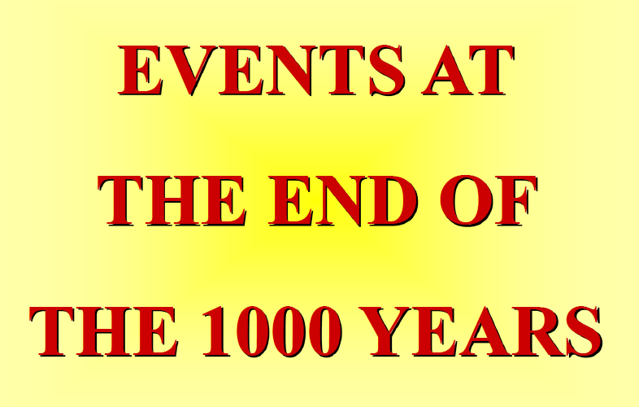

Slide 13
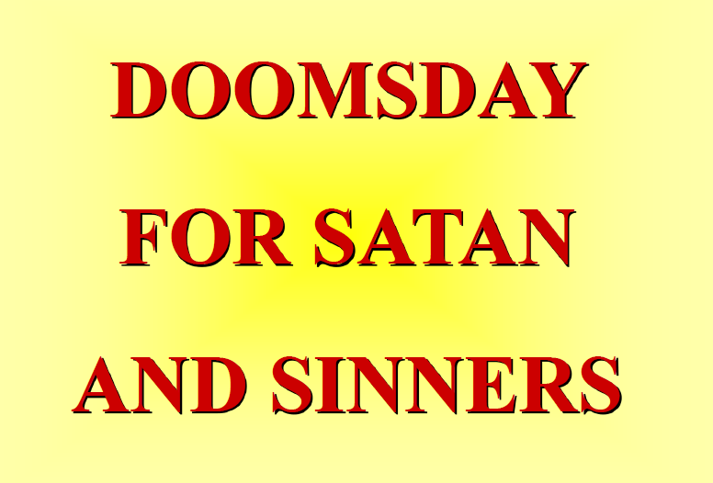
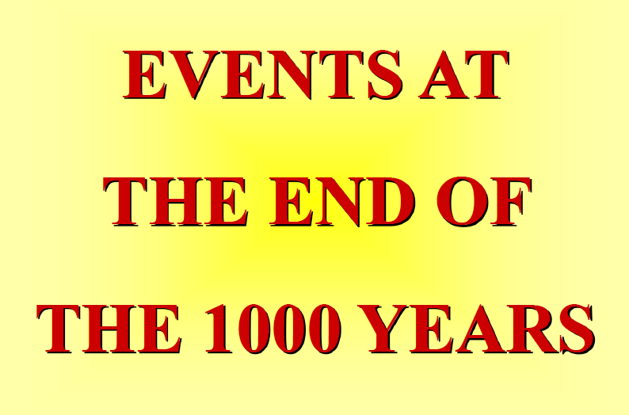

Slide 14


Slide 15
The first lesson for tonight:

Slide 17
Revelation 20:4 (NLT)
4 Then I saw thrones, and the people sitting on them had been given the authority to judge. And I saw the souls of those who had been beheaded for their testimony about Jesus and for…

Slide 18
Revelation 20:4 (NLT)
… proclaiming the word of God. They had not worshiped the beast or his statue, nor accepted his mark on their foreheads or their hands. They all came to life again, and they reigned with Christ for a thousand years.

Slide 19
Revelation 20:5 (NLT)
5 This is the first resurrection. (The rest of the dead did not come back to life until the thousand years had ended.)

Slide 20
Revelation 20:6 (NLT)
6 Blessed and holy are those who share in the first resurrection. For them the second death holds no power, but they will be priests of God and of Christ and will reign with him a thousand years.

Slide 21
John 5:28 (NLT)
28 Don’t be so surprised! Indeed, the time is coming when all the dead in their graves will hear the voice of God’s Son,

Slide 22
John 5:29 (NLT)
29 and they will rise again. Those who have done good will rise to experience eternal life, and those who have continued in evil will rise to experience judgment.

Slide 23
Revelation 20:5 (NLT)
5 This is the first resurrection. (The rest of the dead did not come back to life until the thousand years had ended.)

Slide 25
1 Thessalonians 4:15 (NLT)
15 We tell you this directly from the Lord: We who are still living when the Lord returns will not meet him ahead of those who have died

Slide 26
1 Thessalonians 4:16 (NLT)
16 For the Lord himself will come down from heaven with a commanding shout, with the voice of the archangel, and with the trumpet call of God. First, the believers who have died will rise from their graves.

Slide 27
1Corinthians 15:51-54 (NLT)
51 But let me reveal to you a wonderful secret. We will not all die, but we will all be transformed! 52 It will happen in a moment, in the blink of an eye, when the last trumpet is blown. For when the trumpet sounds, those who have…

Slide 28
1Corinthians 15:51-54 (NLT)
... died will be raised to live forever. And we who are living will also be transformed. 53 For our dying bodies must be transformed into bodies that will never die; our mortal bodies must be transformed into immortal bodies.

Slide 29
1Corinthians 15:51-54 (NLT)
54 Then, when our dying bodies have been transformed into bodies that will never die, this Scripture will be fulfilled: “Death is swallowed up in victory.

Slide 30
Philippians 3:20 (NLT)
20 But we are citizens of heaven, where the Lord Jesus Christ lives. And we are eagerly waiting for him to return as our Savior.

Slide 31
Philippians 3:21 (NLT)
21 He will take our weak mortal bodies and change them into glorious bodies like his own, using the same power with which he will bring everything under his control.

Slide 32
1 Thessalonians 4:17 (NLT)
17 Then, together with them, we who are still alive and remain on the earth will be caught up in the clouds to meet the Lord in the air. Then we will be with the Lord forever.

Slide 33
2 Thessalonians 1:7-9 (NLT)
7 And God will provide rest for you who are being persecuted and also for us when the Lord Jesus appears from heaven. He will come with his mighty angels,

Slide 34
2 Thessalonians 1:7-9 (NLT)
8 in flaming fire, bringing judgment on those who don’t know God and on those who refuse to obey the Good News of our Lord Jesus.

Slide 35
2 Thessalonians 1:7-9 (NLT)
9 They will be punished with eternal destruction, forever separated from the Lord and from his glorious power.

Slide 36
2 Thessalonians 2:8 (NLT)
8 Then the man of lawlessness will be revealed, but the Lord Jesus will slay him with the breath of his mouth and destroy him by the splendor of his coming.

Slide 37
Isaiah 11:4 (NLT)
He will give justice to the poor and make fair decisions for the exploited. The earth will shake at the force of his word, and one breath from his mouth will destroy the wicked.

Slide 38
Revelation 20:5 (NLT)
5 This is the first resurrection. (The rest of the dead did not come back to life until the thousand years had ended.)

Slide 39
Acts 1:9-11 (NLT)
9 After saying this, he was taken up into a cloud while they were watching, and they could no longer see him. 10 As they strained to see him rising into heaven, two white-robed men suddenly stood among them.

Slide 40
Acts 1:9-11 (NLT)
11 “Men of Galilee,” they said, “why are you standing here staring into heaven? Jesus has been taken from you into heaven, but someday he will return from heaven in the same way you saw him go!”

Slide 41
John 13:33 (NLT)
33 Dear children, I will be with you only a little longer. And as I told the Jewish leaders, you will search for me, but you can’t come where I am going.

Slide 42
John 13:36 (NLT)
36 Simon Peter asked, “Lord, where are you going?” And Jesus replied, “You can’t go with me now, but you will follow me later.”

Slide 43
John 14:1-3 (NLT)
1“Don’t let your hearts be troubled. Trust in God, and trust also in me. 2 There is more than enough room in my Father’s home.[a] If this were not so, …

Slide 44
John 14:1-3 (NLT)
… would I have told you that I am going to prepare a place for you? 3 When everything is ready, I will come and get you, so that you will always be with me where I am.

Slide 46
Jeremiah 25:33 (NLT)
33 In that day those the Lord has slaughtered will fill the earth from one end to the other. No one will mourn for them or gather up their bodies to bury them. They will be scattered on the ground like manure.

Slide 48
Revelation 16:18 (NLT)
18 Then the thunder crashed and rolled, and lightning flashed. And a great earthquake struck—the worst since people were placed on the earth.

Slide 49
Revelation 16:20-21 (NLT)
20 And every island disappeared, and all the mountains were leveled. 21 There was a terrible hailstorm, and hailstones weighing as much as seventy-five pounds fell from the sky onto the people below. They cursed God because of the terrible plague of the hailstorm.

Slide 50
Isaiah 24:1 (NLT)
Look! The Lord is about to destroy the earth and make it a vast wasteland. He devastates the surface of the earth and scatters the people.

Slide 51
Isaiah 24:3,19 (NLT)
3 The earth will be completely emptied and looted. The Lord has spoken!
19 The earth has broken up. It has utterly collapsed; it is violently shaken.

Slide 52
Isaiah 24:20 (NLT)
The earth staggers like a drunk. It trembles like a tent in a storm. It falls and will not rise again, for the guilt of its rebellion is very heavy.

Slide 53
Jeremiah 4:23-26 (NLT)
23 I looked at the earth, and it was empty and formless. I looked at the heavens, and there was no light. 24 I looked at the mountains and hills, and they trembled and shook.

Slide 54
Jeremiah 4:23-26 (NLT)
25 I looked, and all the people were gone. All the birds of the sky had flown away. 26 I looked, and the fertile fields had become a wilderness. The towns lay in ruins, crushed by the Lord’s fierce anger.

Slide 55
Jeremiah 4:28 (NLT)
The earth will mourn and the heavens will be draped in black because of my decree against my people. I have made up my mind and will not change it.”

Slide 56
Isaiah 24:3 (NLT)
The earth will be completely emptied and looted. The Lord has spoken!

Slide 57
Isaiah 24:19 (NLT)
The earth has broken up. It has utterly collapsed; it is violently shaken.

Slide 58
Revelation 20:1-3 (NLT)
Then I saw an angel coming down from heaven with the key to the bottomless pit and a heavy chain in his hand. 2 He seized the dragon—that old serpent, who is the devil, Satan—and bound him in chains for a thousand years.

Slide 59
Revelation 20:1-3 (NLT)
3 The angel threw him into the bottomless pit, which he then shut and locked so Satan could not deceive the nations anymore until the thousand years were finished. Afterward he must be released for a little while.

Slide 61
Revelation 20:3 (NLT)
3 The angel threw him into the bottomless pit, which he then shut and locked so Satan could not deceive the nations anymore until the thousand years were finished. Afterward he must be released for a little while.

Slide 62
Revelation 20:4 (NLT)
4 Then I saw thrones, and the people sitting on them had been given the authority to judge. And I saw the souls of those who had been beheaded for their testimony about Jesus and for proclaiming the word of God…

Slide 63
Revelation 20:4 (NLT)
…They had not worshiped the beast or his statue, nor accepted his mark on their foreheads or their hands. They all came to life again, and they reigned with Christ for a thousand years.

Slide 64
Revelation 20:12 (NLT)
12 I saw the dead, both great and small, standing before God’s throne. And the books were opened, including the Book of Life. And the dead were judged according to what they had done, as recorded in the books.

Slide 65
Revelation 20:13 (NLT)
13 The sea gave up its dead, and death and the grave gave up their dead. And all were judged according to their deeds.

Slide 66
1 Corinthians 6:2 (NLT)
2 Don’t you realize that someday we believers will judge the world? And since you are going to judge the world, can’t you decide even these little things among yourselves?

Slide 67
1 Corinthians 6:3 (NLT)
3 Don’t you realize that we will judge angels? So you should surely be able to resolve ordinary disputes in this life.

Slide 68
Revelation 22:12 (NLT)
12 “Look, I am coming soon, bringing my reward with me to repay all people according to their deeds.

Slide 69
2 Peter 2:9 (NLT)
9 So you see, the Lord knows how to rescue godly people from their trials, even while keeping the wicked under punishment until the day of final judgment.

Slide 71
Revelation 21:2 (NLT)
2 And I saw the holy city, the new Jerusalem, coming down from God out of heaven like a bride beautifully dressed for her husband.

Slide 72
Revelation 21:10 (NLT)
10 So he took me in the Spirit to a great, high mountain, and he showed me the holy city, Jerusalem, descending out of heaven from God.

Slide 73
Zechariah 14:1 (NLT)
Watch, for the day of the Lord is coming when your possessions will be plundered right in front of you!

Slide 74
Zechariah 14:4 (NLT)
4 On that day his feet will stand on the Mount of Olives, east of Jerusalem. And the Mount of Olives will split apart, making a wide valley running from east to west. Half the mountain will move toward the north and half toward the south.

Slide 75
Zechariah 14:10 (NLT)
10 All the land from Geba, north of Judah, to Rimmon, south of Jerusalem, will become one vast plain. But Jerusalem will be raised up in its original place and will be inhabited …

Slide 76
Zechariah 14:10 (NLT)
… all the way from the Benjamin Gate over to the site of the old gate, then to the Corner Gate, and from the Tower of Hananel to the king’s winepresses.

Slide 77
Revelation 20:7 (NLT)
7 When the thousand years come to an end, Satan will be let out of his prison.

Slide 78
Revelation 20:8 (NLT)
8 He will go out to deceive the nations—called Gog and Magog—in every corner of the earth. He will gather them together for battle—a mighty army, as numberless as sand along the seashore.

Slide 80
Revelation 20:9 (NLT)
9 And I saw them as they went up on the broad plain of the earth and surrounded God’s people and the beloved city. But fire from heaven came down on the attacking armies and consumed them.

Slide 81
Revelation 20:10 (NLT)
10 Then the devil, who had deceived them, was thrown into the fiery lake of burning sulfur, joining the beast and the false prophet. There they will be tormented day and night forever and ever.

Slide 82
Revelation 20:14 (NLT)
14 Then death and the grave were thrown into the lake of fire. This lake of fire is the second death.

Slide 84
2 Peter 3:10-13 (NLT)
10 But the day of the Lord will come as unexpectedly as a thief. Then the heavens will pass away with a terrible noise, and the very elements themselves will disappear in fire, and the earth and everything on it will be found to deserve judgment.

Slide 85
2 Peter 3:10-13 (NLT)
11 Since everything around us is going to be destroyed like this, what holy and godly lives you should live, 12 looking forward to the day of God and hurrying it along. On that day, he will set the heavens on fire, and the elements will melt away in the flames.

Slide 86
2 Peter 3:10-13 (NLT)
13 But we are looking forward to the new heavens and new earth he has promised, a world filled with God’s righteousness.

Slide 87
Revelation 21:1 (NLT)
Then I saw a new heaven and a new earth, for the old heaven and the old earth had disappeared. And the sea was also gone.

Slide 88
Revelation 21:3 (NLT)
3 I heard a loud shout from the throne, saying, “Look, God’s home is now among his people! He will live with them, and they will be his people. God himself will be with them.

Slide 89
Revelation 21:1-4 (NLT)
Then I saw a new heaven and a new earth, for the old heaven and the old earth had disappeared. And the sea was also gone. 2 And I saw the holy city, the new Jerusalem, coming down from God out of heaven like a bride beautifully dressed for her husband.

Slide 90
Revelation 21:1-4 (NLT)
3 I heard a loud shout from the throne, saying, “Look, God’s home is now among his people! He will live with them, and they will be his people. God himself will be with them.

Slide 91
Revelation 21:1-4 (NLT)
4 He will wipe every tear from their eyes, and there will be no more death or sorrow or crying or pain. All these things are gone forever.”

Slide 92
Revelation 20:9 (NLT)
9 And I saw them as they went up on the broad plain of the earth and surrounded God’s people and the beloved city. But fire from heaven came down on the attacking armies and consumed them.

Slide 93
Revelation 20:15 (NLT)
15 And anyone whose name was not found recorded in the Book of Life was thrown into the lake of fire.

Slide 94
Matthew 24:14 (NLT)
14 And the Good News about the Kingdom will be preached throughout the whole world, so that all nations will hear it; and then the end will come.

Slide 95
Mark 16:15 (NLT)
15 And then he told them, “Go into all the world and preach the Good News to everyone.

Slide 96
Revelation 14:6 (NLT)
6 And I saw another angel flying through the sky, carrying the eternal Good News to proclaim to the people who belong to this world—to every nation, tribe, language, and people.

Slide 97
Revelation 14:7 (NLT)
7 “Fear God,” he shouted. “Give glory to him. For the time has come when he will sit as judge. Worship him who made the heavens, the earth, the sea, and all the springs of water.”

Slide 98
Revelation 22:17 (NLT)
17 The Spirit and the bride say, “Come.” Let anyone who hears this say, “Come.” Let anyone who is thirsty come. Let anyone who desires drink freely from the water of life.

Slide 99
END -
I am ready to answer any question you may have.

Slide 100
Let us Pray to close the Bible study.

Slide 101
Don’t Be Afraid to Follow Jesus!
“If you love Him, keep His commandments”

