Slide 1
The study will begin at 7:30 PM
THE BOOK OF REVELATION
BIBLE STUDY

Slide 2
Let us Pray and then start the Bible study..

Slide 3
Let us start the Bible study..

Slide 4
How Do You Know When You Are Converted?
“Love”
Last Bible Study – If You are Converted.

Slide 5
How Do You Know When You Are Converted?
“Changed”

Slide 6
How Do You Know When You Are Converted?
“Obedient”

Slide 7
How Do You Know When You Are Converted?
“Witness”

Slide 8
How Do You Know When You Are Converted?
“Pray for Others”

Slide 9
The 7 Churches of Revelation

Slide 10
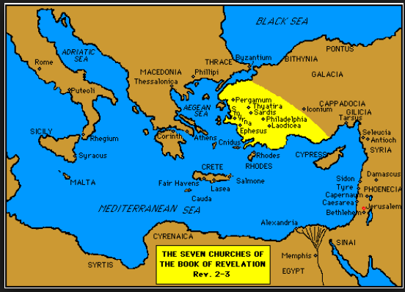

Slide 11
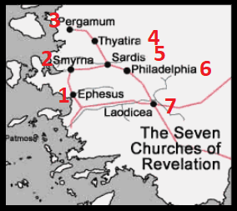

Slide 12
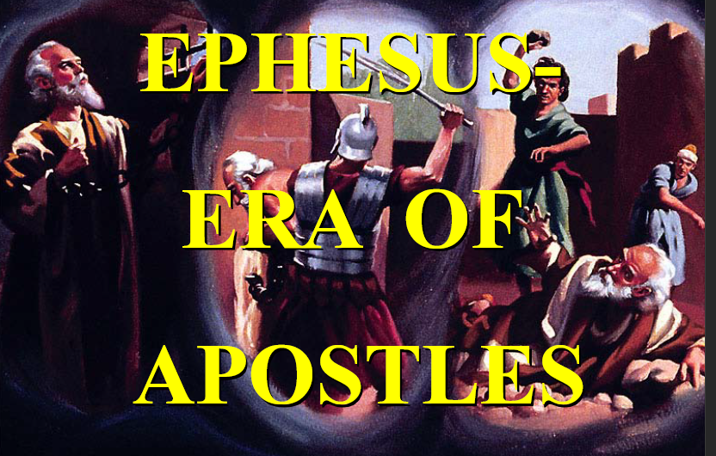

Slide 13
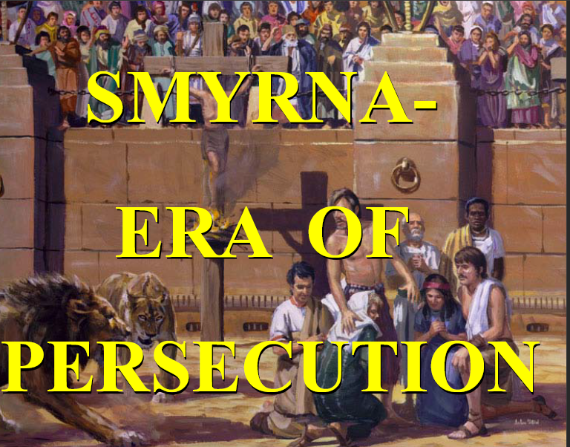

Slide 14
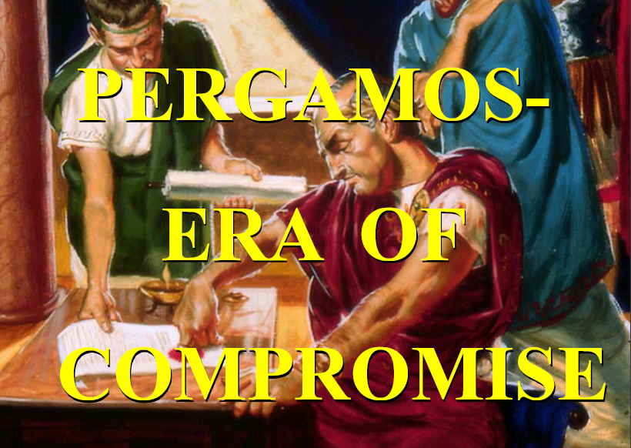

Slide 15
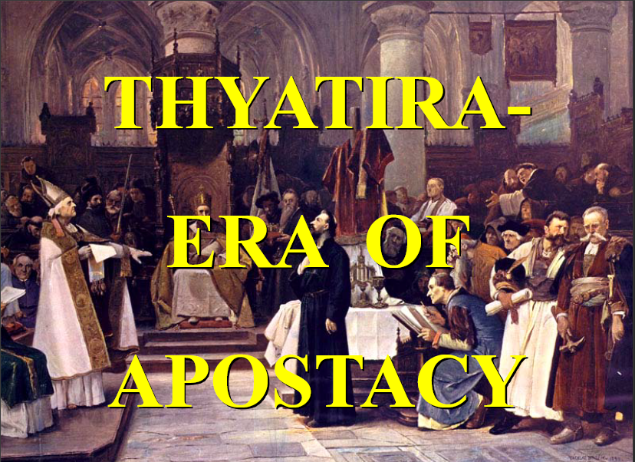

Slide 16
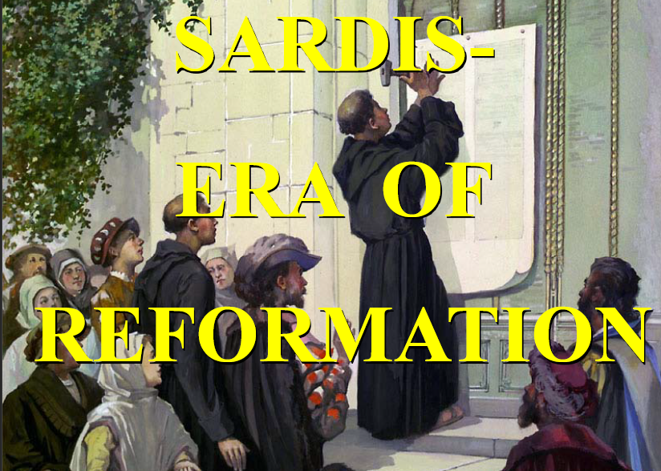

Slide 17
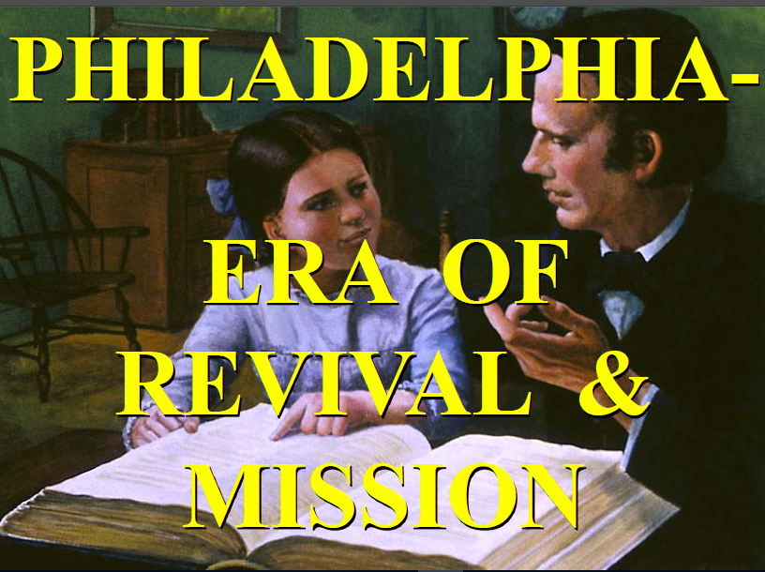

Slide 18
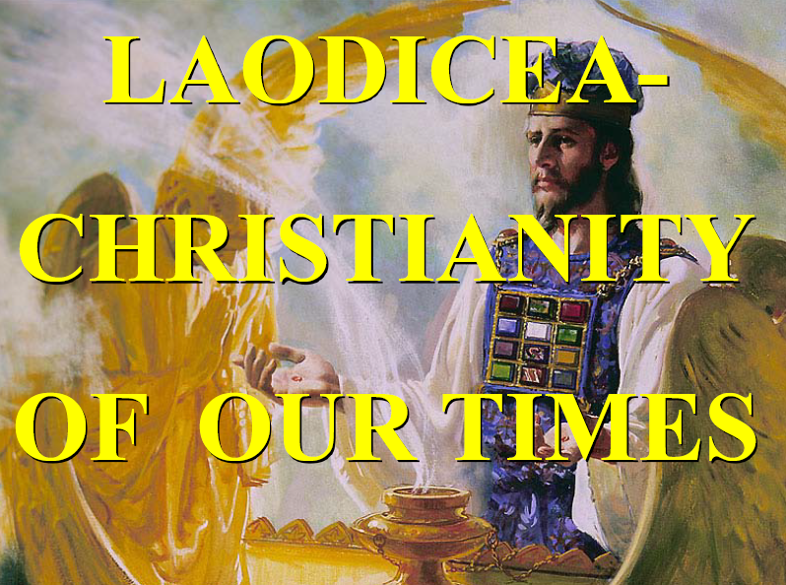

Slide 19
Revelation 22:18, 19. (NLT)
18 And I solemnly declare to everyone who hears the words of prophecy written in this book: If anyone adds anything to what is written here, God will add to that person the plagues described in this book.

Slide 20
Revelation 22:18, 19. (NLT)
19 And if anyone removes any of the words from this book of prophecy, God will remove that person’s share in the tree of life and in the holy city that are described in this book.

Slide 21
Revelation 1:4. (NLT)
4 This letter is from John to the seven churches in the province of Asia. Grace and peace to you from the one who is, who always was, and who is still to come; from the sevenfold Spirit before his throne;.

Slide 22
I know thy works.

Slide 23
Revelation 2:2. (NLT)
2 “I know all the things you do. I have seen your hard work and your patient endurance. I know you don’t tolerate evil people. You have examined the claims of those who say they are apostles but are not. You have discovered they are liars.

Slide 24
Revelation 2:9. (NLT)
9 “I know about your suffering and your poverty—but you are rich! I know the blasphemy of those opposing you. They say they are Jews, but they are not, because their synagogue belongs to Satan.

Slide 25
Revelation 2:13. (NLT)
13 “I know that you live in the city where Satan has his throne, yet you have remained loyal to me. You refused to deny me even when Antipas, my faithful witness, was martyred among you there in Satan’s city.

Slide 26
Revelation 2:19. (NLT)
19 “I know all the things you do. I have seen your love, your faith, your service, and your patient endurance. And I can see your constant improvement in all these things.

Slide 27
Revelation 3:1. (NLT)
“Write this letter to the angel of the church in Sardis. This is the message from the one who has the sevenfold Spirit of God and the seven stars: “I know all the things you do, and that you have a reputation for being alive—but you are dead.

Slide 28
Revelation 3:8. (NLT)
8 “I know all the things you do, and I have opened a door for you that no one can close. You have little strength, yet you obeyed my word and did not deny me.

Slide 29
Revelation 3:15. (NLT)
15 “I know all the things you do, that you are neither hot nor cold. I wish that you were one or the other!.

Slide 30
To him that overcometh

Slide 31
Revelation 2:7. (NLT)
7 “Anyone with ears to hear must listen to the Spirit and understand what he is saying to the churches. To everyone who is victorious I will give fruit from the tree of life in the paradise of God.

Slide 32
Revelation 2:11. (NLT)
11 “Anyone with ears to hear must listen to the Spirit and understand what he is saying to the churches. Whoever is victorious will not be harmed by the second death.

Slide 33
Revelation 2:17. (NLT)
17 “Anyone with ears to hear must listen to the Spirit and understand what he is saying to the churches. To everyone who is victorious I will give some of the manna that has been hidden away in heaven. And I will give to each one a white stone, and on the stone will be engraved a new name that no one understands except the one who receives it.

Slide 34
Revelation 2:26. (NLT)
26 To all who are victorious, who obey me to the very end, to them I will give authority over all the nations.

Slide 35
Revelation 3:5 . (NLT)
5 All who are victorious will be clothed in white. I will never erase their names from the Book of Life, but I will announce before my Father and his angels that they are mine.

Slide 36
Revelation 3:12. (NLT)
12 All who are victorious will become pillars in the Temple of my God, and they will never have to leave it. And I will write on them the name of my God, and they will be citizens in the city of my God—the new Jerusalem that comes down from heaven from my God. And I will also write on them my new name.

Slide 37
Revelation 3:21. (NLT)
21 Those who are victorious will sit with me on my throne, just as I was victorious and sat with my Father on his throne.

Slide 38
Hear what the spirit saith unto the churches.

Slide 39
Revelation 2:7. (NLT)
7 “Anyone with ears to hear must listen to the Spirit and understand what he is saying to the churches. To everyone who is victorious I will give fruit from the tree of life in the paradise of God.

Slide 40
Revelation 2:11. (NLT)
11 “Anyone with ears to hear must listen to the Spirit and understand what he is saying to the churches. Whoever is victorious will not be harmed by the second death.

Slide 41
Revelation 2:17. (NLT)
17 “Anyone with ears to hear must listen to the Spirit and understand what he is saying to the churches. To everyone who is victorious I will give some of the manna that has been hidden away in heaven. And I will give to each one a white stone, and on the stone will be engraved a new name that no one understands except the one who receives it.

Slide 42
Revelation 2:29. (NLT)
29 “Anyone with ears to hear must listen to the Spirit and understand what he is saying to the churches.

Slide 43
Revelation 3:6. (NLT)
6 “Anyone with ears to hear must listen to the Spirit and understand what he is saying to the churches.

Slide 44
Revelation 3:13. (NLT)
13 “Anyone with ears to hear must listen to the Spirit and understand what he is saying to the churches.

Slide 45
Revelation 3:22. (NLT)
22 “Anyone with ears to hear must listen to the Spirit and understand what he is saying to the churches.”

Slide 47
Revelation 2:4. (NLT)
4 “But I have this complaint against you. You don’t love me or each other as you did at first!

Slide 48
Revelation 2:2. (NLT)
2 “I know all the things you do. I have seen your hard work and your patient endurance. I know you don’t tolerate evil people. You have examined the claims of those who say they are apostles but are not. You have discovered they are liars.

Slide 50
Revelation 2:10. (NLT)
10 Don’t be afraid of what you are about to suffer. The devil will throw some of you into prison to test you. You will suffer for ten days. But if you remain faithful even when facing death, I will give you the crown of life.

Slide 51
Revelation 2:11. (NLT)
11 “Anyone with ears to hear must listen to the Spirit and understand what he is saying to the churches. Whoever is victorious will not be harmed by the second death.

Slide 53
Revelation 2:14, 15. (NLT)
14 “But I have a few complaints against you. You tolerate some among you whose teaching is like that of Balaam, who showed Balak how to trip up the people of Israel. He taught them to sin by eating food offered to idols and by committing sexual sin.

Slide 54
Revelation 2:14, 15. (NLT)
15 In a similar way, you have some Nicolaitans among you who follow the same teaching.

Slide 55
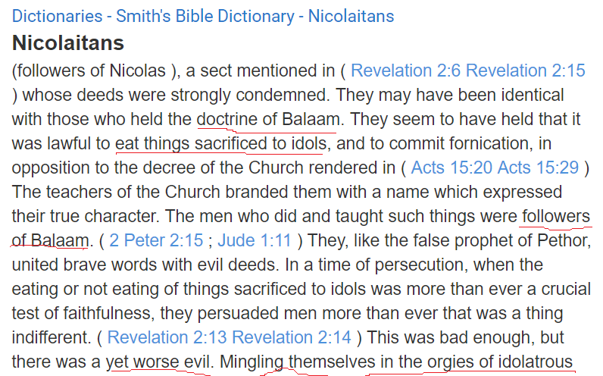

Slide 57
Revelation 2:20. (NLT)
20 “But I have this complaint against you. You are permitting that woman—that Jezebel who calls herself a prophet—to lead my servants astray. She teaches them to commit sexual sin and to eat food offered to idols.

Slide 58
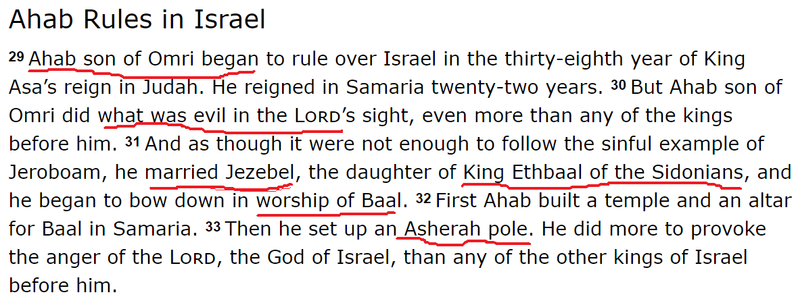

Slide 59
Revelation 2:22, 23. (NLT)
22 “Therefore, I will throw her on a bed of suffering, and those who commit adultery with her will suffer greatly unless they repent and turn away from her evil deeds.

Slide 60
Revelation 2:22, 23. (NLT)
23 I will strike her children dead. Then all the churches will know that I am the one who searches out the thoughts and intentions of every person. And I will give to each of you whatever you deserve.

Slide 61
Revelation 2:24. (NLT)
24 “But I also have a message for the rest of you in Thyatira who have not followed this false teaching. I will ask nothing more of you.

Slide 63
Revelation 3:2. (NLT)
2 Wake up! Strengthen what little remains, for even what is left is almost dead. I find that your actions do not meet the requirements of my God.

Slide 64
Revelation 3:1. (NLT)
“Write this letter to the angel of the church in Sardis. This is the message from the one who has the sevenfold Spirit of God and the seven stars: “I know all the things you do, and that you have a reputation for being alive—but you are dead.

Slide 66
Revelation 2:9. (NLT)
9 “I know about your suffering and your poverty—but you are rich! I know the blasphemy of those opposing you. They say they are Jews, but they are not, because their synagogue belongs to Satan.

Slide 67
Revelation 3:9. (NLT)
9 Look, I will force those who belong to Satan’s synagogue—those liars who say they are Jews but are not—to come and bow down at your feet. They will acknowledge that you are the ones I love.

Slide 68
Revelation 3:7-8. (NLT)
7 “Write this letter to the angel of the church in Philadelphia. This is the message from the one who is holy and true, the one who has the key of David. What he opens, no one can close; and what he closes, no one can open.

Slide 69
Revelation 3:7-8. (NLT)
8 “I know all the things you do, and I have opened a door for you that no one can close. You have little strength, yet you obeyed my word and did not deny me.

Slide 71
Revelation 3:15-17. (NLT)
15 “I know all the things you do, that you are neither hot nor cold. I wish that you were one or the other! 16 But since you are like lukewarm water, neither hot nor cold, I will spit you out of my mouth!

Slide 72
Revelation 3:15-17. (NLT)
17 You say, ‘I am rich. I have everything I want. I don’t need a thing!’ And you don’t realize that you are wretched and miserable and poor and blind and naked.

Slide 73
Revelation 3:18. (NLT)
18 So I advise you to buy gold from me—gold that has been purified by fire. Then you will be rich. Also buy white garments from me so you will not be shamed by your nakedness, and ointment for your eyes so you will be able to see.

Slide 74
Revelation 3:20. (NLT)
20 “Look! I stand at the door and knock. If you hear my voice and open the door, I will come in, and we will share a meal together as friends

Slide 75
END -
I am ready to answer any question you may have.

Slide 76
Let us Pray to close the Bible study.

Slide 77
Don’t Be Afraid to Follow Jesus!
“If you love Him, keep His commandments”

