Slide 1
The study will begin at 7:30 PM
THE BOOK OF REVELATION
BIBLE STUDY

Slide 2
Let us Pray and then start the Bible study..

Slide 3
Let us start the Bible study..

Slide 4
Last Week Bible Study, we looked at:
Righteousness by Faith

Slide 5

SALVATION IS A GIFT
Salvation is like an umbrella
The Rain represents the sins of life.
The People represents sinners saved by grace.
Choose to go under the umbrella or not.

Slide 6
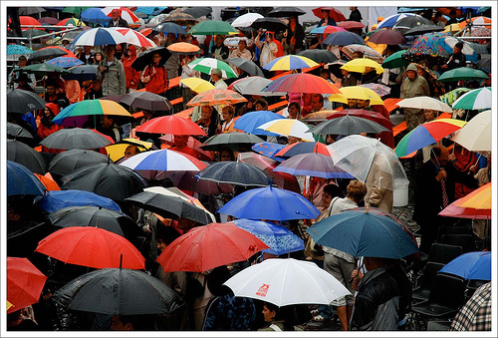
SALVATION IS A GIFT
But there are many others who will confortable enjoy the gift of salvation and experienced its blessing even now as they wait for the final gift – eternal life.

Slide 7
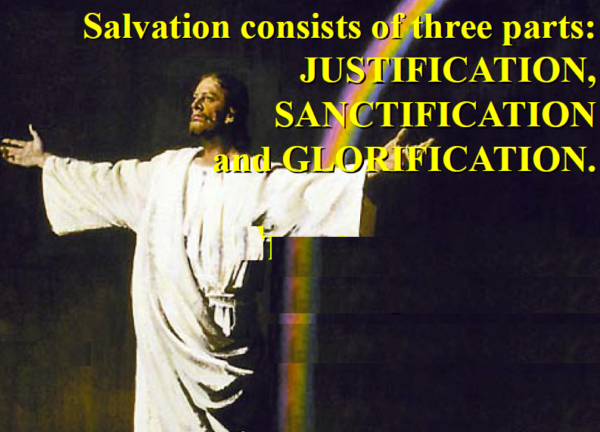

Slide 8
Tonight’s Bible Study:
Revelation in Review

Slide 11
Revelation 1:12-14. (NLT)
12 When I turned to see who was speaking to me, I saw seven gold lampstands. 13 And standing in the middle of the lampstands was someone like the Son of Man. He was wearing a long robe with a gold sash across his chest. 14 His head and his hair were white like wool, as white as snow. And his eyes were like flames of fire. 15 His feet were like polished bronze refined in a furnace

Slide 12
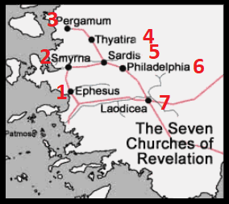

Slide 13
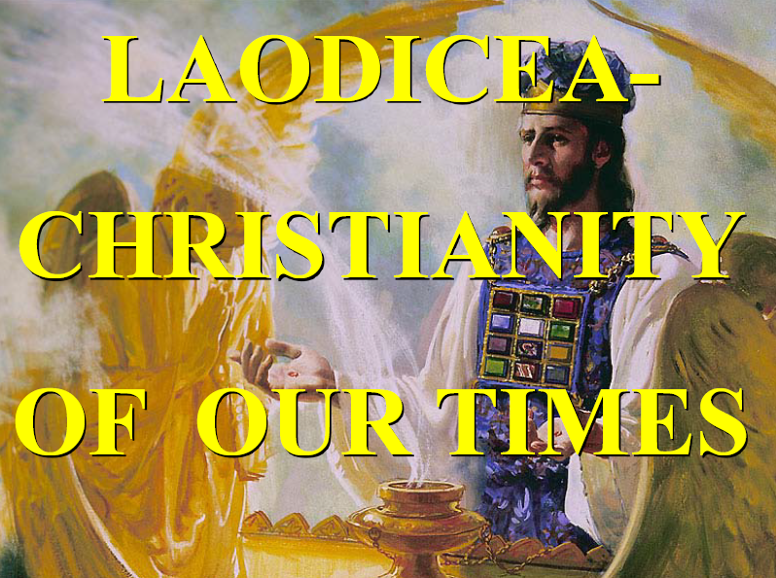

Slide 14
Revelation 3:15-17. (NLT)
15 “I know all the things you do, that you are neither hot nor cold. I wish that you were one or the other! 16 But since you are like lukewarm water, neither hot nor cold, I will spit you out of my mouth!

Slide 15
Revelation 3:15-17. (NLT)
17 You say, ‘I am rich. I have everything I want. I don’t need a thing!’ And you don’t realize that you are wretched and miserable and poor and blind and naked.

Slide 16
Revelation 3:18. (NLT)
18 So I advise you to buy gold from me—gold that has been purified by fire. Then you will be rich. Also buy white garments from me so you will not be shamed by your nakedness, and ointment for your eyes so you will be able to see.

Slide 17
Revelation 3:20. (NLT)
20 “Look! I stand at the door and knock. If you hear my voice and open the door, I will come in, and we will share a meal together as friends

Slide 19
Revelation 5:4-7. (NLT)
4 Then I began to weep bitterly because no one was found worthy to open the scroll and read it. 5 But one of the twenty-four elders said to me, “Stop weeping! Look, the Lion of the tribe of Judah, the heir to David’s throne, has won the victory. He is worthy to open the scroll and its seven seals.”

Slide 20
Revelation 5:4-7. (NLT)
6 Then I saw a Lamb that looked as if it had been slaughtered, but it was now standing between the throne and the four living beings and among the twenty-four elders. He had seven horns and seven eyes, which represent the sevenfold Spirit of God that is sent out into every part of the earth.

Slide 21
Revelation 5:4-7. (NLT)
7 He stepped forward and took the scroll from the right hand of the one sitting on the throne.

Slide 23


Slide 24
Revelation 7:2 (NLT)
2 And I saw another angel coming up from the east, carrying the seal of the living God. And he shouted to those four angels, who had been given power to harm land and sea,

Slide 25
Revelation 7:3 (NLT)
3 “Wait! Don’t harm the land or the sea or the trees until we have placed the seal of God on the foreheads of his servants.”

Slide 26
Revelation 14:6 (NLT)
6 And I saw another angel flying through the sky, carrying the eternal Good News to proclaim to the people who belong to this world—to every nation, tribe, language, and people.

Slide 27
Matthew 24:14 (NLT)
14 And the Good News about the Kingdom will be preached throughout the whole world, so that all nations will hear it; and then the end will come.

Slide 29
Ezekiel 20:12. (NLT)
12 And I gave them my Sabbath days of rest as a sign between them and me. It was to remind them that I am the Lord, who had set them apart to be holy.

Slide 30
Ezekiel 20:20. (NLT)
20 and keep my Sabbath days holy, for they are a sign to remind you that I am the Lord your God.’

Slide 31
Exodus 31:17. (NLT)
17 It is a permanent sign of my covenant with the people of Israel. For in six days the Lord made heaven and earth, but on the seventh day he stopped working and was refreshed.’”

Slide 33
Revelation 10:8-9. (NLT)
8 Then the voice from heaven spoke to me again: “Go and take the open scroll from the hand of the angel who is standing on the sea and on the land.” 9 So I went to the angel and told him to give me the small scroll. “Yes, take it and eat it,” he said. “It will be sweet as honey in your mouth, but it will turn sour in your stomach!” 10 So I took the small scroll from the hand of the angel, and I ate it! It was sweet in my mouth, but when I swallowed it, it turned sour in my stomach.

Slide 35
1260 Years
The 1260 days prophecy appears several times in the Bible. What is this time period? It is a very important time period since it was mention over and over again by Daniel and John.
1260 days / 30 = 42 months = 3 ½ years;
1 time + 2 time + ½ time = 3 ½ times.

Slide 36
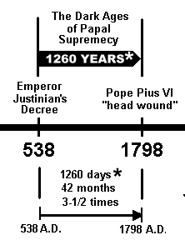
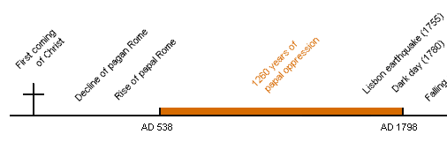
1260 Years

Slide 37
The Two Witnesses
The two witnesses represent the Scriptures of the Old and the New Testament. Both are important testimonies to the origin and perpetuity of the law of God. Both are witnesses also to the plan of salvation. The types, sacrifices, and prophecies of the Old Testament point forward to a Saviour to come. The Gospels and Epistles of the New Testament tell of a Saviour who has come in the exact manner foretold by type and prophecy.
http://www.whiteestate.org/books/gc/gc15.html

Slide 39
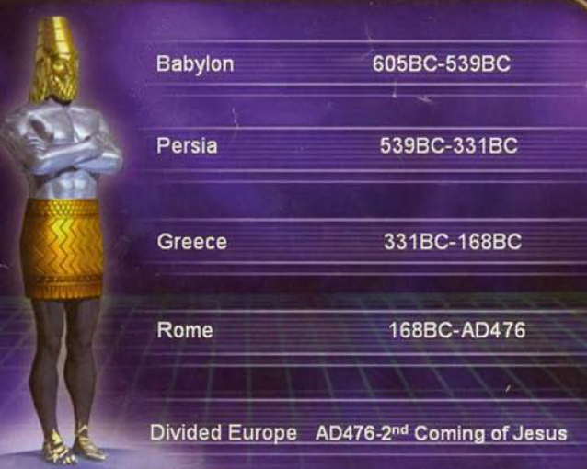

Slide 40
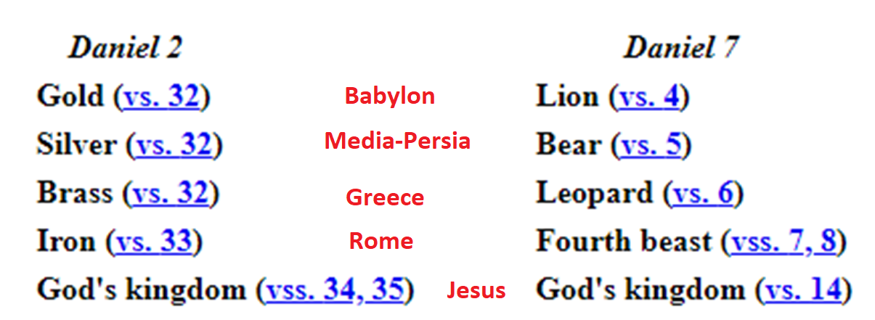

Slide 41
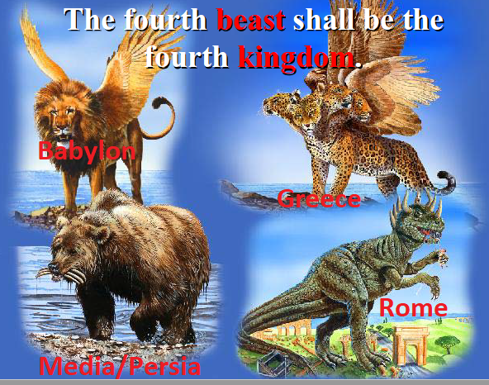

Slide 42
Daniel 7:8 (NLT)
8 As I was looking at the horns, suddenly another small horn appeared among them. Three of the first horns were torn out by the roots to make room for it. This little horn had eyes like human eyes and a mouth that was boasting arrogantly..

Slide 43
Daniel 7:24-25 (NLT)
24 Its ten horns are ten kings who will rule that empire. Then another king will arise, different from the other ten, who will subdue three of them.

Slide 44
The Little Horn Identified
Vatican state is a COUNTRY! It's the smallest country there is, which matches this 'little' horn. The next thing we notice is that it rises up 'among' the other horns.

Slide 45
The Little Horn Identified
This match the Papal Church of Rome. Pagan Rome fell in 476 AD and split into the ten kingdoms of Europe. The Roman Catholic Church came to power in 538 AD (which is after Rome split into the ten kingdoms).

Slide 47
Daniel 7:25 (KJV)
25 And he shall speak great words against the most High, and shall wear out the saints of the most High, and think to change times and laws: and they shall be given into his hand until a time and times and the dividing of time.

Slide 48
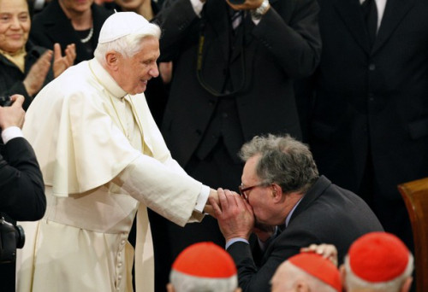

Slide 49
Q & A - Catholic Priest
Question: Has the [Catholic] church power to make any alterations in the commandments of God?
Answer: ...Instead of the seventh day, and other festivals appointed by the old law, the church has prescribed the Sundays and holy days to be set apart for God’s worship; and these we are now obliged to keep in consequence of God’s commandment, instead of the ancient Sabbath. (The Catholic Christian Instructed in the Sacraments, Sacrifices, Ceremonies, and Observances of the Church By Way of Question and Answer, RT Rev. Dr. Challoner, p. 204)

Slide 50
Q & A - Catholic Priest
Question: Have you any other way of proving that the Church has power to institute festivals of precept?
Answer: Had she not such power, she could not have done that in which all modern religionists agree with her. She could not have substituted the observance of Sunday the first day of the week, for the observance of Saturday the seventh day, a change for which there is no Scriptural authority. –Rev. Stephen Keenan, (1851), p. 174.

Slide 52
Revelation 13:11 (NLT)
11 Then I saw another beast come up out of the earth. He had two horns like those of a lamb, but he spoke with the voice of a dragon.

Slide 53
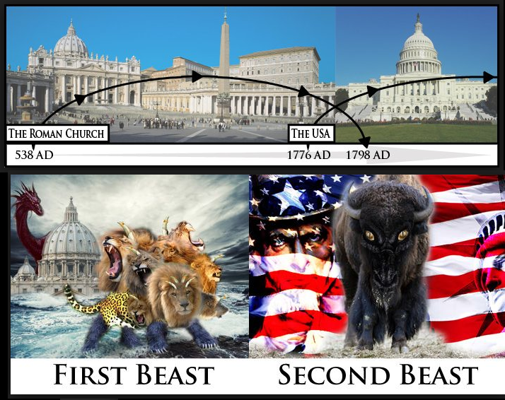

Slide 54
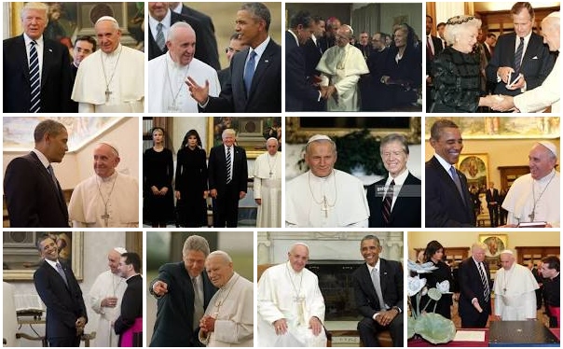
Papacy Power – 1st Beast
America’s Power – 2nd Beast

Slide 55
Revelation 17:1-5 (NLT)
3 So the angel took me in the Spirit into the wilderness. There I saw a woman sitting on a scarlet beast that had seven heads and ten horns, and blasphemies against God were written all over it.

Slide 56
Revelation 17:1-5 (NLT)
4 The woman wore purple and scarlet clothing and beautiful jewelry made of gold and precious gems and pearls. In her hand she held a gold goblet full of obscenities and the impurities of her immorality.

Slide 57
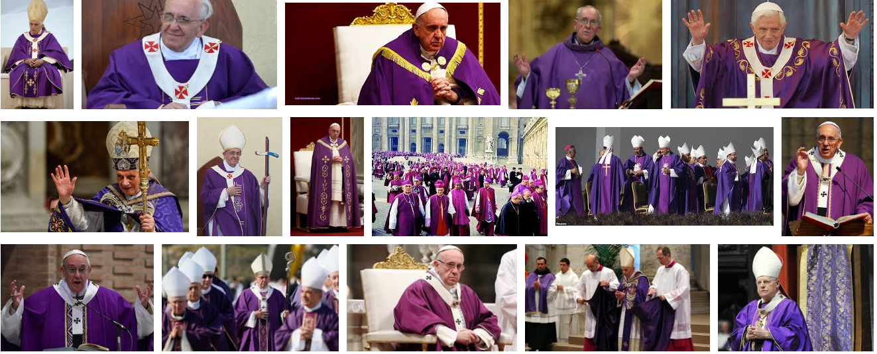
Church (woman) Wore Purple and Scarlet Clothing

Slide 58
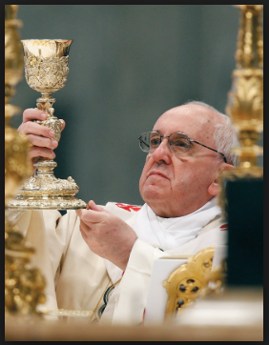
The Church (she) Held a Gold Goblet

Slide 61
Revelation 14:6-12 (NLT)
6 And I saw another angel flying through the sky, carrying the eternal Good News to proclaim to the people who belong to this world—to every nation, tribe, language, and people.

Slide 62
Revelation 14:6-12 (NLT)
7 “Fear God,” he shouted. “Give glory to him. For the time has come when he will sit as judge. Worship him who made the heavens, the earth, the sea, and all the springs of water.”

Slide 63
Revelation 14:6-12 (NLT)
8 Then another angel followed him through the sky, shouting, “Babylon is fallen—that great city is fallen—because she made all the nations of the world drink the wine of her passionate immorality.”

Slide 64
Revelation 14:6-12 (NLT)
9 Then a third angel followed them, shouting, “Anyone who worships the beast and his statue or who accepts his mark on the forehead or on the hand.

Slide 65
Revelation 14:6-12 (NLT)
10 must drink the wine of God’s anger. It has been poured full strength into God’s cup of wrath. And they will be tormented with fire and burning sulfur in the presence of the holy angels and the Lamb.

Slide 66
Revelation 14:6-12 (NLT)
11 The smoke of their torment will rise forever and ever, and they will have no relief day or night, for they have worshiped the beast and his statue and have accepted the mark of his name.”

Slide 67
Revelation 14:6-12 (NLT)
12 This means that God’s holy people must endure persecution patiently, obeying his commands and maintaining their faith in Jesus.

Slide 69
Wicked Dead Came Back to Life
– After 1000 Years
Rev 20:5
5 This is the first resurrection. The rest of the dead did not come back to life until the thousand years had ended.

Slide 70
Plagues – Wrath of God
Rev 15: 1-3
Then I saw in heaven another marvelous event of great significance. Seven angels were holding the seven last plagues, which would bring God’s wrath to completion. 2 I saw before me what seemed to be a glass sea mixed with …

Slide 71
Plagues – Wrath of God
fire. And on it stood all the people who had been victorious over the beast and his statue and the number representing his name. They were all holding harps that God had given them. 3 And they were singing the song of Moses, the servant of God, and the song of the Lamb

Slide 72
Plagues – Wrath of God
Rev 15:8 The Temple was filled with smoke from God’s glory and power. No one could enter the Temple until the seven angels had completed pouring out the seven plagues.
[The Temple is in heaven]

Slide 74
Revelation 12:17. (NLT)
17 And the dragon was angry at the woman and declared war against the rest of her children—all who keep God’s commandments and maintain their testimony for Jesus.

Slide 76
Revelation 20:10. (NLT)
10 Then the devil, who had deceived them, was thrown into the fiery lake of burning sulfur, joining the beast and the false prophet.

Slide 77
Revelation 20:14-15. (NLT)
14 Then death and the grave were thrown into the lake of fire. This lake of fire is the second death. 15 And anyone whose name was not found recorded in the Book of Life was thrown into the lake of fire.

Slide 79
END -
I am ready to answer any question you may have.

Slide 80
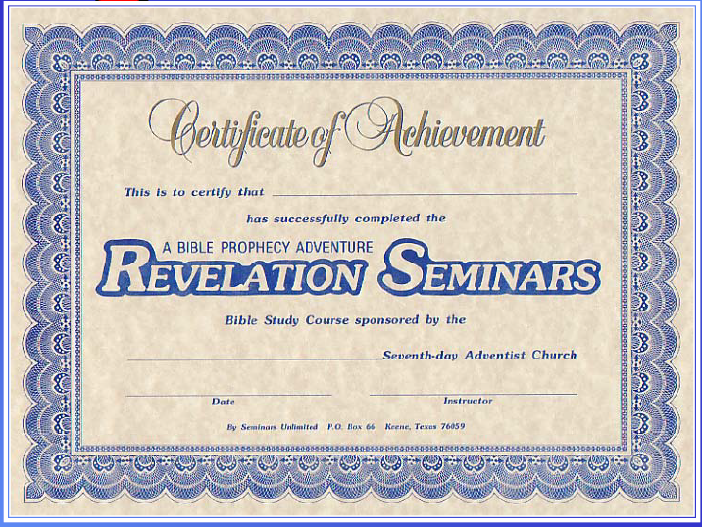

Slide 81
Let us Pray to close the Bible study.

Slide 82
Don’t Be Afraid to Follow Jesus!
“If you love Him, keep His commandments”

