Slide 1
The study will begin at 7:30 PM
THE BOOK OF REVELATION
BIBLE STUDY

Slide 2
Let us Pray and then start the Bible study..

Slide 3
Let us start the Bible study..

Slide 4
Last Week Bible Study, we looked at:
Revelation’s Pageant of
Conquest and Defeat

Slide 5
Plagues of The
7-Trumpets
vs
7-Bowls
[After the 2nd Resurrection of the wicked]

Slide 6
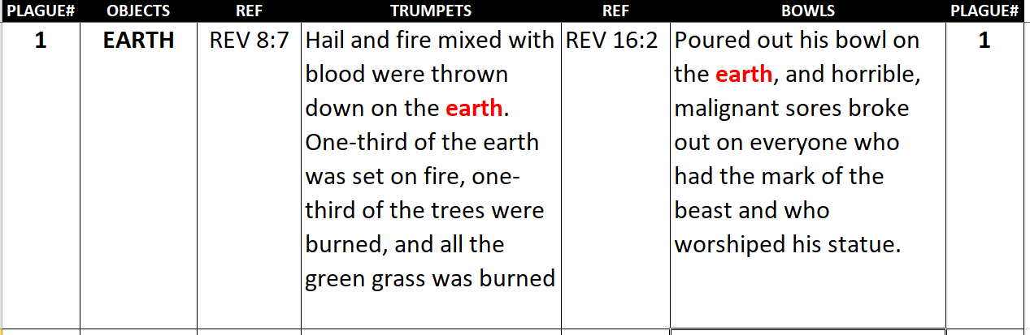
1st -TRUMPET vs 1st BOWL

Slide 7
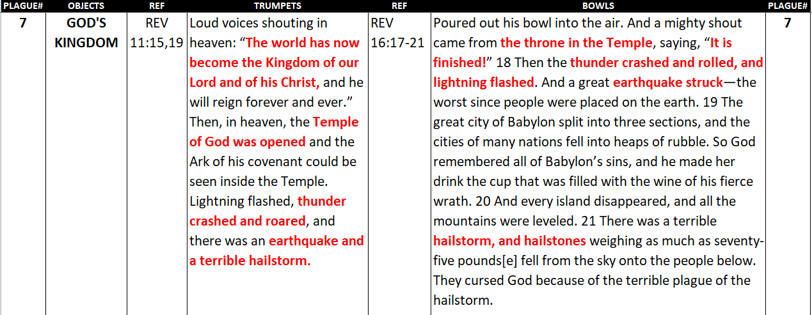
7th -TRUMPET vs 7th BOWL

Slide 8
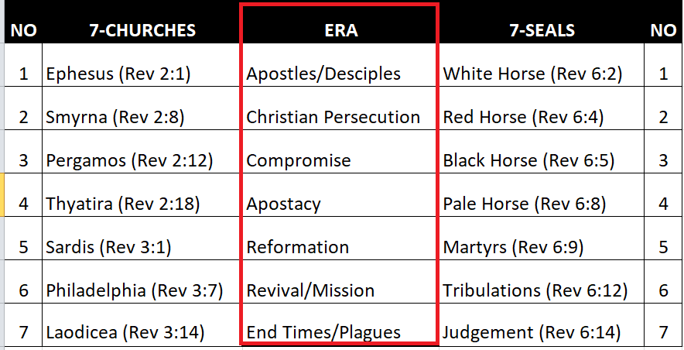

Slide 9
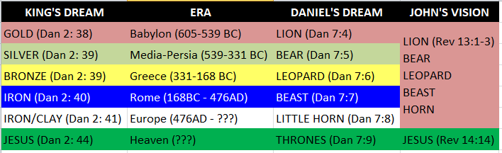
From 605-BC to End Of Evil

Slide 10
Tonight’s Bible Study:
Righteousness by Faith

Slide 11


Slide 12


Slide 13


Slide 14
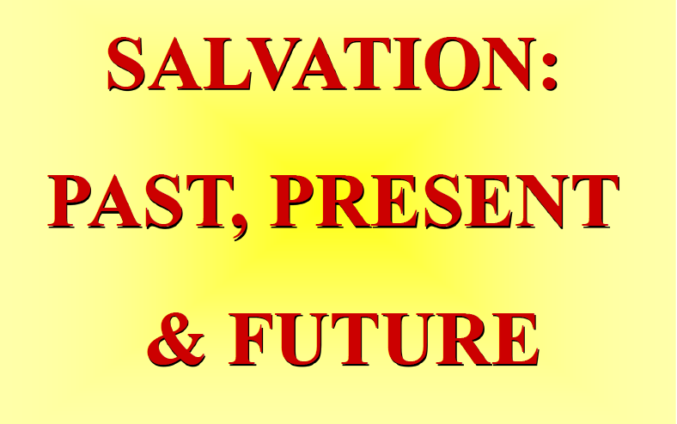

Slide 15


Slide 16


Slide 17
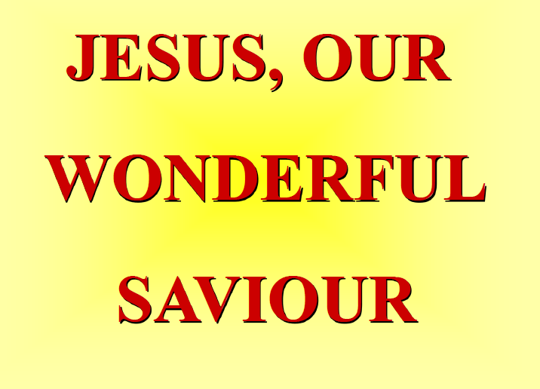

Slide 18
The first lesson for tonight:

Slide 20

SALVATION IS A GIFT
Salvation is like an umbrella
The Rain represents the sins of life.
The People represents sinners saved by grace.
Choose to go under the umbrella or not.

Slide 21
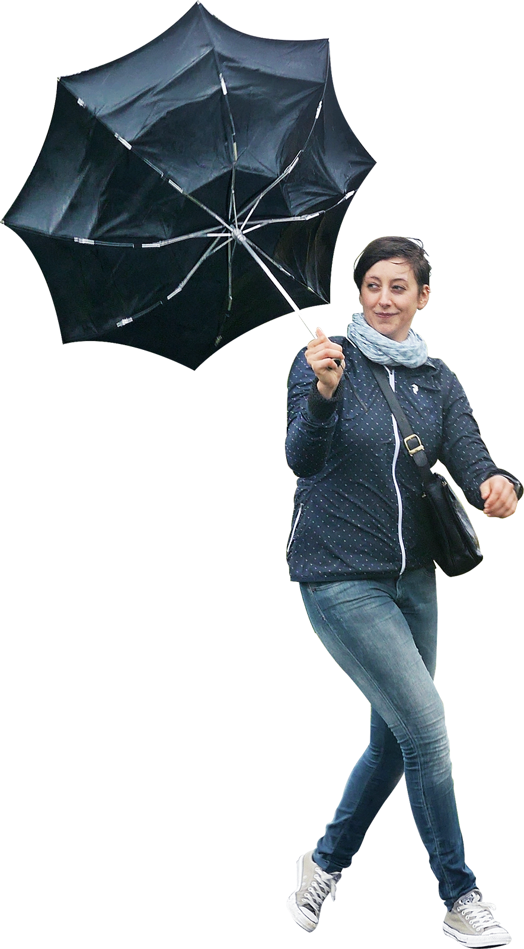
SALVATION IS A GIFT
Some people choose to let the wind of strife (temptations) to not allow them experience the gift of salvation.

Slide 22
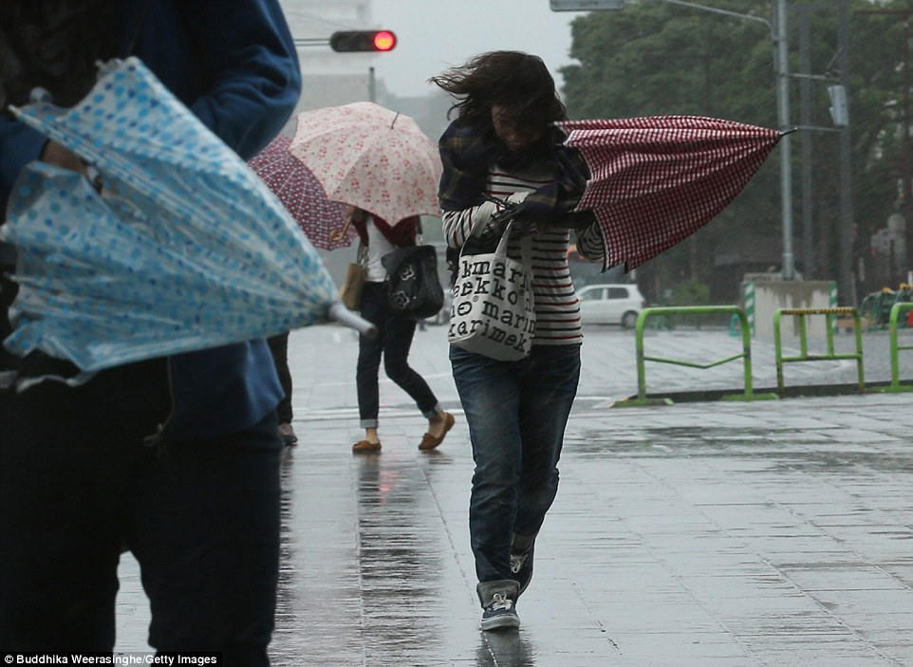
SALVATION IS A GIFT
Some people have and know the gift of salvation, but choose to not use its power, even during the storms of life and many temptations.

Slide 23
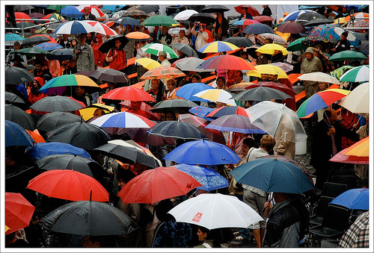
SALVATION IS A GIFT
But there are many others who will confortable enjoy the gift of salvation and experienced its blessing even now as they wait for the final gift – eternal life.

Slide 24
Romans 3:22. (NLT)
22 We are made right with God by placing our faith in Jesus Christ. And this is true for everyone who believes, no matter who we are.

Slide 25
Ephesians 2:8, 9. (NLT)
8 God saved you by his grace when you believed. And you can’t take credit for this; it is a gift from God. 9 Salvation is not a reward for the good things we have done, so none of us can boast about it.

Slide 27
Romans 3:24-25. (NLT)
24 Yet God, in his grace, freely makes us right in his sight. He did this through Christ Jesus when he freed us from the penalty for our sins. 25 For God presented Jesus as the sacrifice for sin. …

Slide 28
Romans 3:24-25. (NLT)
… People are made right with God when they believe that Jesus sacrificed his life, shedding his blood. This sacrifice shows that God was being fair when he held back and did not punish those who sinned in times past.

Slide 29
1 John 1:9. (NLT)
9 But if we confess our sins to him, he is faithful and just to forgive us our sins and to cleanse us from all wickedness.

Slide 30
John 3:3. (NLT)
3 Jesus replied, “I tell you the truth, unless you are born again, you cannot see the Kingdom of God.”

Slide 32
1 Thessalonians 4:3-12. (NLT)
3 God’s will is for you to be holy, so stay away from all sexual sin. 4 Then each of you will control his own body and live in holiness and honor— 5 not in lustful passion like the pagans who do not know God and his ways.

Slide 33
1 Thessalonians 4:3-12. (NLT)
6 Never harm or cheat a fellow believer in this matter by violating his wife, for the Lord avenges all such sins, as we have solemnly warned you before. 7 God has called us to live holy lives, not impure lives.

Slide 34
1 Thessalonians 4:3-12. (NLT)
8 Therefore, anyone who refuses to live by these rules is not disobeying human teaching but is rejecting God, who gives his Holy Spirit to you. 9 But we don’t need to write to you about the importance of loving each other, for God himself has taught you to love one another.

Slide 35
1 Thessalonians 4:3-12. (NLT)
10 Indeed, you already show your love for all the believers throughout Macedonia. Even so, dear brothers and sisters, we urge you to love them even more. 11 Make it your goal to live a quiet life, minding your own business and working with your hands, just as we instructed you before.

Slide 36
1 Thessalonians 4:3-12. (NLT)
12 Then people who are not believers will respect the way you live, and you will not need to depend on others.

Slide 37
Ephesians 4:13. (NLT)
13 This will continue until we all come to such unity in our faith and knowledge of God’s Son that we will be mature in the Lord, measuring up to the full and complete standard of Christ.

Slide 38
John 17:17. (NLT)
17 Make them holy by your truth; teach them your word, which is truth.

Slide 39
Romans 8:3-4. (NLT)
3 The law of Moses was unable to save us because of the weakness of our sinful nature. So God did what the law could not do. He sent his own Son in a body like the bodies we sinners have. ..

Slide 40
Romans 8:3-4. (NLT)
And in that body God declared an end to sin’s control over us by giving his Son as a sacrifice for our sins. 4 He did this so that the just requirement of the law would be fully satisfied for us, ..

Slide 41
Romans 8:3-4. (NLT)
… who no longer follow our sinful nature but instead follow the Spirit.

Slide 42
Romans 8:29. (NLT)
29 For God knew his people in advance, and he chose them to become like his Son, so that his Son would be the firstborn among many brothers and sisters.

Slide 43
Colossians 3:8-10. (NLT)
8 But now is the time to get rid of anger, rage, malicious behavior, slander, and dirty language. 9 Don’t lie to each other, for you have stripped off your old sinful nature and all its wicked deeds.

Slide 44
Colossians 3:8-10. (NLT)
10 Put on your new nature, and be renewed as you learn to know your Creator and become like him.

Slide 46
Isaiah 49:6. (NLT)
He says, “You will do more than restore the people of Israel to me. I will make you a light to the Gentiles, and you will bring my salvation to the ends of the earth.”

Slide 47
Isaiah 9:2. (NLT)
The people who walk in darkness will see a great light. For those who live in a land of deep darkness, a light will shine.

Slide 48
2 Corinthians 1:10. (NLT)
10 And he did rescue us from mortal danger, and he will rescue us again. We have placed our confidence in him, and he will continue to rescue us.

Slide 49
Acts 4:12. (NLT)
12 There is salvation in no one else! God has given no other name under heaven by which we must be saved.”

Slide 50
2 Corinthians 8:12. (NLT)
12 Whatever you give is acceptable if you give it eagerly. And give according to what you have, not what you don’t have.

Slide 52
Isaiah 53:6. (NLT)
All of us, like sheep, have strayed away. We have left God’s paths to follow our own. Yet the Lord laid on him the sins of us all.

Slide 53
Matthew 5:30. (NLT)
30 And if your hand—even your stronger hand—causes you to sin, cut it off and throw it away. It is better for you to lose one part of your body than for your whole body to be thrown into hell.

Slide 54
John 15:2. (NLT)
2 He cuts off every branch of mine that doesn’t produce fruit, and he prunes the branches that do bear fruit so they will produce even more.

Slide 56
Revelation 22:19. (NLT)
19 And if anyone removes any of the words from this book of prophecy, God will remove that person’s share in the tree of life and in the holy city that are described in this book.

Slide 57
Philippians 1:6. (NLT)
6 And I am certain that God, who began the good work within you, will continue his work until it is finally finished on the day when Christ Jesus returns.

Slide 58
Philippians 2:12-13. (NLT)
12 Dear friends, you always followed my instructions when I was with you. And now that I am away, it is even more important. Work hard to show the results of your salvation,

Slide 59
Philippians 2:12-13. (NLT)
… obeying God with deep reverence and fear. 13 For God is working in you, giving you the desire and the power to do what pleases him.

Slide 61
Revelation 5:12. (NLT)
12 And they sang in a mighty chorus: “Worthy is the Lamb who was slaughtered—to receive power and riches and wisdom and strength and honor and glory and blessing.”

Slide 62
Matthew 11:28-30. (NLT)
28 Then Jesus said, “Come to me, all of you who are weary and carry heavy burdens, and I will give you rest. 29 Take my yoke upon you. Let me teach you, because I am humble and gentle at heart, and you will find rest for your souls. 30 For my yoke is easy to bear, and the burden I give you is light.”

Slide 63
END -
I am ready to answer any question you may have.

Slide 64
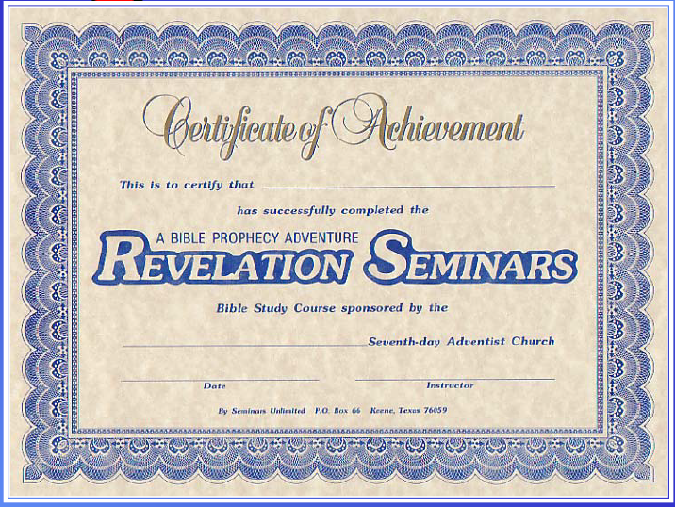

Slide 65
Let us Pray to close the Bible study.

Slide 66
Don’t Be Afraid to Follow Jesus!
“If you love Him, keep His commandments”

