Slide 1
The study will begin at 7:30 PM
THE BOOK OF REVELATION
BIBLE STUDY

Slide 2
Let us Pray and then start the Bible study..

Slide 3
Let us start the Bible study..

Slide 4
Last Week Bible Study, we looked at:
The Seven Plagues
of Revelation

Slide 5
Revelation 15:1. (NLT)
Then I saw in heaven another marvelous event of great significance. Seven angels were holding the seven last plagues, which would bring God’s wrath to completion.

Slide 6
Seven Last Plagues
First Bowl: Loathsome Sores
Second Bowl: The Sea Turns to Blood
Third Bowl: The Waters Turn to Blood
Fourth Bowl: Men Are Scorched
Fifth Bowl: Darkness and Pain
Sixth Bowl: Euphrates Dried Up
Seventh Bowl: The Earth Utterly Shaken

Slide 7
Sea Of Glass – In Heaven
Rev 15: 2-3
I saw before me what seemed to be a glass sea mixed with fire. And on it stood all the people who had been victorious over the beast and his statue and the number representing his name. They were all holding harps that God had given them. 3 And they were singing the song of Moses, the servant of God, and the song of the Lamb

Slide 8
Revelation 15:8. (NLT)
8 The Temple was filled with smoke from God’s glory and power. No one could enter the Temple until the seven angels had completed pouring out the seven plagues.

Slide 9
Tonight’s Bible Study:
Revelation’s Pageant of
Conquest and Defeat

Slide 10
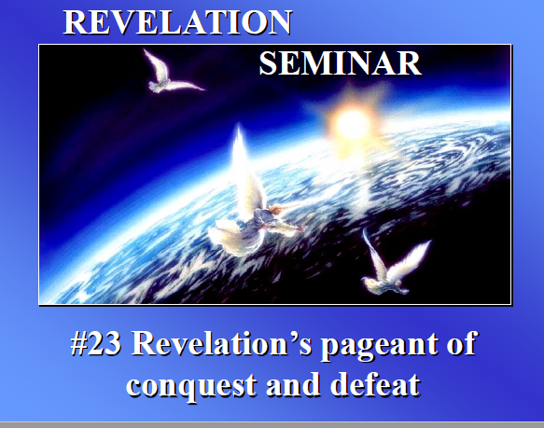

Slide 11
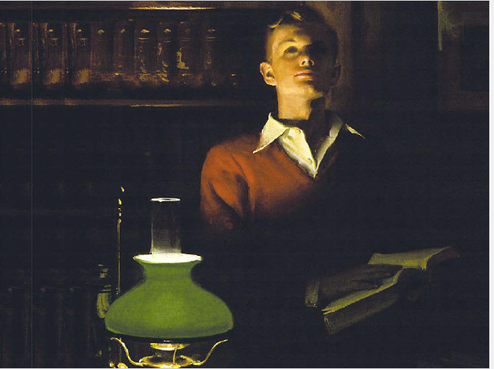

Slide 12
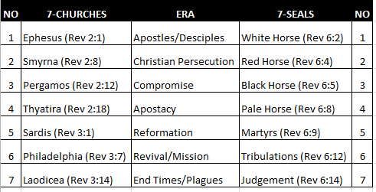

Slide 13
Revelation 6:9-11. (NLT)
9 When the Lamb broke the fifth seal, I saw under the altar the souls of all who had been martyred for the word of God and for being faithful in their testimony.

Slide 14
Revelation 6:9-11. (NLT)
10 They shouted to the Lord and said, “O Sovereign Lord, holy and true, how long before you judge the people who belong to this world and avenge our blood for what they have done to us?”

Slide 15
Revelation 6:9-11. (NLT)
11 Then a white robe was given to each of them. And they were told to rest a little longer until the full number of their brothers and sisters—their fellow servants of Jesus who were to be martyred—had joined them.
[In the 1st Resurrection]

Slide 16
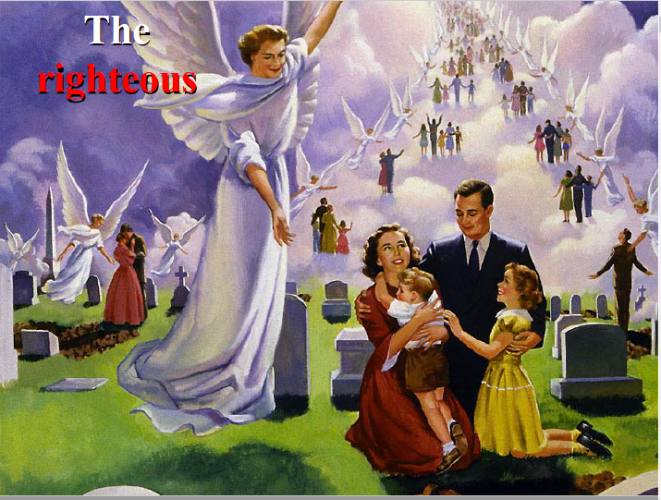

Slide 17
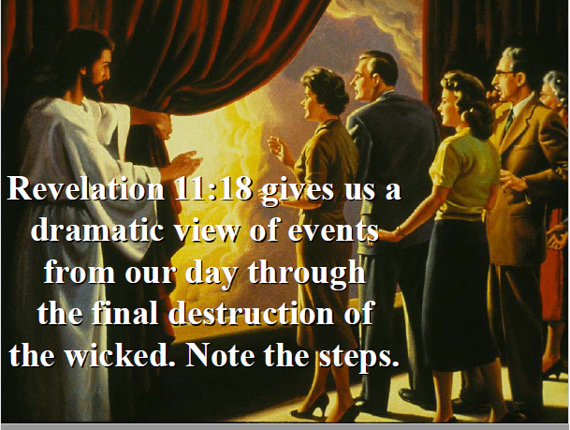

Slide 18
Revelation 11:18. (NLT)
The nations were filled with wrath, but now the time of your wrath has come. It is time to judge the dead and reward your servants the prophets, as well as your holy people, and all who fear your name, from the least to the greatest. It is time to destroy all who have caused destruction on the earth.”

Slide 19
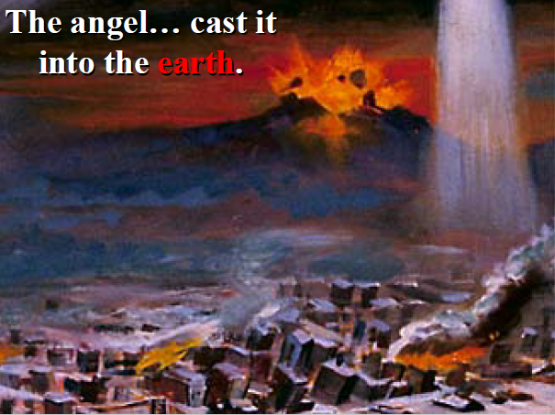

Slide 20
Plagues of The
7-Trumpets
vs
7-Bowls
[After the 2nd Resurrection of the wicked]

Slide 21
Revelation 8:7. (NLT)
7 The first angel blew his trumpet, and hail and fire mixed with blood were thrown down on the earth. One-third of the earth was set on fire, one-third of the trees were burned, and all the green grass was burned.

Slide 22
Revelation 16:2 (NLT)
2 So the first angel left the Temple and poured out his bowl on the earth, and horrible, malignant sores broke out on everyone who had the mark of the beast and who worshiped his statue.

Slide 23
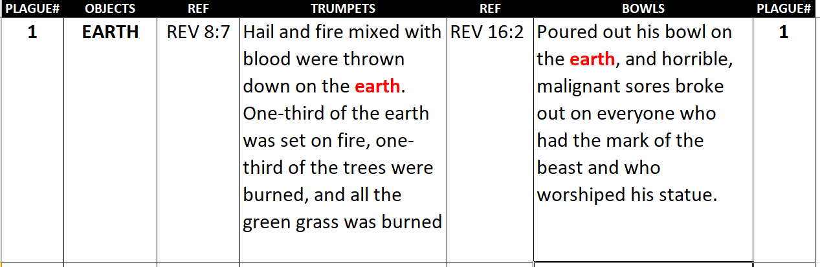
1st -TRUMPET vs 1st BOWL

Slide 24
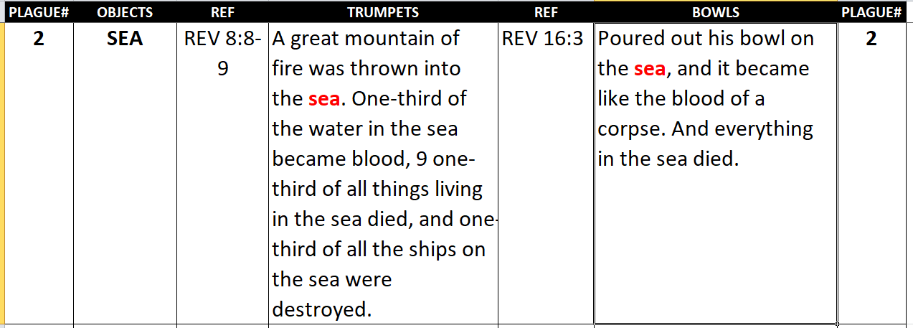
2nd -TRUMPET vs 2nd BOWL

Slide 25
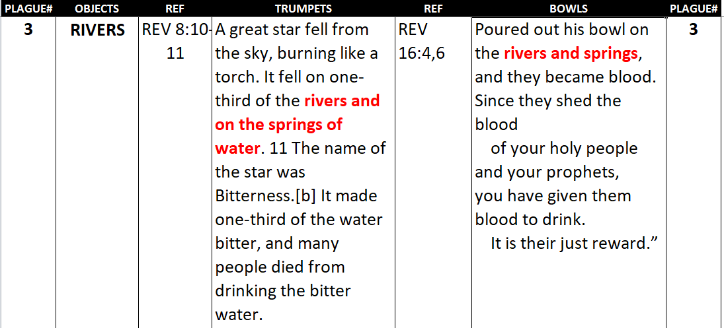
3rd -TRUMPET vs 3rd BOWL

Slide 26
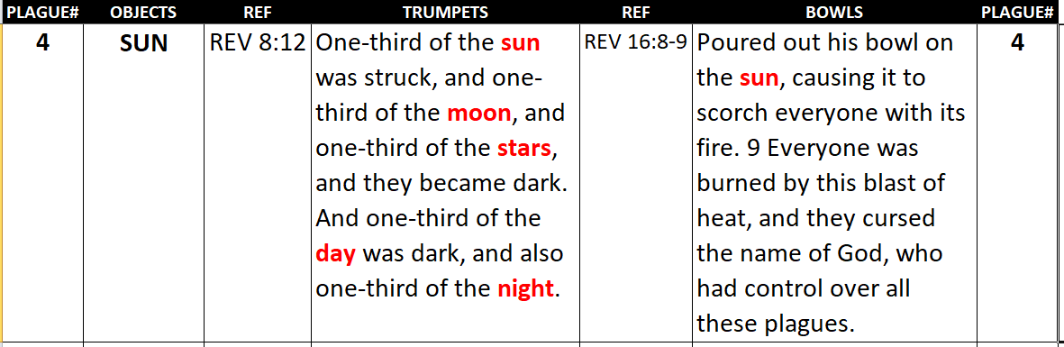
4th -TRUMPET vs 4th BOWL

Slide 27
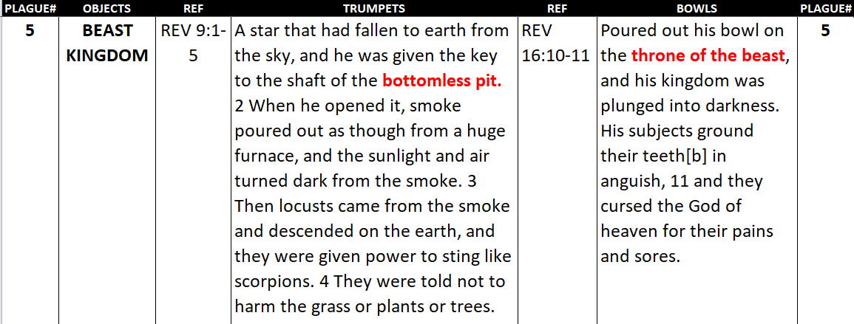
5th -TRUMPET vs 5th BOWL

Slide 28
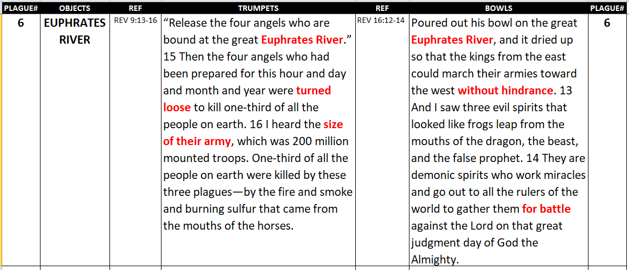
6th -TRUMPET vs 6th BOWL

Slide 29
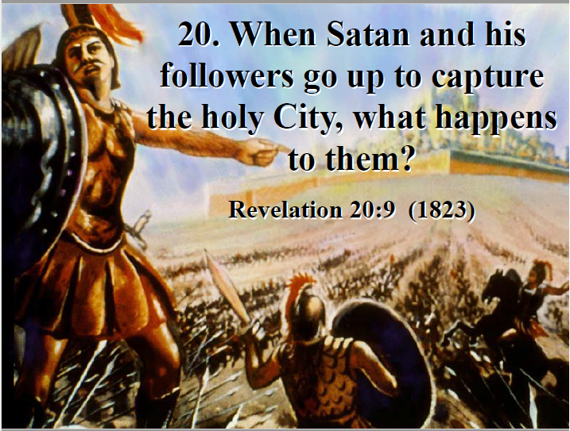

Slide 30
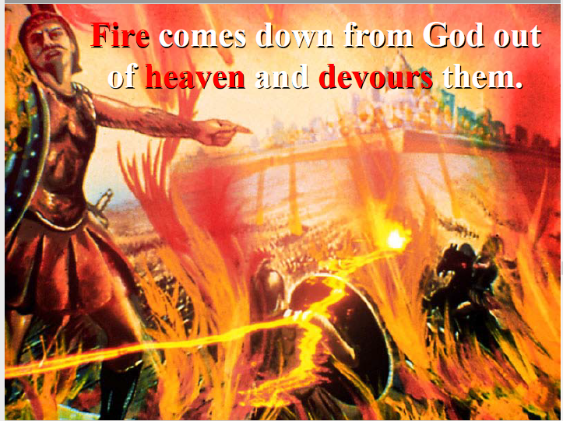

Slide 31
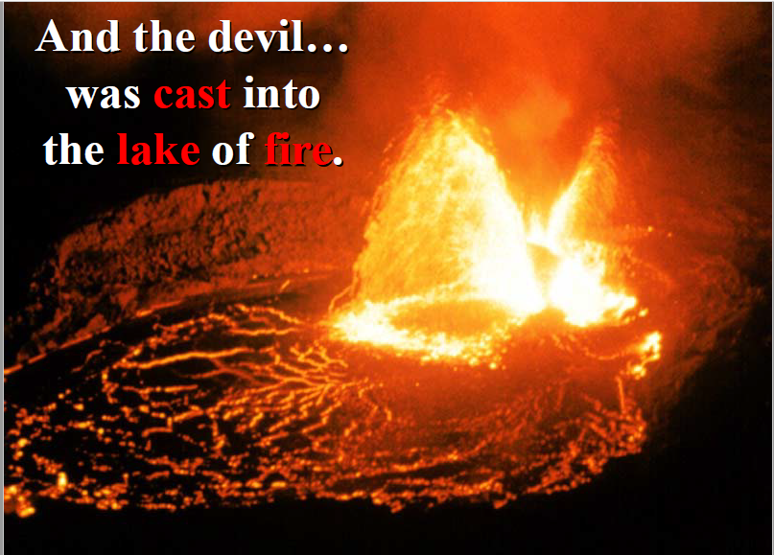

Slide 32
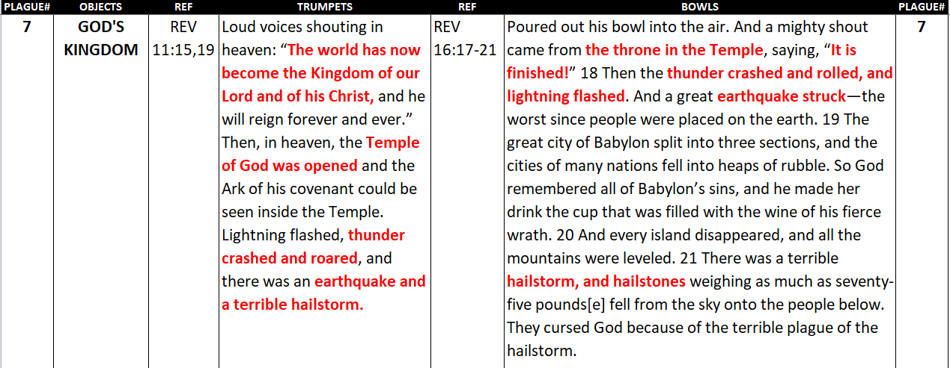
7th -TRUMPET vs 7th BOWL

Slide 33
Revelation 15:8. (NLT)
8 The Temple was filled with smoke from God’s glory and power. No one could enter the Temple until the seven angels had completed pouring out the seven plagues.

Slide 34
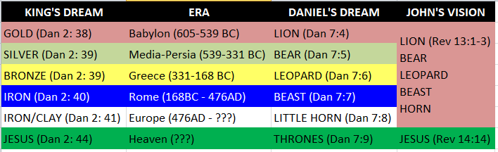
From 605-BC to End Of Evil

Slide 35
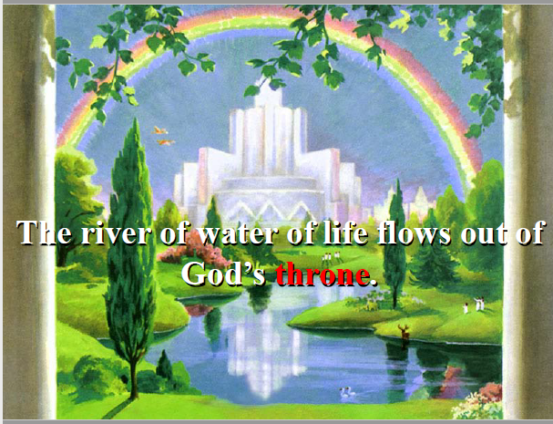

Slide 37
END -
I am ready to answer any question you may have.

Slide 38
Let us Pray to close the Bible study.

Slide 39
Don’t Be Afraid to Follow Jesus!
“If you love Him, keep His commandments”

