Slide 1
The study will begin at 7:30 PM
THE BOOK OF REVELATION
BIBLE STUDY

Slide 2
Let us Pray and then start the Bible study..

Slide 3
Let us start the Bible study..

Slide 4
Last Week Bible Study, we looked at:
Revelation’s Lake of Fire

Slide 5
Speak in Parables
Psm 78:2-3 For I will speak to you in a parable. I will teach you hidden lessons from our past—3 stories we have heard and known, stories our ancestors handed down to us….
Mat 13:3 He told many stories in the form of parables, such as this one: “Listen! A farmer went out to plant some seeds….”

Slide 6
Bodies Tormented in Hell? - Parable

Slide 7
Matthew 13:40-42 . (NLT)
42 And the angels will throw them into the fiery furnace, where there will be weeping and gnashing of teeth.

Slide 8
Malachi 4:1. (NLT)
The Lord of Heaven’s Armies says, “The day of judgment is coming, burning like a furnace. On that day the arrogant and the wicked will be burned up like straw. They will be consumed—roots, branches, and all.

Slide 9
Tonight’s Bible Study:
The Seven Plagues
of Revelation

Slide 10
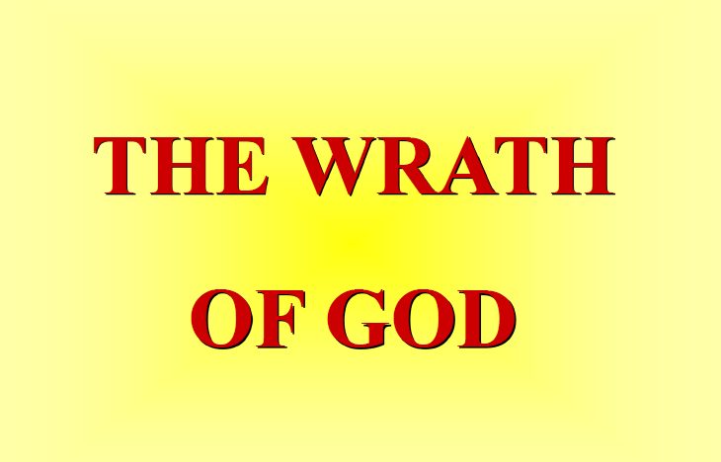

Slide 11


Slide 12


Slide 13
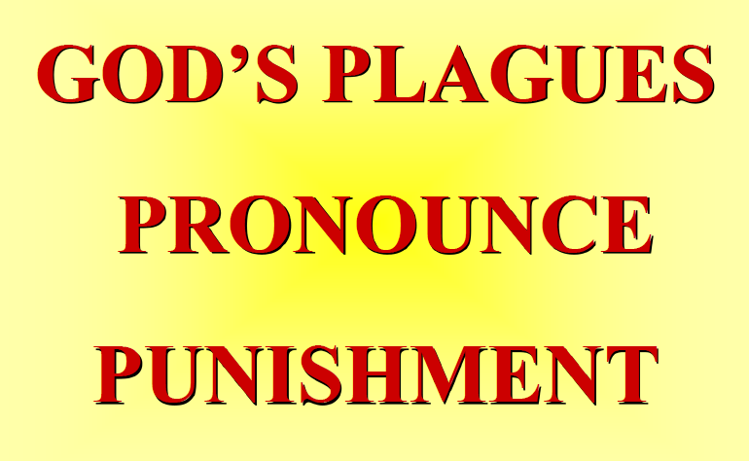

Slide 14
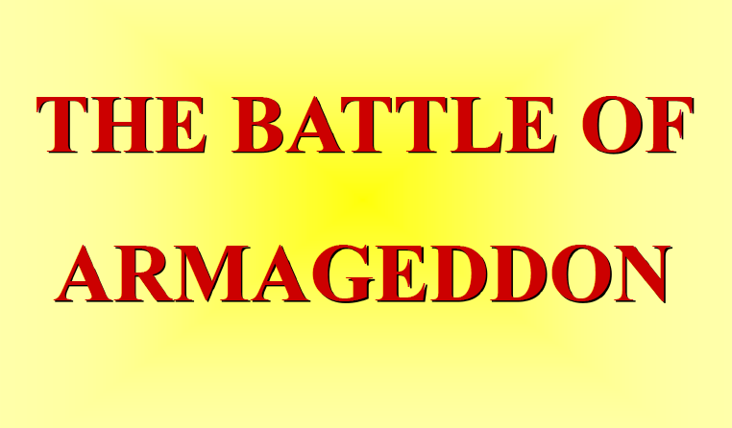

Slide 15
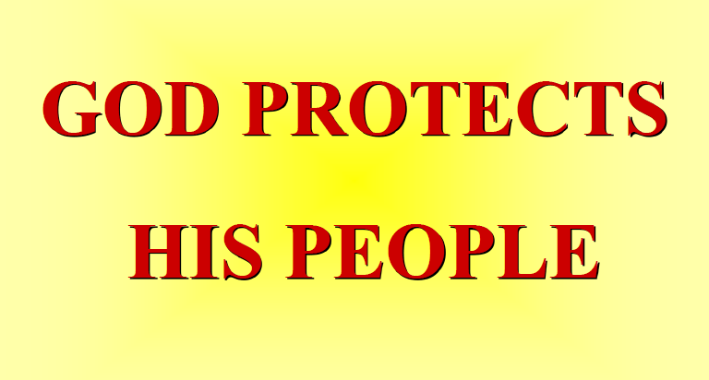

Slide 16


Slide 17
The First Lesson for Tonight:

Slide 19
Revelation 15:1. (NLT)
Then I saw in heaven another marvelous event of great significance. Seven angels were holding the seven last plagues, which would bring God’s wrath to completion.

Slide 20
Revelation 14:6-12. (NLT)
6 And I saw another angel flying through the sky, carrying the eternal Good News to proclaim to the people who belong to this world—to every nation, tribe, language, and people.

Slide 21
Revelation 14:6-12. (NLT)
7 “Fear God,” he shouted. “Give glory to him. For the time has come when he will sit as judge. Worship him who made the heavens, the earth, the sea, and all the springs of water.”

Slide 22
Revelation 14:6-12. (NLT)
8 Then another angel followed him through the sky, shouting, “Babylon is fallen—that great city is fallen—because she made all the nations of the world drink the wine of her passionate immorality.”

Slide 23
Revelation 14:6-12. (NLT)
9 Then a third angel followed them, shouting, “Anyone who worships the beast and his statue or who accepts his mark on the forehead or on the hand.

Slide 24
Revelation 14:6-12. (NLT)
10 must drink the wine of God’s anger. It has been poured full strength into God’s cup of wrath. And they will be tormented with fire and burning sulfur in the presence of the holy angels and the Lamb.

Slide 25
Revelation 14:6-12. (NLT)
11 The smoke of their torment will rise forever and ever, and they will have no relief day or night, for they have worshiped the beast and his statue and have accepted the mark of his name.”

Slide 26
Revelation 14:6-12. (NLT)
12 This means that God’s holy people must endure persecution patiently, obeying his commands and maintaining their faith in Jesus.

Slide 27
Revelation 14:10. (NLT)
10 must drink the wine of God’s anger. It has been poured full strength into God’s cup of wrath. And they will be tormented with fire and burning sulfur in the presence of the holy angels and the Lamb.

Slide 28
Revelation 15:2. (NLT)
2 I saw before me what seemed to be a glass sea mixed with fire. And on it stood all the people who had been victorious over the beast and his statue and the number representing his name. They were all holding harps that God had given them

Slide 29
Revelation 15:3-4. (NLT)
3 And they were singing the song of Moses, the servant of God, and the song of the Lamb: “Great and marvelous are your works, O Lord God, the Almighty. Just and true are your ways, O King of the nations…

Slide 30
Revelation 15:3-4. (NLT)
4 Who will not fear you, Lord, and glorify your name? For you alone are holy. All nations will come and worship before you, for your righteous deeds have been revealed.”

Slide 32
Revelation 15:8. (NLT)
8 The Temple was filled with smoke from God’s glory and power. No one could enter the Temple until the seven angels had completed pouring out the seven plagues.

Slide 33
Revelation 22:11-12. (NLT)
11 Let the one who is doing harm continue to do harm; let the one who is vile continue to be vile; let the one who is righteous continue to live righteously; let the one who is holy continue to be holy.”

Slide 34
Revelation 22:11-12. (NLT)
12 “Look, I am coming soon, bringing my reward with me to repay all people according to their deeds.

Slide 36
Revelation 16:10-11. (NLT)
10 Then the fifth angel poured out his bowl on the throne of the beast, and his kingdom was plunged into darkness. His subjects ground their teeth in anguish, 11 and they cursed the God of heaven for their pains and sores. But they did not repent of their evil deeds and turn to God.

Slide 37
Revelation 16:21. (NLT)
21 There was a terrible hailstorm, and hailstones weighing as much as seventy-five pounds fell from the sky onto the people below. They cursed God because of the terrible plague of the hailstorm.

Slide 39
Revelation 18:8. (NLT)
Therefore, these plagues will overtake her in a single day—death and mourning and famine. She will be completely consumed by fire, for the Lord God who judges her is mighty.”

Slide 40
Isaiah 28:21. (NLT)
The Lord will come as he did against the Philistines at Mount Perazim and against the Amorites at Gibeon. He will come to do a strange thing; he will come to do an unusual deed:

Slide 41
Seven Plagues
First Bowl: Loathsome Sores
Second Bowl: The Sea Turns to Blood
Third Bowl: The Waters Turn to Blood
Fourth Bowl: Men Are Scorched
Fifth Bowl: Darkness and Pain
Sixth Bowl: Euphrates Dried Up
Seventh Bowl: The Earth Utterly Shaken

Slide 42
Revelation 16:2. (NLT)
2 So the first angel left the Temple and poured out his bowl on the earth, and horrible, malignant sores broke out on everyone who had the mark of the beast and who worshiped his statue.

Slide 43
Revelation 16:3. (NLT)
3 Then the second angel poured out his bowl on the sea, and it became like the blood of a corpse. And everything in the sea died.

Slide 44
Revelation 16:4-7. (NLT)
4 Then the third angel poured out his bowl on the rivers and springs, and they became blood. 5 And I heard the angel who had authority over all water saying, “You are just, O Holy One, who is and who …

Slide 45
Revelation 16:4-7. (NLT)
… always was, because you have sent these judgments. 6 Since they shed the blood of your holy people and your prophets, you have given them blood to drink. It is their just reward.” 7 And I heard a voice …

Slide 46
Revelation 16:4-7. (NLT)
… from the altar, saying, “Yes, O Lord God, the Almighty, your judgments are true and just.”

Slide 47
Revelation 16:8-9. (NLT)
8 Then the fourth angel poured out his bowl on the sun, causing it to scorch everyone with its fire. 9 Everyone was burned by this blast of heat, and they cursed the name of God, who had control over all these plagues. They did not repent of their sins and turn to God and give him glory.

Slide 48
Revelation 16:10-11. (NLT)
10 Then the fifth angel poured out his bowl on the throne of the beast, and his kingdom was plunged into darkness. His subjects ground their teeth in anguish, 11 and they cursed the God of heaven for their pains and sores. But they did not repent of their evil deeds and turn to God.

Slide 50
Revelation 16:12-16. (NLT)
12 Then the sixth angel poured out his bowl on the great Euphrates River, and it dried up so that the kings from the east could march their armies toward the west without hindrance.

Slide 51
Revelation 16:12-16. (NLT)
13 And I saw three evil spirits that looked like frogs leap from the mouths of the dragon, the beast, and the false prophet. 14 They are demonic spirits who work miracles and go out to all the rulers of the …

Slide 52
Revelation 16:12-16. (NLT)
… world to gather them for battle against the Lord on that great judgment day of God the Almighty. 15 “Look, I will come as unexpectedly as a thief! Blessed are all who are watching for me, who keep their …

Slide 53
Revelation 16:12-16. (NLT)
… clothing ready so they will not have to walk around naked and ashamed.” 16 And the demonic spirits gathered all the rulers and their armies to a place with the Hebrew name Armageddon

Slide 54
Revelation 16:17-21. (NLT)
17 Then the seventh angel poured out his bowl into the air. And a mighty shout came from the throne in the Temple, saying, “It is finished!” 18 Then the thunder crashed and rolled, and lightning …

Slide 55
Revelation 16:17-21. (NLT)
… flashed. And a great earthquake struck—the worst since people were placed on the earth. 19 The great city of Babylon split into three sections, and the cities of many nations fell into heaps of rubble. So God …

Slide 56
Revelation 16:17-21. (NLT)
… remembered all of Babylon’s sins, and he made her drink the cup that was filled with the wine of his fierce wrath. 20 And every island disappeared, and all the mountains were leveled.

Slide 57
Revelation 16:17-21. (NLT)
21 There was a terrible hailstorm, and hailstones weighing as much as seventy-five pounds fell from the sky onto the people below. They cursed God because of the terrible plague of the hailstorm.

Slide 58
Revelation 16:19. (NLT)
19 The great city of Babylon split into three sections, and the cities of many nations fell into heaps of rubble. So God remembered all of Babylon’s sins, and he made her drink the cup that was filled with the wine of his fierce wrath.

Slide 59
Where will God’s People be
during the 7 Last Plagues?
Interesting Passages…

Slide 60
Wicked Dead Came Back to Life
– After 1000 Years
Rev 20:5
5 This is the first resurrection. The rest of the dead did not come back to life until the thousand years had ended.

Slide 61
The City - New Jerusalem
Rev 15: 1-3
Then I saw in heaven another marvelous event of great significance. Seven angels were holding the seven last plagues, which would bring God’s wrath to completion. 2 I saw before me what seemed to be a glass sea mixed with …

Slide 62
The City - New Jerusalem
fire. And on it stood all the people who had been victorious over the beast and his statue and the number representing his name. They were all holding harps that God had given them. 3 And they were singing the song of Moses, the servant of God, and the song of the Lamb

Slide 63
The City - New Jerusalem
Rev 15:8 The Temple was filled with smoke from God’s glory and power. No one could enter the Temple until the seven angels had completed pouring out the seven plagues.
[The Temple is in heaven]

Slide 64
Where Are The Saints
Rev 16:1-2
Then I heard a mighty voice from the Temple say to the seven angels, “Go your ways and pour out on the earth the seven bowls containing God’s wrath.” 2 So the first angel left the Temple and poured out his bowl on the earth, and horrible, malignant sores broke out on everyone who had the mark of the beast and who worshiped his statue. [The saints are in heaven]

Slide 65
Who Were Present?
Rev 14:9-10 Then a third angel followed them, saying with a loud voice, “If anyone worships the beast and his image, and receives his mark on his forehead or on his hand,

Slide 66
Who Were Present?
10 … he himself shall also drink of the wine of the wrath of God, which is poured out full strength into the cup of His indignation. He shall be tormented with fire and brimstone in the presence of the holy angels and in the presence of the Lamb.
(The saints were not presence.)

Slide 67
When is Armageddon?
Rev 16:16-18 And the demonic spirits gathered all the rulers and their armies to a place with the Hebrew name Armageddon. 17 Then the seventh angel poured out his bowl into the air. And a mighty shout came from the throne in the Temple, saying, “It is finished!” 18 Then the thunder crashed and rolled, and lightning flashed. And a great earthquake struck—the worst since people were placed on the earth.
[During the 6th And 7th Plagues]

Slide 68
When is Armageddon?
Rev 20:7-9 When the thousand years come to an end, Satan will be let out of his prison. 8 He will go out to deceive the nations—called Gog and Magog—in every corner of the earth. He will gather them together for battle—a mighty army, as numberless as sand along the seashore. 9 And I saw them as they went up on the broad plain of the earth and surrounded God’s people and the beloved city. But fire from heaven came down on the attacking armies and consumed them.

Slide 69
The Saints will be in heaven, waiting for the end of the plagues; then the New Jerusalem City descends with the Saints
(at the end of the 7th plague)

Slide 71
Exodus 12:7, 13. (NLT)
7 They are to take some of the blood and smear it on the sides and top of the doorframes of the houses where they eat the animal.

Slide 72
Exodus 12:13. (NLT)
13 But the blood on your doorposts will serve as a sign, marking the houses where you are staying. When I see the blood, I will pass over you. This plague of death will not touch you when I strike the land of Egypt.

Slide 73
Revelation 12:11. (NLT)
And they have defeated him by the blood of the Lamb and by their testimony. And they did not love their lives so much that they were afraid to die.

Slide 74
Revelation 22:18. (NLT)
18 And I solemnly declare to everyone who hears the words of prophecy written in this book: If anyone adds anything to what is written here, God will add to that person the plagues described in this book.

Slide 75
Psalm 91:10-11. (NLT)
10 no evil will conquer you; no plague will come near your home.
11 For he will order his angels to protect you wherever you go.

Slide 76
Psalm 91:5. (NLT)
5 Do not be afraid of the terrors of the night, nor the arrow that flies in the day.

Slide 77
Ephesians 6:10-17. (NLT)
10 A final word: Be strong in the Lord and in his mighty power. 11 Put on all of God’s armor so that you will be able to stand firm against all strategies of the devil.

Slide 78
Ephesians 6:10-17. (NLT)
12 For we are not fighting against flesh-and-blood enemies, but against evil rulers and authorities of the unseen world, against mighty powers in this dark world, and against evil spirits in the heavenly places.

Slide 79
Ephesians 6:10-17. (NLT)
13 Therefore, put on every piece of God’s armor so you will be able to resist the enemy in the time of evil. Then after the battle you will still be standing firm.

Slide 80
Ephesians 6:10-17. (NLT)
14 Stand your ground, putting on the belt of truth and the body armor of God’s righteousness. 15 For shoes, put on the peace that comes from the Good News so that you will be fully prepared.

Slide 81
Ephesians 6:10-17. (NLT)
16 In addition to all of these, hold up the shield of faith to stop the fiery arrows of the devil. 17 Put on salvation as your helmet, and take the sword of the Spirit, which is the word of God.

Slide 82
END -
I am ready to answer any question you may have.

Slide 83
Let us Pray to close the Bible study.

Slide 84
Don’t Be Afraid to Follow Jesus!
“If you love Him, keep His commandments”

