Slide 1
The study will begin at 7:30 PM
THE BOOK OF REVELATION
BIBLE STUDY

Slide 2
Let us Pray and then start the Bible study..

Slide 3
Let us start the Bible study..

Slide 4
Last Week Bible Study, we look at:
The Mark of The Beast

Slide 5
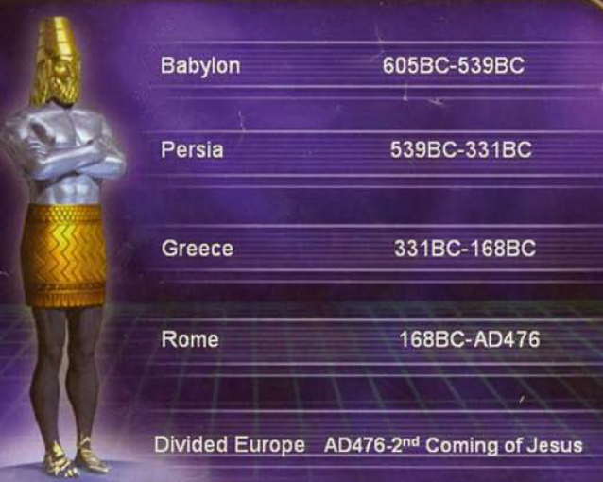

Slide 6
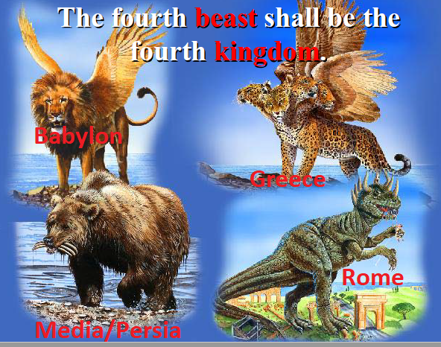

Slide 7
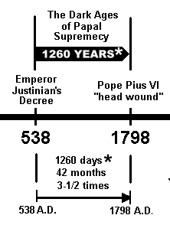
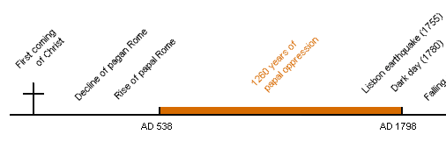
1260 Years

Slide 8
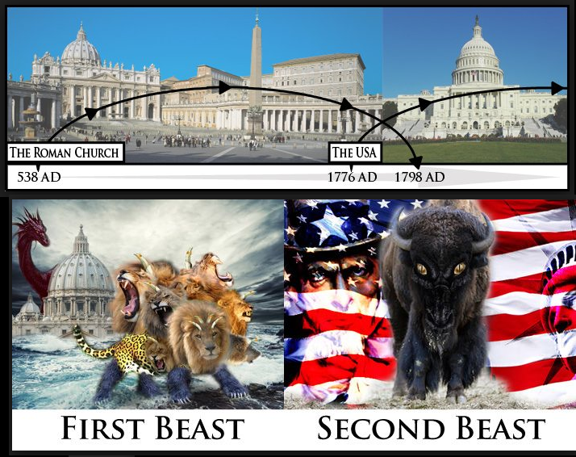

Slide 9
Tonight’s Bible Study:
Mystic Babylon
The Great Harlot of the Beast

Slide 10
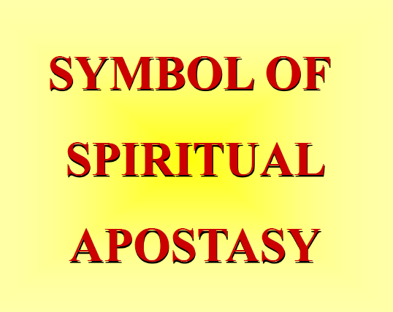

Slide 11
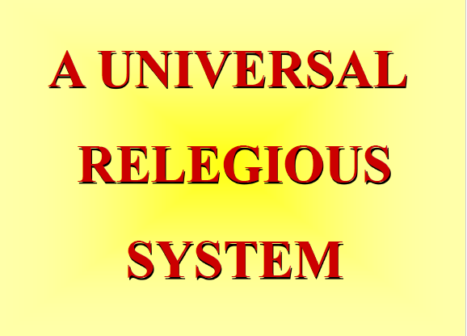

Slide 12
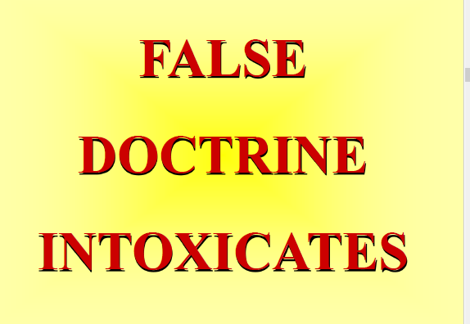

Slide 13


Slide 14


Slide 15
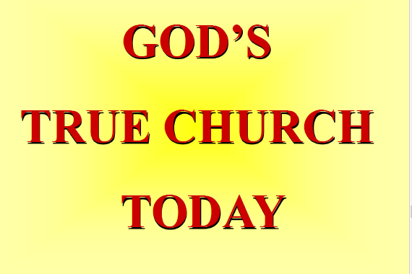

Slide 16
The first lesson for tonight:

Slide 18
Symbols in This Lesson
Beast = Kingdom/government/political power Daniel 7:17, 23
Purple = Royalty Mark 15:17, Judges 8:26
Red/Scarlet = Sin/corruption Isaiah 1:18; Nahum 2:3; Revelation 17:1-4
Waters = Inhabited area/people/nations Revelation 17:15
Mountains = Political or religio-political powers Isaiah 2:2, 3; Jeremiah 17:3; 31:23; 51:24, 25; Ezekiel 17:22, 23; Daniel 2:35, 44, 45
Wine = doctrines/blood/covenant Luke 5:37
Babylon = apostasy/confusion/rebellion Gen. 10:8-10; 11:6-9; Rev. 18:2, 3; 17:1-5
Woman, Pure = True Church Jeremiah 6:2; 2 Corinthians 11:2; Ephesians 5:23-27
Woman, Corrupt = Apostate church Ezk. 16:15-58; 23:2-21; Hos. 2:5; 3:1; Rev. 14:4
Harlot = Apostate church/religion Isaiah 1:21-27; Jeremiah 3:1-3; 6-9

Slide 19
Revelation 14:6-12 (NLT)
6 And I saw another angel flying through the sky, carrying the eternal Good News to proclaim to the people who belong to this world—to every nation, tribe, language, and people.

Slide 20
Revelation 14:6-12 (NLT)
7 “Fear God,” he shouted. “Give glory to him. For the time has come when he will sit as judge. Worship him who made the heavens, the earth, the sea, and all the springs of water.”

Slide 21
Revelation 14:6-12 (NLT)
8 Then another angel followed him through the sky, shouting, “Babylon is fallen—that great city is fallen—because she made all the nations of the world drink the wine of her passionate immorality.”

Slide 22
Revelation 14:6-12 (NLT)
9 Then a third angel followed them, shouting, “Anyone who worships the beast and his statue or who accepts his mark on the forehead or on the hand.

Slide 23
Revelation 14:6-12 (NLT)
10 must drink the wine of God’s anger. It has been poured full strength into God’s cup of wrath. And they will be tormented with fire and burning sulfur in the presence of the holy angels and the Lamb.

Slide 24
Revelation 14:6-12 (NLT)
11 The smoke of their torment will rise forever and ever, and they will have no relief day or night, for they have worshiped the beast and his statue and have accepted the mark of his name.”

Slide 25
Revelation 14:6-12 (NLT)
12 This means that God’s holy people must endure persecution patiently, obeying his commands and maintaining their faith in Jesus.

Slide 26
Revelation 18:4 (NLT)
4 Then I heard another voice calling from heaven, “Come away from her, my people. Do not take part in her sins, or you will be punished with her.

Slide 27
“Woman” in Revelation?
Throughout the Bible a pure “woman” is a symbol of God’s true church while a harlot represents a corrupt church. Hosea 1:2; Ezekiel 16; 2 Corinthians 11:2.
Woman => Church

Slide 28
Hosea 1:2(NKJV)
2 When the Lord first began speaking to Israel through Hosea, he said to him, “Go and marry a prostitute, so that some of her children will be conceived in prostitution. This will illustrate how Israel has acted like a prostitute by turning against the Lord and worshiping other gods.”
Israel => Church , Prostitute => Woman

Slide 29
Ezekiel 16:1-3 (NLT)
16 Then another message came to me from the Lord: 2 “Son of man, confront Jerusalem with her detestable sins. 3 Give her this message from the Sovereign Lord…
Jerusalem=> Church (Unfaithful Wife)

Slide 30
2 Corinthians 11:2 (NLT)
2 For I am jealous for you with the jealousy of God himself. I promised you as a pure bride to one husband—Christ.

Slide 31
Isaiah 13:19-21 (NLT)
19 Babylon, the most glorious of kingdoms, the flower of Chaldean pride, will be devastated like Sodom and Gomorrah when God destroyed them. 20 Babylon will never be inhabited again. It will remain …

Slide 32
Isaiah 13:19-21 (NLT)
… empty for generation after generation. Nomads will refuse to camp there, and shepherds will not bed down their sheep. Desert animals will move into the ruined city, and the houses will be …

Slide 33
Isaiah 13:19-21 (NLT)
… haunted by howling creatures. Owls will live among the ruins, and wild goats will go there to dance.

Slide 34
Revelation 18:2-5 (NLT)
2 He gave a mighty shout: “Babylon is fallen—that great city is fallen! She has become a home for demons. She is a hideout for every foul spirit, a hideout for every foul vulture and every foul and dreadful animal.

Slide 35
Revelation 18:2-5 (NLT)
3 For all the nations have fallen because of the wine of her passionate immorality. The kings of the world have committed adultery with her. Because of her desires for extravagant luxury, the merchants of the world have grown rich.”

Slide 36
Revelation 18:2-5 (NLT)
4 Then I heard another voice calling from heaven, “Come away from her, my people. Do not take part in her sins, or you will be punished with her. 5 For her sins are piled as high as heaven, and God remembers her evil deeds.

Slide 37
Revelation 17:1-5 (NLT)
1 One of the seven angels who had poured out the seven bowls came over and spoke to me. “Come with me,” he said, “and I will show you the judgment that is going to come on the great prostitute, who rules over many waters.

Slide 38
Revelation 17:1-5 (NLT)
2 The kings of the world have committed adultery with her, and the people who belong to this world have been made drunk by the wine of her immorality.”

Slide 39
Revelation 17:1-5 (NLT)
3 So the angel took me in the Spirit into the wilderness. There I saw a woman sitting on a scarlet beast that had seven heads and ten horns, and blasphemies against God were written all over it.

Slide 40
Revelation 17:1-5 (NLT)
4 The woman wore purple and scarlet clothing and beautiful jewelry made of gold and precious gems and pearls. In her hand she held a gold goblet full of obscenities and the impurities of her immorality.

Slide 41
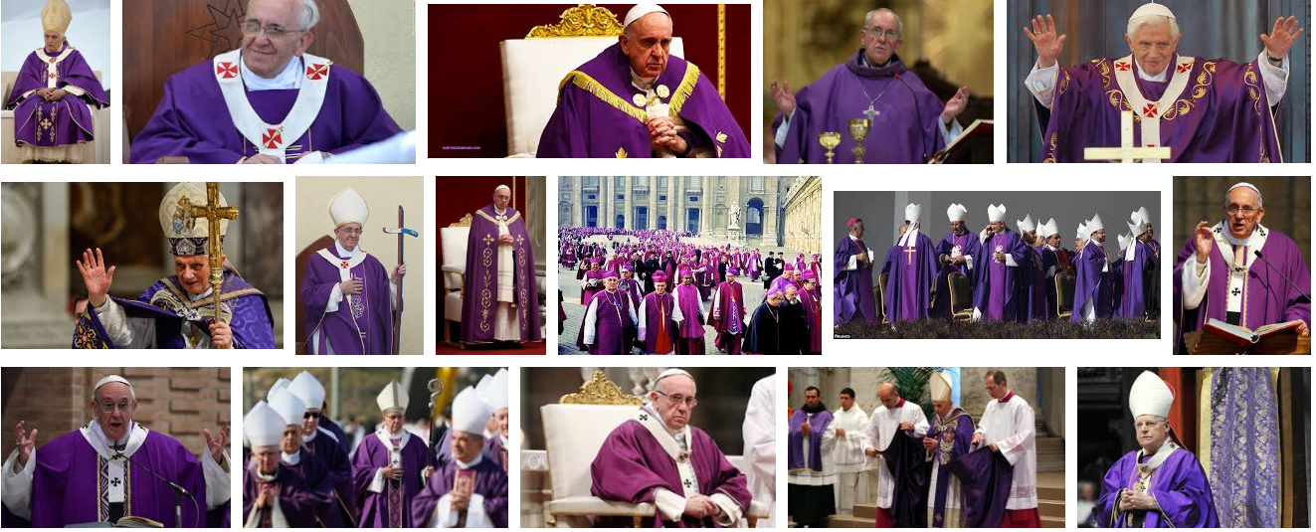
Church (woman) Wore Purple and Scarlet Clothing

Slide 42
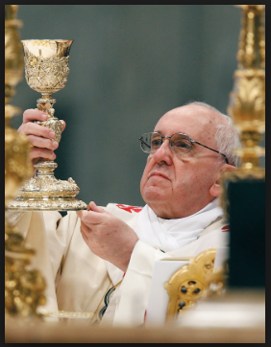
The Church (she) Held a Gold Goblet

Slide 43
Revelation 17:5 (NLT)
5 A mysterious name was written on her forehead: “Babylon the Great, Mother of All Prostitutes and Obscenities in the World.”

Slide 45
Genesis 10:8-9 (NLT)
8 Cush was also the ancestor of Nimrod, who was the first heroic warrior on earth. 9 Since he was the greatest hunter in the world, his name became proverbial. People would say, “This man is like Nimrod, the greatest hunter in the world.”

Slide 46
Genesis 10:10 (NLT)
10 He built his kingdom in the land of Babylonia, with the cities of Babylon, Erech, Akkad, and Calneh.

Slide 47
Genesis 11:5-9 (NLT)
5 But the Lord came down to look at the city and the tower the people were building. 6 “Look!” he said. “The people are united, and they all speak the same language. After this, nothing they set out to do will be impossible for them!

Slide 48
Genesis 11:5-9 (NLT)
7 Come, let’s go down and confuse the people with different languages. Then they won’t be able to understand each other.” 8 In that way, the Lord scattered them all over the world, and they stopped building the city.

Slide 49
Genesis 11:5-9 (NLT)
9 That is why the city was called Babel, because that is where the Lord confused the people with different languages. In this way he scattered them all over the world.

Slide 51
Revelation 17:2 (NLT)
2 The kings of the world have committed adultery with her, and the people who belong to this world have been made drunk by the wine of her immorality.”

Slide 52
Revelation 17:4 (NLT)
4 The woman wore purple and scarlet clothing and beautiful jewelry made of gold and precious gems and pearls. In her hand she held a gold goblet full of obscenities and the impurities of her immorality.

Slide 53
Revelation 18:3 (NLT)
3 For all the nations have fallen because of the wine of her passionate immorality. The kings of the world have committed adultery with her. Because of her desires for extravagant luxury, the merchants of the world have grown rich.”

Slide 54
Revelation 14:8 (NLT)
8 Then another angel followed him through the sky, shouting, “Babylon is fallen—that great city is fallen—because she made all the nations of the world drink the wine of her passionate immorality.”

Slide 56
Revelation 17:8 (NLT)
8 The beast you saw was once alive but isn’t now. And yet he will soon come up out of the bottomless pit and go to eternal destruction. And the people who belong to this world, whose names were …

Slide 57
Revelation 17:8 (NLT)
… not written in the Book of Life before the world was made, will be amazed at the reappearance of this beast who had died.

Slide 58
Revelation 13:3 (NLT)
3 I saw that one of the heads of the beast seemed wounded beyond recovery—but the fatal wound was healed! The whole world marveled at this miracle and gave allegiance to the beast.

Slide 59
Jeremiah 51:24 (NLT)
24 “I will repay Babylon and the people of Babylonia for all the wrong they have done to my people in Jerusalem,” says the Lord.

Slide 60
Jeremiah 51:25 (NLT)
“Look, O mighty mountain, destroyer of the earth! I am your enemy,” says the Lord.” I will raise my fist against you, to knock you down from the heights. When I am finished, you will be nothing but a heap of burnt rubble.

Slide 61
Revelation 17:9-11 (NLT)
9 “This calls for a mind with understanding: The seven heads of the beast represent the seven hills where the woman rules. They also represent seven kings. 10 Five kings have already fallen, the sixth now …

Slide 62
Revelation 17:9-11 (NLT)
… reigns, and the seventh is yet to come, but his reign will be brief. 11 “The scarlet beast that was, but is no longer, is the eighth king. He is like the other seven, and he, too, is headed for destruction.

Slide 63
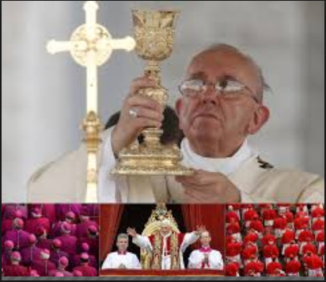
Purple & Scarlet Colors
PURPLE = >
< = SCARLET

Slide 64
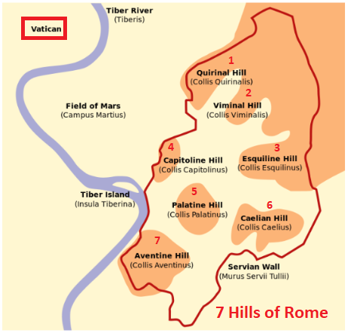
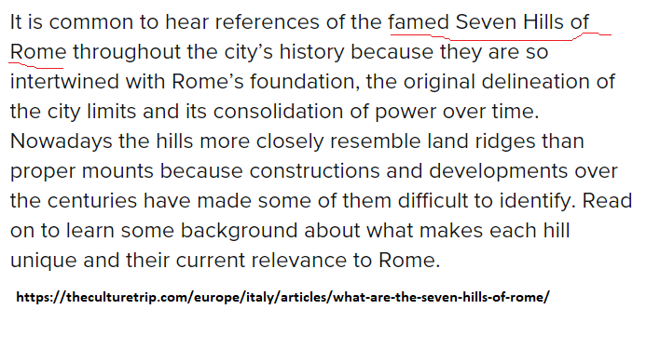

Slide 65
Revelation 17:12-13 (NLT)
12 The ten horns of the beast are ten kings who have not yet risen to power. They will be appointed to their kingdoms for one brief moment to reign with the beast. 13 They will all agree to give him their power and authority.

Slide 67
Revelation 14:8 (NLT)
8 Then another angel followed him through the sky, shouting, “Babylon is fallen—that great city is fallen—because she made all the nations of the world drink the wine of her passionate immorality.”

Slide 68
Revelation 18:4 (NLT)
4 Then I heard another voice calling from heaven, “Come away from her, my people. Do not take part in her sins, or you will be punished with her.

Slide 69
John 10:16 (NLT)
16 I have other sheep, too, that are not in this sheepfold. I must bring them also. They will listen to my voice, and there will be one flock with one shepherd.

Slide 71
Acts 2:47 (NLT)
47 all the while praising God and enjoying the goodwill of all the people. And each day the Lord added to their fellowship those who were being saved.

Slide 72
Revelation 18:4 (NLT)
4 Then I heard another voice calling from heaven, “Come away from her, my people. Do not take part in her sins, or you will be punished with her.

Slide 73
END -
I am ready to answer any question you may have.

Slide 74
Let us Pray to close the Bible study.

Slide 75
Don’t Be Afraid to Follow Jesus!
“If you love Him, keep His commandments”

