Slide 1
The study will begin at 7:30 PM
THE BOOK OF REVELATION
BIBLE STUDY

Slide 2
Let us Pray and then start the Bible study..

Slide 3
Let us start the Bible study..

Slide 4
Last Week Bible Study, we looked at:
Modern prophets and visions

Slide 5
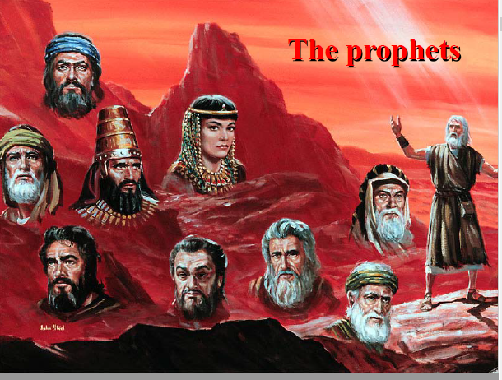

Slide 6
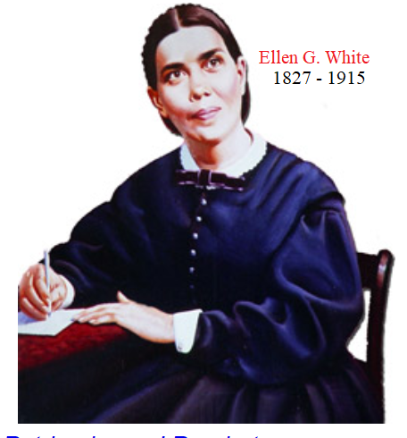

Slide 7
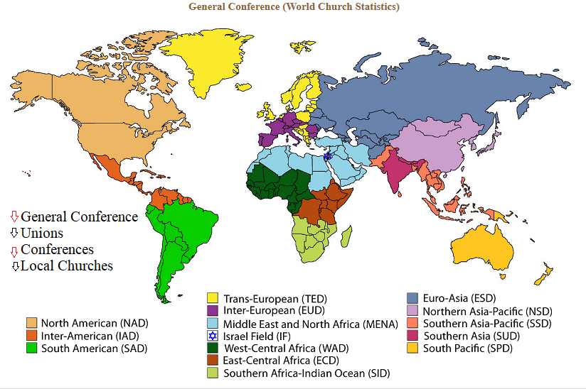
Impact on the World Since 1863
150 year later

Slide 8
Tonight’s Bible Study:
Revelation’s Lake of Fire

Slide 9
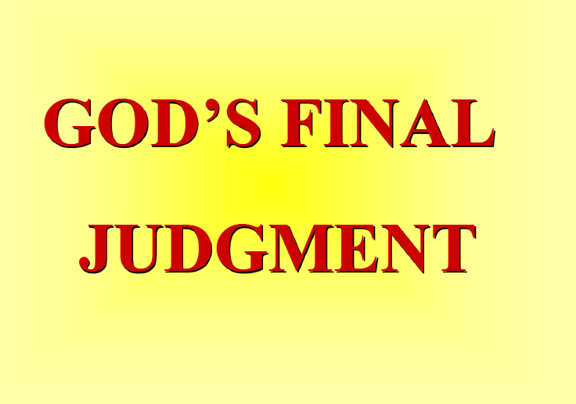

Slide 10
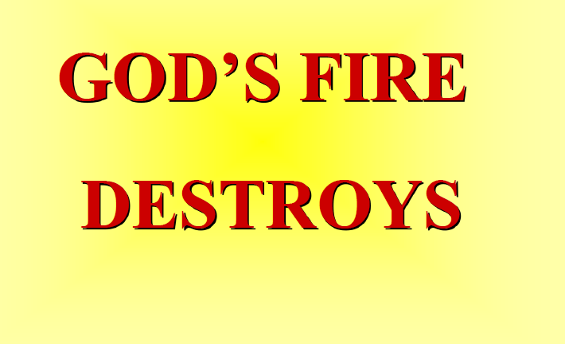

Slide 11


Slide 12
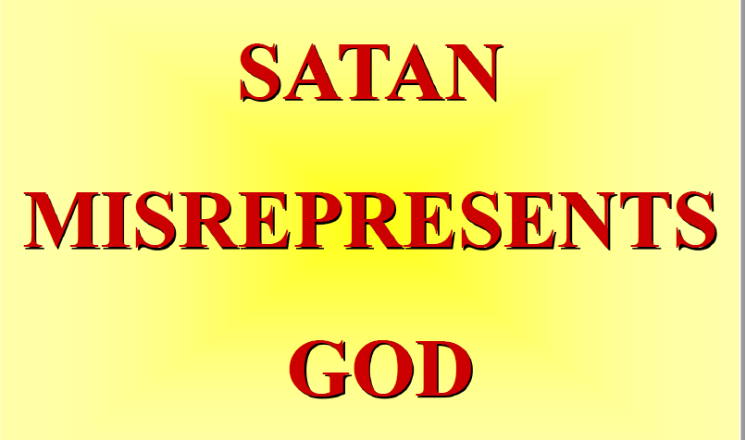

Slide 13


Slide 14
The First Lesson for Tonight:

Slide 16
2 Peter 2:9. (NLT)
9 So you see, the Lord knows how to rescue godly people from their trials, even while keeping the wicked under punishment until the day of final judgment.

Slide 17
John 12:48. (NLT)
48 But all who reject me and my message will be judged on the day of judgment by the truth I have spoken.

Slide 18
Matthew 13:40-42 . (NLT)
40 “Just as the weeds are sorted out and burned in the fire, so it will be at the end of the world. 41 The Son of Man will send his angels, and they will remove from his Kingdom everything that causes sin and all who do evil.

Slide 19
Matthew 13:40-42 . (NLT)
42 And the angels will throw them into the fiery furnace, where there will be weeping and gnashing of teeth.

Slide 20
Job 21:30-32. (NLT)
30 Evil people are spared in times of calamity and are allowed to escape disaster. 31 No one criticizes them openly or pays them back for what they have done. 32 When they are carried to the grave, an honor guard keeps watch at their tomb.

Slide 21
Romans 6:23. (NLT)
23 For the wages of sin is death, but the free gift of God is eternal life through Christ Jesus our Lord.

Slide 22
Revelation 21:8. (NLT)
8 “But cowards, unbelievers, the corrupt, murderers, the immoral, those who practice witchcraft, idol worshipers, and all liars—their fate is in the fiery lake of burning sulfur. This is the second death.”

Slide 23
Ezekiel 18:4. (NLT)
4 For all people are mine to judge—both parents and children alike. And this is my rule: The person who sins is the one who will die.

Slide 24
Ezekiel 18:20. (NLT)
20 The person who sins is the one who will die. The child will not be punished for the parent’s sins, and the parent will not be punished for the child’s sins. Righteous people will be rewarded for their own righteous behavior, and wicked people will be punished for their own wickedness.

Slide 26
Revelation 20:9. (NLT)
9 And I saw them as they went up on the broad plain of the earth and surrounded God’s people and the beloved city. But fire from heaven came down on the attacking armies and consumed them.

Slide 27
2 Peter 3:10. (NLT)
10 But the day of the Lord will come as unexpectedly as a thief. Then the heavens will pass away with a terrible noise, and the very elements themselves will disappear in fire, and the earth and everything on it will be found to deserve judgment

Slide 28
Malachi 4:1. (NLT)
The Lord of Heaven’s Armies says, “The day of judgment is coming, burning like a furnace. On that day the arrogant and the wicked will be burned up like straw. They will be consumed—roots, branches, and all.

Slide 29
Isaiah 47:14. (NLT)
But they are like straw burning in a fire; they cannot save themselves from the flame. You will get no help from them at all; their hearth is no place to sit for warmth.

Slide 30
Malachi 4:3. (NLT)
3 On the day when I act, you will tread upon the wicked as if they were dust under your feet,” says the Lord of Heaven’s Armies.

Slide 31
Psalm 37:10. (NLT)
10 Soon the wicked will disappear. Though you look for them, they will be gone.

Slide 32
Psalm 37:20. (NLT)
20 But the wicked will die. The Lord’s enemies are like flowers in a field— they will disappear like smoke.

Slide 34
Revelation 22:12. (NLT)
12 “Look, I am coming soon, bringing my reward with me to repay all people according to their deeds.

Slide 35
Revelation 20:10. (NLT)
10 Then the devil, who had deceived them, was thrown into the fiery lake of burning sulfur, joining the beast and the false prophet. There they will be tormented day and night forever and ever.

Slide 36
Ezekiel 28:17-19. (NLT)
17 Your heart was filled with pride because of all your beauty. Your wisdom was corrupted by your love of splendor. So I threw you to the ground and exposed you to the curious gaze of kings.

Slide 37
Ezekiel 28:17-19. (NLT)
18 You defiled your sanctuaries with your many sins and your dishonest trade. So I brought fire out from within you, and it consumed you. I reduced you to ashes on the ground in the sight of all who were watching.”

Slide 38
Ezekiel 28:17-19. (NLT)
19 All who knew you are appalled at your fate. You have come to a terrible end, and you will exist no more.”

Slide 39
Matthew 5:30. (NLT)
30 And if your hand—even your stronger hand—causes you to sin, cut it off and throw it away. It is better for you to lose one part of your body than for your whole body to be thrown into hell.

Slide 40
Matthew 10:28. (NLT)
28 “Don’t be afraid of those who want to kill your body; they cannot touch your soul. Fear only God, who can destroy both soul and body in hell.

Slide 42
Job 4:17. (NLT)
‘Can a mortal be innocent before God? Can anyone be pure before the Creator?’

Slide 43
Matthew 25:41. (NLT)
41 “Then the King will turn to those on the left and say, ‘Away with you, you cursed ones, into the eternal fire prepared for the devil and his demons.

Slide 45
Isaiah 28:21. (NLT)
The Lord will come as he did against the Philistines at Mount Perazim and against the Amorites at Gibeon. He will come to do a strange thing; he will come to do an unusual deed:

Slide 46
Revelation 21:4. (NLT)
4 He will wipe every tear from their eyes, and there will be no more death or sorrow or crying or pain. All these things are gone forever.”

Slide 47
John 14:23-24. (NLT)
23 Jesus replied, “All who love me will do what I say. My Father will love them, and we will come and make our home with each of them. 24 Anyone who doesn’t love me will not obey me. And remember, my words are not my own. What I am telling you is from the Father who sent me.

Slide 48
Exodus 34:6-7. (NLT)
6 The Lord passed in front of Moses, calling out, “Yahweh! The Lord! The God of compassion and mercy! I am slow to anger and filled with unfailing love and faithfulness.

Slide 49
Exodus 34:6-7. (NLT)
7 I lavish unfailing love to a thousand generations. I forgive iniquity, rebellion, and sin. But I do not excuse the guilty. I lay the sins of the parents upon their children and grandchildren; the entire family is affected—even children in the third and fourth generations.”

Slide 50
Nahum 1:9. (NLT)
Why are you scheming against the Lord? He will destroy you with one blow; he won’t need to strike twice!

Slide 51
Isaiah 65:17. (NLT)
“Look! I am creating new heavens and a new earth, and no one will even think about the old ones anymore.

Slide 52
2 Peter 3:13. (NLT)
13 But we are looking forward to the new heavens and new earth he has promised, a world filled with God’s righteousness.

Slide 53
Revelation 21:3. (NLT)
3 I heard a loud shout from the throne, saying, “Look, God’s home is now among his people! He will live with them, and they will be his people. God himself will be with them.

Slide 54
For ever!

Slide 55
Revelation 20:10. (NLT)
10 Then the devil, who had deceived them, was thrown into the fiery lake of burning sulfur, joining the beast and the false prophet. There they will be tormented day and night forever and ever.

Slide 56
Matthew 21:19. (KJV)
And when he saw a fig tree in the way, he came to it, and found nothing thereon, but leaves only, and said unto it, Let no fruit grow on thee henceforward for ever. And presently the fig tree withered away.

Slide 57
Deuteronomy 13:14-16. (NLT)
14 In such cases, you must examine the facts carefully. If you find that the report is true and such a detestable act has been committed among you, 15 you must attack that town and completely destroy all its inhabitants, as well as all the livestock. 16 Then you must pile all the plunder in the middle of the open square and burn it. Burn the entire town as a burnt offering to the Lord your God. That town must remain a ruin forever; it may never be rebuilt.

Slide 58
Jude 1:7. (NLT)
And don’t forget Sodom and Gomorrah and their neighboring towns, which were filled with immorality and every kind of sexual perversion. Those cities were destroyed by fire and serve as a warning of the eternal fire of God’s judgment.

Slide 59
Matthew 25:41. (NLT)
“Then the King will turn to those on the left and say, ‘Away with you, you cursed ones, into the eternal fire prepared for the devil and his demons.”

Slide 60
Speak in Parables
Psm 78:2-3 For I will speak to you in a parable. I will teach you hidden lessons from our past—3 stories we have heard and known, stories our ancestors handed down to us….
Mat 13:3 He told many stories in the form of parables, such as this one: “Listen! A farmer went out to plant some seeds….”

Slide 61
Matthew 13:24-30. (NLT)
24 Here is another story Jesus told: “The Kingdom of Heaven is like a farmer who planted good seed in his field. 25 But that night as the workers slept, his enemy came and planted weeds among the wheat, then slipped away. 26 When the crop began to grow and produce grain, the weeds also grew.

Slide 62
Matthew 13:24-30. (NLT)
27 “The farmer’s workers went to him and said, ‘Sir, the field where you planted that good seed is full of weeds! Where did they come from?’ 28 “‘An enemy has done this!’ the farmer exclaimed. “‘Should we pull out the weeds?’ they asked. 29 “‘No,’ he replied, ‘you’ll uproot the wheat if you do.

Slide 63
Matthew 13:24-30. (NLT)
30 Let both grow together until the harvest. Then I will tell the harvesters to sort out the weeds, tie them into bundles, and burn them, and to put the wheat in the barn.’”

Slide 64
Bodies Tormented in Hell? - Parable

Slide 65
Luke 16:19-31. (NLT)
19 Jesus said, “There was a certain rich man who was splendidly clothed in purple and fine linen and who lived each day in luxury. 20 At his gate lay a poor man named Lazarus who was covered with sores. 21 As Lazarus lay there longing for scraps from the rich man’s table, the dogs would come and lick his open sores. 22 “Finally, the poor man died

Slide 66
Luke 16:19-31. (NLT)
… and was carried by the angels to sit beside Abraham at the heavenly banquet. The rich man also died and was buried, 23 and he went to the place of the dead. There, in torment, he saw Abraham in the far distance with Lazarus at his side. 24 “The rich man shouted, ‘Father Abraham, have some pity! Send Lazarus over here to dip the tip of his

Slide 67
Luke 16:19-31. (NLT)
… finger in water and cool my tongue. I am in anguish in these flames.’ 25 “But Abraham said to him, ‘Son, remember that during your lifetime you had everything you wanted, and Lazarus had nothing. So now he is here being comforted, and you are in anguish. 26 And besides, there is a great chasm separating us. No one can cross over to you from here, and

Slide 68
Luke 16:19-31. (NLT)
… no one can cross over to us from there.’ 27 “Then the rich man said, ‘Please, Father Abraham, at least send him to my father’s home. 28 For I have five brothers, and I want him to warn them so they don’t end up in this place of torment.’ 29 “But Abraham said, ‘Moses and the prophets have warned them. Your brothers can read what they wrote.’

Slide 69
Luke 16:19-31. (NLT)
30 “The rich man replied, ‘No, Father Abraham! But if someone is sent to them from the dead, then they will repent of their sins and turn to God.’ 31 “But Abraham said, ‘If they won’t listen to Moses and the prophets, they won’t be persuaded even if someone rises from the dead.’”

Slide 70
END -
I am ready to answer any question you may have.

Slide 71
Let us Pray to close the Bible study.

Slide 72
Don’t Be Afraid to Follow Jesus!
“If you love Him, keep His commandments”

