Slide 1
The study will begin at 7:30 PM
THE BOOK OF REVELATION
BIBLE STUDY

Slide 2
Let us Pray and then start the Bible study..

Slide 3
Let us start the Bible study..

Slide 4
Last Week Bible Study, we look at:
The 4 Horsemen
&
Seven Seals

Slide 5
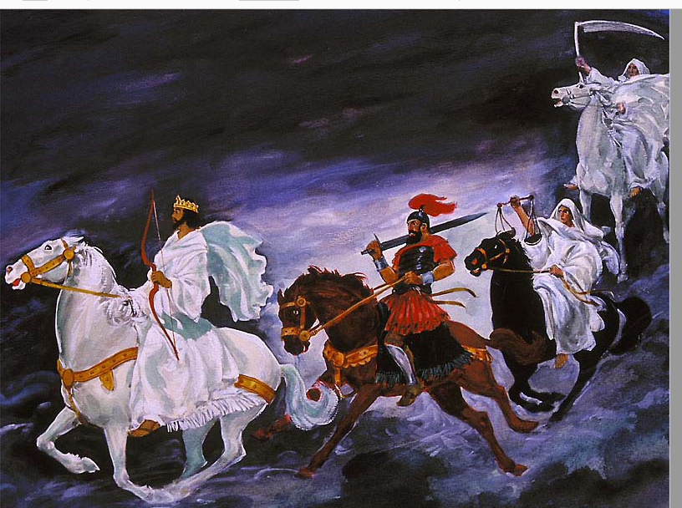

Slide 6
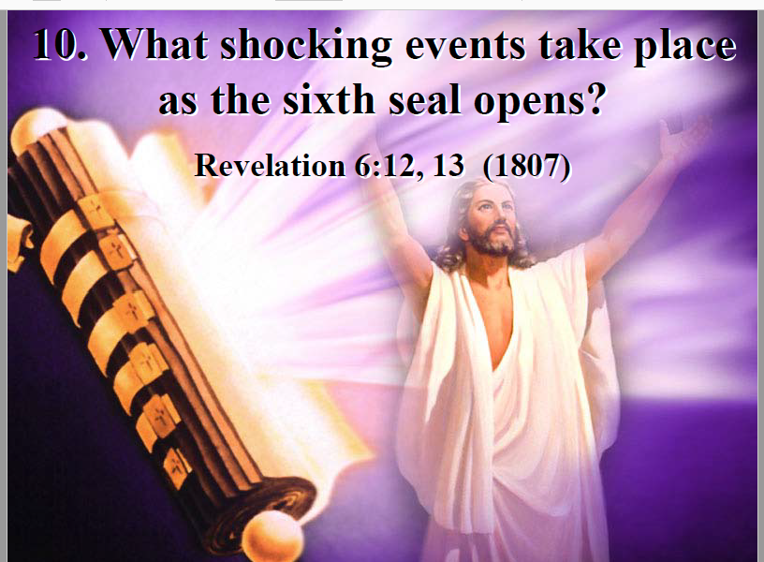

Slide 7
Tonight’s Bible Study:
Mark of the Beast

Slide 8
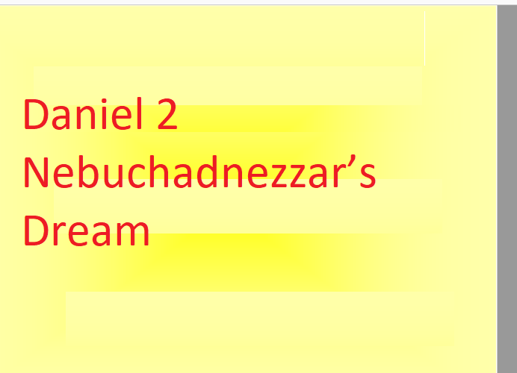

Slide 9
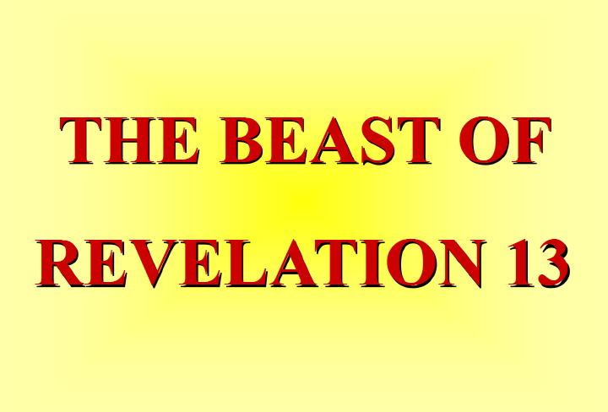

Slide 10
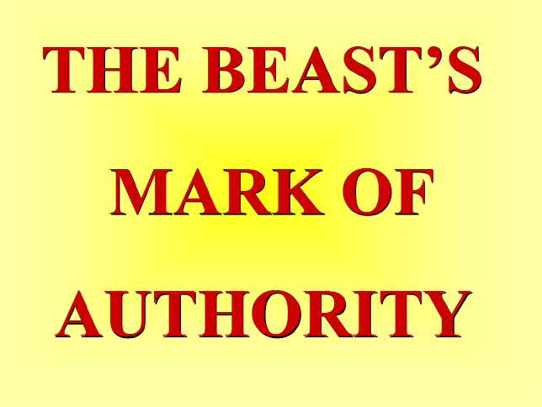

Slide 11
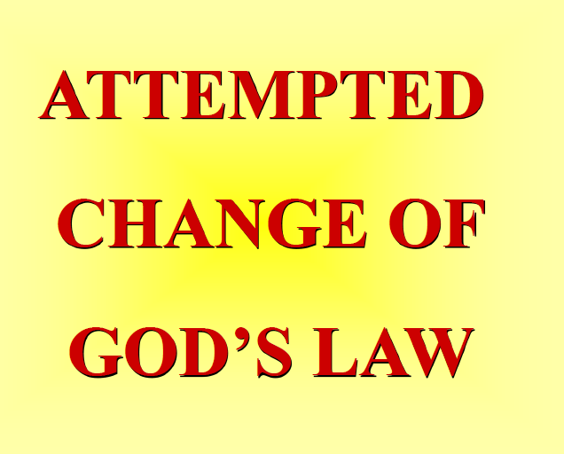

Slide 12


Slide 13


Slide 14
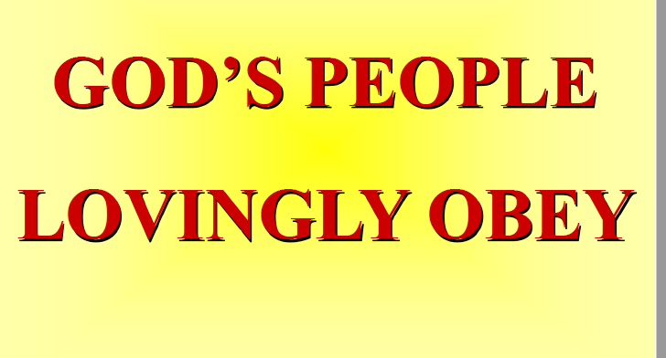

Slide 15
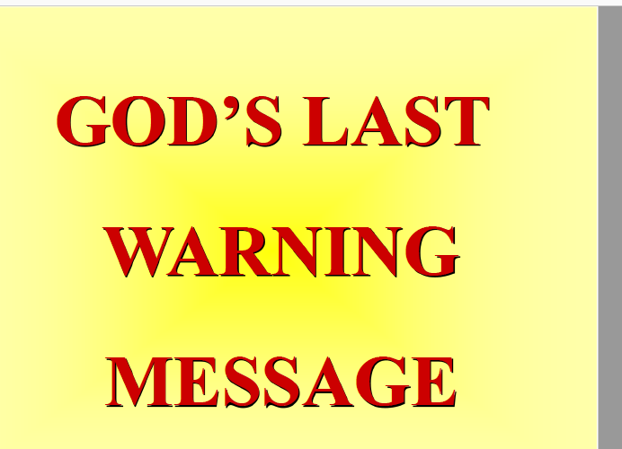

Slide 16
The first lesson for tonight:

Slide 18
Daniel 2:1 (NLT)
One night during the second year of his reign, Nebuchadnezzar had such disturbing dreams that he couldn’t sleep..

Slide 19
Daniel 2:9 (NLT)
“While Your Majesty was sleeping, you dreamed about coming events. He who reveals secrets has shown you what is going to happen.”

Slide 20
Daniel 2:31-35 (NLT)
31 “In your vision, Your Majesty, you saw standing before you a huge, shining statue of a man. It was a frightening sight. 32 The head of the statue was made of fine gold. Its chest and arms were silver, its belly and thighs were bronze,

Slide 21
Daniel 2:31-35 (NLT)
33 its legs were iron, and its feet were a combination of iron and baked clay. 34 As you watched, a rock was cut from a mountain, but not by human hands. It struck the feet of iron and clay, smashing them to bits.

Slide 22
Daniel 2:31-35 (NLT)
35 The whole statue was crushed into small pieces of iron, clay, bronze, silver, and gold. Then the wind blew them away without a trace, like chaff on a threshing floor. But the rock that knocked the statue down became a great mountain that covered the whole earth.

Slide 23
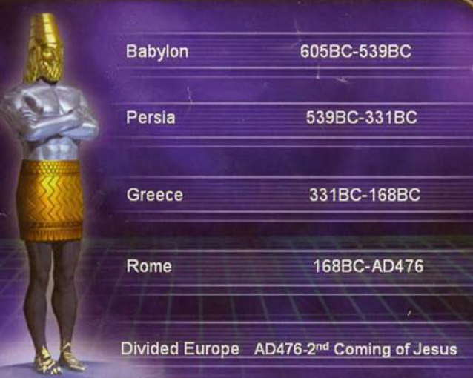

Slide 24
Daniel 2:38 (NLT)
38 He has made you the ruler over all the inhabited world and has put even the wild animals and birds under your control. You are the head of gold.

Slide 25
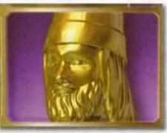


Slide 26
Daniel 2:39 (NLT)
39 “But after your kingdom comes to an end, another kingdom, inferior to yours, will rise to take your place…”

Slide 27
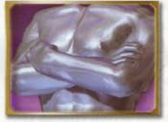


Slide 28
Daniel 2:39 (NLT)
39 “… After that kingdom has fallen, yet a third kingdom, represented by bronze, will rise to rule the world.”

Slide 29
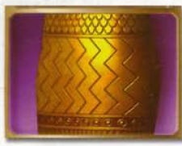


Slide 30
Daniel 2:40 (NLT)
40 Following that kingdom, there will be a fourth one, as strong as iron. That kingdom will smash and crush all previous empires, just as iron smashes and crushes everything it strikes.

Slide 31
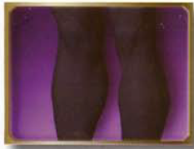

Slide 32
Daniel 2:41-43 (NLT)
41 The feet and toes you saw were a combination of iron and baked clay, showing that this kingdom will be divided. Like iron mixed with clay, it will have some of the strength of iron.

Slide 33
Daniel 2:41-43 (NLT)
42 But while some parts of it will be as strong as iron, other parts will be as weak as clay. 43 This mixture of iron and clay also shows that these kingdoms will try to strengthen themselves by forming alliances …

Slide 34
Daniel 2:41-43 (NLT)
… with each other through intermarriage. But they will not hold together, just as iron and clay do not mix.

Slide 35
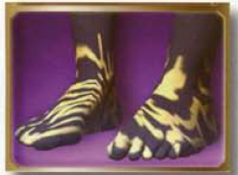

Slide 36
Daniel 2:44-45 (NLT)
44 “During the reigns of those kings, the God of heaven will set up a kingdom that will never be destroyed or conquered. It will crush all these kingdoms into nothingness, and it will stand forever.

Slide 37
Daniel 2:44-45 (NLT)
45 That is the meaning of the rock cut from the mountain, though not by human hands, that crushed to pieces the statue of iron, bronze, clay, silver, and gold. The great God was showing the king what will happen in the future. The dream is true, and its meaning is certain.”

Slide 38
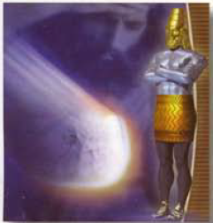

Slide 39
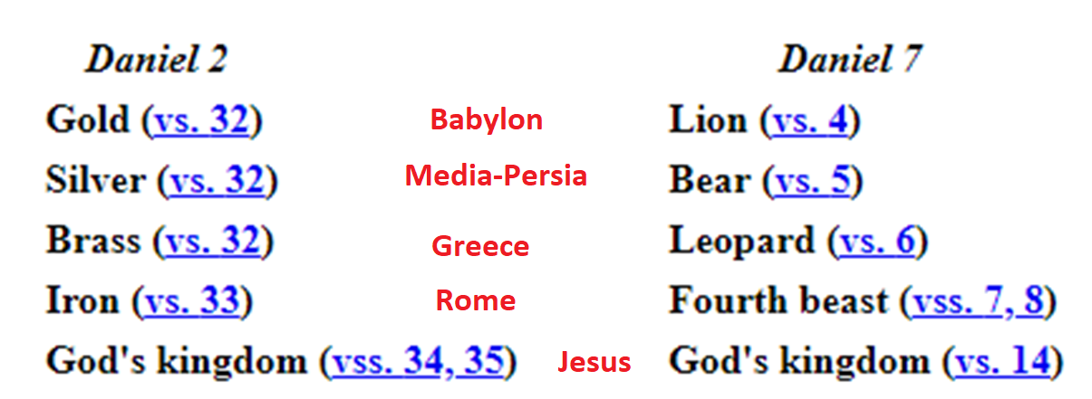

Slide 40
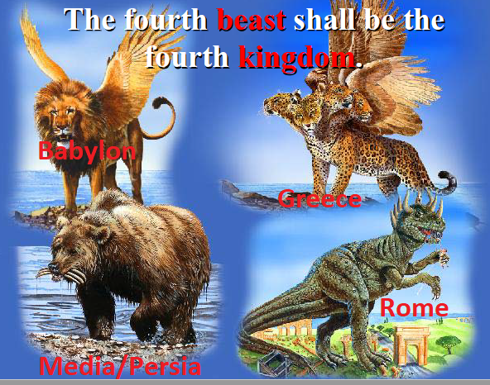

Slide 41
Daniel 7:4-7 (NLT)
4 The first beast was like a lion with eagles’ wings. As I watched, its wings were pulled off, and it was left standing with its two hind feet on the ground, like a human being. And it was given a human mind.

Slide 42
Daniel 7:4-7 (NLT)
5 Then I saw a second beast, and it looked like a bear. It was rearing up on one side, and it had three ribs in its mouth between its teeth. And I heard a voice saying to it, “Get up! Devour the flesh of many people!”

Slide 43
Daniel 7:4-7 (NLT)
6 Then the third of these strange beasts appeared, and it looked like a leopard. It had four bird’s wings on its back, and it had four heads. Great authority was given to this beast.

Slide 44
Daniel 7:4-7 (NLT)
7 Then in my vision that night, I saw a fourth beast—terrifying, dreadful, and very strong. It devoured and crushed its victims with huge iron teeth and trampled their remains beneath its feet. It was different from any of the other beasts, and it had ten horns.

Slide 45
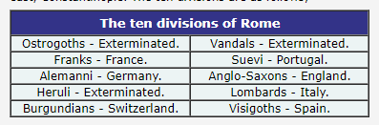
Ten Horns

Slide 46
Daniel 7:8 (NLT)
8 As I was looking at the horns, suddenly another small horn appeared among them. Three of the first horns were torn out by the roots to make room for it. This little horn had eyes like human eyes and a mouth that was boasting arrogantly..

Slide 47
Daniel 7:24-25 (NLT)
24 Its ten horns are ten kings who will rule that empire. Then another king will arise, different from the other ten, who will subdue three of them.

Slide 48
Daniel 7:24-25 (NLT)
25 He will defy the Most High and oppress the holy people of the Most High. He will try to change their sacred festivals and laws, and they will be placed under his control for a time, times, and half a time.

Slide 49
1260 Years
The 1260 days prophecy appears several times in the Bible. What is this time period? It is a very important time period since it was mention over and over again by Daniel and John.
1260 days / 30 = 42 months = 3 ½ years;
1 time + 2 time + ½ time = 3 ½ times.

Slide 50
The Little Horn Identified
Vatican state is a COUNTRY! It's the smallest country there is, which matches this 'little' horn. The next thing we notice is that it rises up 'among' the other horns.

Slide 51
The Little Horn Identified
This little horn came up AFTER the ten, and the little horn came up 'among' them, therefore this little kingdom came up in the same area as the other ten kingdoms.

Slide 52
The Little Horn Identified
This match the Papal Church of Rome. Pagan Rome fell in 476 AD and split into the ten kingdoms of Europe. The Roman Catholic Church came to power in 538 AD (which is after Rome split into the ten kingdoms).

Slide 53
Daniel 7:24-25 (NLT)
25 He will defy the Most High and oppress the holy people of the Most High. He will try to change their sacred festivals and laws, and they will be placed under his control for a time, times, and half a time.

Slide 54
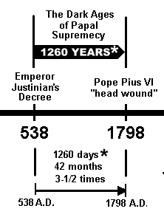
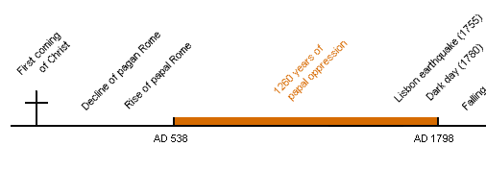
1260 Years

Slide 56
Daniel 7:23 (NLT)
23 Then he said to me, “This fourth beast is the fourth world power that will rule the earth. It will be different from all the others. It will devour the whole world, trampling and crushing everything in its path.

Slide 57
Revelation 17:15 (NLT)
15 Then the angel said to me, “The waters where the prostitute is ruling represent masses of people of every nation and language.

Slide 58
Revelation 13:1-8 (NLT)
1 Then I saw a beast rising up out of the sea. It had seven heads and ten horns, with ten crowns on its horns. And written on each head were names that blasphemed God.

Slide 59
Revelation 13:1-8 (NLT)
2 This beast looked like a leopard, but it had the feet of a bear and the mouth of a lion! And the dragon gave the beast his own power and throne and great authority.

Slide 60
Revelation 13:1-8 (NLT)
3 I saw that one of the heads of the beast seemed wounded beyond recovery—but the fatal wound was healed! The whole world marveled at this miracle and gave allegiance to the beast.

Slide 61
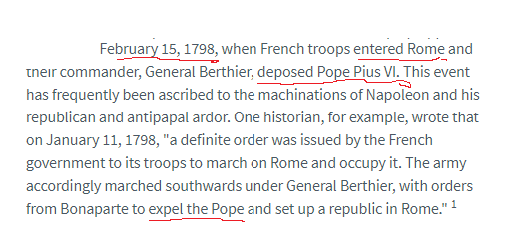
Wounded Beyond Recovery
https://www.ministrymagazine.org/archive/1979/06/napoleon-and-the-pope%E2%80%94what-really-happened-in-1798

Slide 62
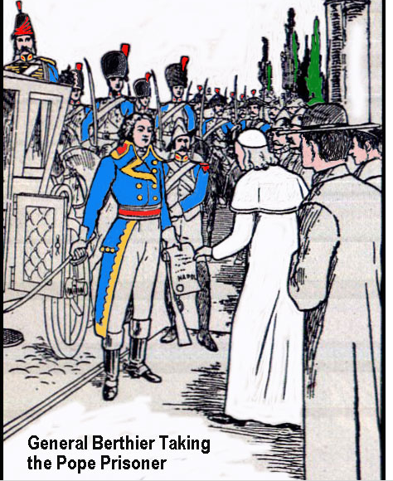
http://www.british-israel.us/66.html

Slide 63
Revelation 13:1-8 (NLT)
4 They worshiped the dragon for giving the beast such power, and they also worshiped the beast. “Who is as great as the beast?” they exclaimed. “Who is able to fight against him?”

Slide 64
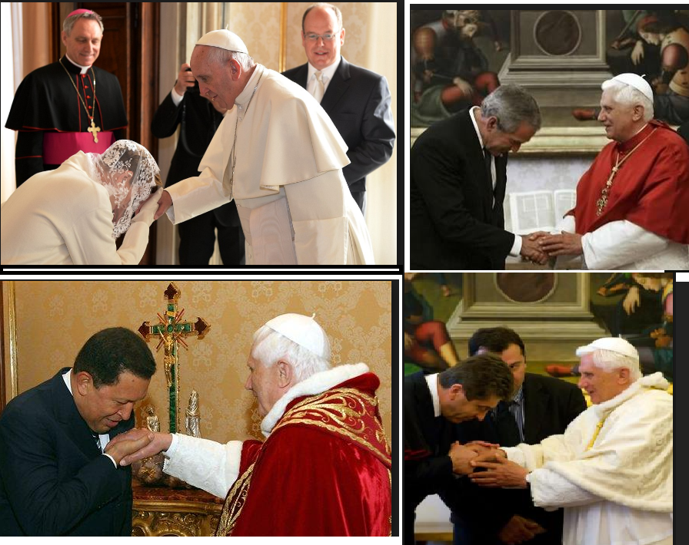

Slide 65
Revelation 13:1-8 (NLT)
5 Then the beast was allowed to speak great blasphemies against God. And he was given authority to do whatever he wanted for forty-two months.

Slide 66
Revelation 13:1-8 (NLT)
6 And he spoke terrible words of blasphemy against God, slandering his name and his dwelling—that is, those who dwell in heaven. 7 And the beast was allowed to wage war against God’s holy people and to

Slide 67
Revelation 13:1-8 (NLT)
conquer them. And he was given authority to rule over every tribe and people and language and nation. 8 And all the people who belong to this world worshiped the beast.

Slide 68
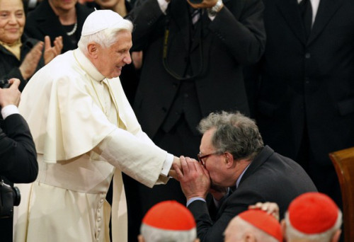

Slide 69
Revelation 13:1-8 (NLT)
They are the ones whose names were not written in the Book of Life that belongs to the Lamb who was slaughtered before the world was made.

Slide 71
Q & A - Catholic Priest
Question: Has the [Catholic] church power to make any alterations in the commandments of God?
Answer: ...Instead of the seventh day, and other festivals appointed by the old law, the church has prescribed the Sundays and holy days to be set apart for God’s worship; and these we are now obliged to keep in consequence of God’s commandment, instead of the ancient Sabbath. (The Catholic Christian Instructed in the Sacraments, Sacrifices, Ceremonies, and Observances of the Church By Way of Question and Answer, RT Rev. Dr. Challoner, p. 204)

Slide 72
Q & A - Catholic Priest
Question: Have you any other way of proving that the Church has power to institute festivals of precept?
Answer: Had she not such power, she could not have done that in which all modern religionists agree with her. She could not have substituted the observance of Sunday the first day of the week, for the observance of Saturday the seventh day, a change for which there is no Scriptural authority. –Rev. Stephen Keenan, (1851), p. 174.

Slide 74
Daniel 7:25 (KJV)
25 And he shall speak great words against the most High, and shall wear out the saints of the most High, and think to change times and laws: and they shall be given into his hand until a time and times and the dividing of time.

Slide 75
Malachi 2:7-9 (NLT)
7 “The words of a priest’s lips should preserve knowledge of God, and people should go to him for instruction, for the priest is the messenger of the Lord of Heaven’s Armies.

Slide 76
Malachi 2:7-9 (NLT)
8 But you priests have left God’s paths. Your instructions have caused many to stumble into sin. You have corrupted the covenant I made with the Levites,” says the Lord of Heaven’s Armies.

Slide 77
Malachi 2:7-9 (NLT)
9 “So I have made you despised and humiliated in the eyes of all the people. For you have not obeyed me but have shown favoritism in the way you carry out my instructions.”

Slide 78
Hosea 8:12 (NLT)
Even though I gave them all my laws, they act as if those laws don’t apply to them.
(e.g. 4th Commandments)

Slide 79
Ezekiel 22:26 (NLT)
26 Your priests have violated my instructions and defiled my holy things. They make no distinction between what is holy and what is not. And they do not teach my people the difference between what is ceremonially clean and unclean. They disregard my Sabbath days so that I am dishonored among them.

Slide 80
Deuteronomy 4:2 (NLT)
2 Do not add to or subtract from these commands I am giving you. Just obey the commands of the Lord your God that I am giving you.

Slide 81
Proverbs 30:5, 6 (NLT)
Every word of God proves true. He is a shield to all who come to him for protection.6 Do not add to his words, or he may rebuke you and expose you as a liar.

Slide 82
Proverbs 30:5, 6 (NLT)
17 But that doesn’t mean that the law has lost its force. It is easier for heaven and earth to disappear than for the smallest point of God’s law to be overturned.

Slide 83
Matthew 5:18 (NLT)
18 I tell you the truth, until heaven and earth disappear, not even the smallest detail of God’s law will disappear until its purpose is achieved.

Slide 85
Revelation 13:16 (NLT)
16 He required everyone—small and great, rich and poor, free and slave—to be given a mark on the right hand or on the forehead.

Slide 86
Revelation 14:13 (NLT)
13 And I heard a voice from heaven saying, “Write this down: Blessed are those who die in the Lord from now on. Yes, says the Spirit, they are blessed indeed, for they will rest from their hard work; for their good deeds follow them!”

Slide 87
Revelation 7:1-3 (NLT)
Then I saw four angels standing at the four corners of the earth, holding back the four winds so they did not blow on the earth or the sea, or even on any tree.

Slide 88
Revelation 7:1-3 (NLT)
2 And I saw another angel coming up from the east, carrying the seal of the living God. And he shouted to those four angels, who had been given power to harm land and sea,

Slide 89
Revelation 7:1-3 (NLT)
3 “Wait! Don’t harm the land or the sea or the trees until we have placed the seal of God on the foreheads of his servants.”

Slide 90
Revelation 14:9-10 (NLT)
9 Then a third angel followed them, shouting, “Anyone who worships the beast and his statue or who accepts his mark on the forehead or on the hand...

Slide 91
Revelation 14:9-10 (NLT)
10 must drink the wine of God’s anger. It has been poured full strength into God’s cup of wrath. And they will be tormented with fire and burning sulfur in the presence of the holy angels and the Lamb.

Slide 93
Romans 6:16 (NLT)
16 Don’t you realize that you become the slave of whatever you choose to obey? You can be a slave to sin, which leads to death, or you can choose to obey God, which leads to righteous living.

Slide 94
Matthew 12:30 (NLT)
30 “Anyone who isn’t with me opposes me, and anyone who isn’t working with me is actually working against me.

Slide 95
Revelation 13:11 (NLT)
11 Then I saw another beast come up out of the earth. He had two horns like those of a lamb, but he spoke with the voice of a dragon.

Slide 96
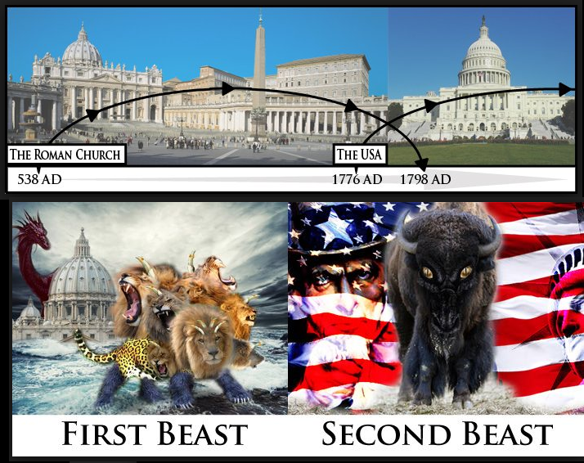

Slide 97
Revelation 13:12 (NLT)
12 He exercised all the authority of the first beast. And he required all the earth and its people to worship the first beast, whose fatal wound had been healed.

Slide 98
Revelation 13:16 (NLT)
16 He required everyone—small and great, rich and poor, free and slave—to be given a mark on the right hand or on the forehead.

Slide 99
Revelation 13:13-14 (NLT)
13 He did astounding miracles, even making fire flash down to earth from the sky while everyone was watching. 14 And with all the miracles he was allowed to perform on behalf of the first beast, …

Slide 100
Revelation 13:13-14 (NLT)
… he deceived all the people who belong to this world. He ordered the people to make a great statue of the first beast, who was fatally wounded and then came back to life.

Slide 101
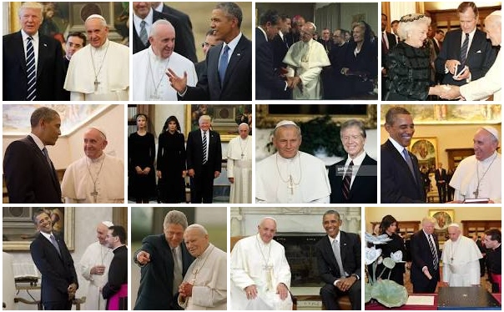
Papacy Power – 1st Beast
America’s Power – 2nd Beast

Slide 102
Revelation 13:13-14 (NLT)
… he deceived all the people who belong to this world. He ordered the people to make a great statue of the first beast, who was fatally wounded and then came back to life.

Slide 104
Acts 5:29 (NLT)
29 But Peter and the apostles replied, “We must obey God rather than any human authority.

Slide 105
Revelation 14:12 (NLT)
12 This means that God’s holy people must endure persecution patiently, obeying his commands and maintaining their faith in Jesus.

Slide 107
Revelation 14:6-12 (NLT)
6 And I saw another angel flying through the sky, carrying the eternal Good News to proclaim to the people who belong to this world—to every nation, tribe, language, and people.

Slide 108
Revelation 14:6-12 (NLT)
7 “Fear God,” he shouted. “Give glory to him. For the time has come when he will sit as judge. Worship him who made the heavens, the earth, the sea, and all the springs of water.”

Slide 109
Revelation 14:6-12 (NLT)
8 Then another angel followed him through the sky, shouting, “Babylon is fallen—that great city is fallen—because she made all the nations of the world drink the wine of her passionate immorality.”

Slide 110
Revelation 14:6-12 (NLT)
9 Then a third angel followed them, shouting, “Anyone who worships the beast and his statue or who accepts his mark on the forehead or on the hand..

Slide 111
Revelation 14:6-12 (NLT)
10 must drink the wine of God’s anger. It has been poured full strength into God’s cup of wrath. And they will be tormented with fire and burning sulfur in the presence of the holy angels and the Lamb.

Slide 112
Revelation 14:6-12 (NLT)
11 The smoke of their torment will rise forever and ever, and they will have no relief day or night, for they have worshiped the beast and his statue and have accepted the mark of his name.”

Slide 113
Revelation 14:6-12 (NLT)
12 This means that God’s holy people must endure persecution patiently, obeying his commands and maintaining their faith in Jesus.

Slide 114
Matthew 11:28-30 (NLT)
28 Then Jesus said, “Come to me, all of you who are weary and carry heavy burdens, and I will give you rest. 29 Take my yoke upon you. Let me teach you, because I am humble and gentle at heart, …

Slide 115
Matthew 11:28-30 (NLT)
… and you will find rest for your souls. 30 For my yoke is easy to bear, and the burden I give you is light.”

Slide 116
Revelation 3:20 (NLT)
20 “Look! I stand at the door and knock. If you hear my voice and open the door, I will come in, and we will share a meal together as friends.

Slide 117
END -
I am ready to answer any question you may have.

Slide 118
Let us Pray to close the Bible study.

Slide 119
Don’t Be Afraid to Follow Jesus!
“If you love Him, keep His commandments”

