Slide 1
The study will begin at 7:30 PM
THE BOOK OF REVELATION
BIBLE STUDY

Slide 2
Let us Pray and then start the Bible study..

Slide 3
Let us start the Bible study..

Slide 4
Last Week Bible Study, we looked at:
Revelation Proclaims
God’s Judgment

Slide 5
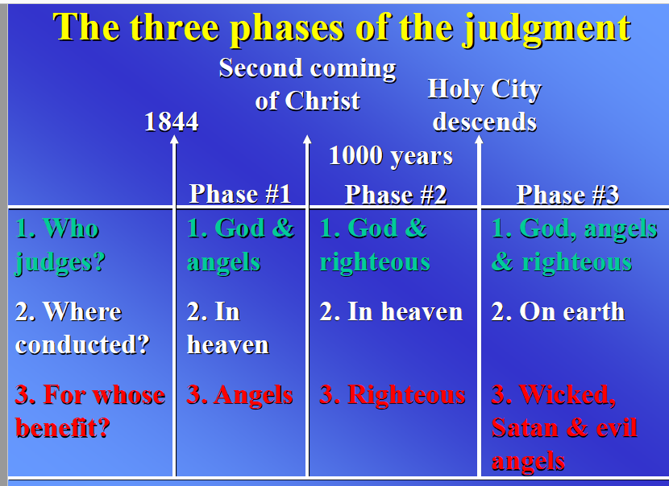

Slide 6
Tonight’s Bible Study:
Modern prophets and visions

Slide 7
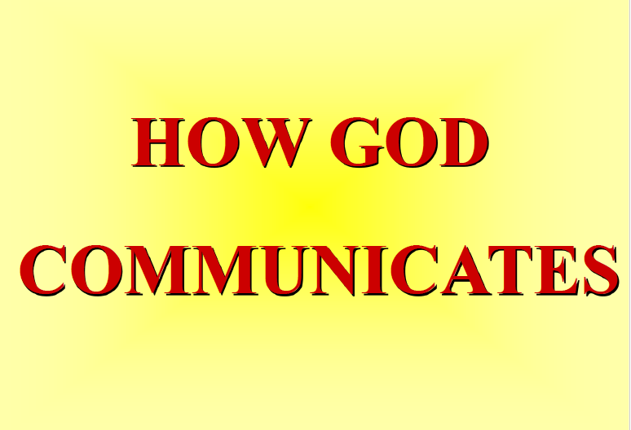

Slide 8


Slide 9


Slide 10
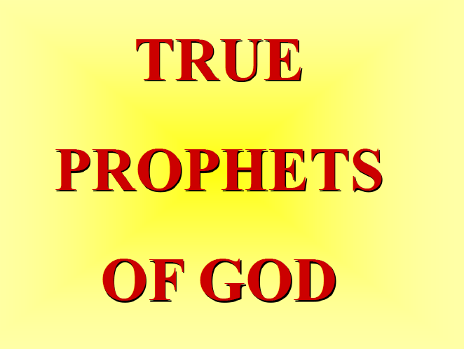

Slide 11
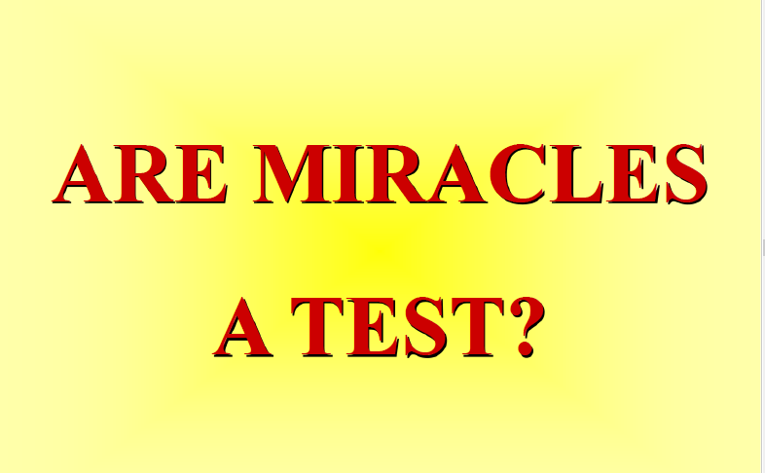

Slide 12
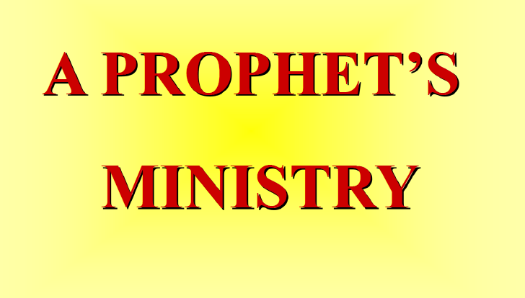

Slide 13
The First Lesson for Tonight:

Slide 15
Revelation 1:1-4. (NLT)
This is a revelation from Jesus Christ, which God gave him to show his servants the events that must soon take place. He sent an angel to present this revelation to his servant John,

Slide 16
Revelation 1:1-4. (NLT)
2 who faithfully reported everything he saw. This is his report of the word of God and the testimony of Jesus Christ. 3 God blesses the one who reads the words of this prophecy to the church, and he

Slide 17
Revelation 1:1-4. (NLT)
blesses all who listen to its message and obey what it says, for the time is near. John’s Greeting to the Seven Churches 4 This letter is from John to the seven churches in the province of Asia. Grace and peace to

Slide 18
Revelation 1:1-4. (NLT)
you from the one who is, who always was, and who is still to come; from the sevenfold Spirit before his throne;

Slide 19
Amos 3:7. (NLT)
7 Indeed, the Sovereign Lord never does anything until he reveals his plans to his servants the prophets.

Slide 20
2 Peter 1:21. (NLT)
21 or from human initiative. No, those prophets were moved by the Holy Spirit, and they spoke from God.

Slide 21
Judges 4:4-5. (NLT)
4 Deborah, the wife of Lappidoth, was a prophet who was judging Israel at that time. 5 She would sit under the Palm of Deborah, between Ramah and Bethel in the hill country of Ephraim, and the Israelites would go to her for judgment.

Slide 22
Joel 2:28-31. (NLT)
28 “Then, after doing all those things, I will pour out my Spirit upon all people. Your sons and daughters will prophesy. Your old men will dream dreams, and your young men will see visions.

Slide 23
Joel 2:28-31. (NLT)
29 In those days I will pour out my Spirit even on servants—men and women alike. 30 And I will cause wonders in the heavens and on the earth— blood and fire and columns of smoke.

Slide 24
Joel 2:28-31. (NLT)
31 The sun will become dark, and the moon will turn blood red before that great and terrible day of the Lord arrives.

Slide 26
Ephesians 4:7, 8. (NLT)
7 However, he has given each one of us a special gift through the generosity of Christ. 8 That is why the Scriptures say, “When he ascended to the heights, he led a crowd of captives and gave gifts to his people.”

Slide 27
Ephesians 4:11. (NLT)
11 Now these are the gifts Christ gave to the church: the apostles, the prophets, the evangelists, and the pastors and teachers.

Slide 28
Ephesians 4:12. (NLT)
12 Their responsibility is to equip God’s people to do his work and build up the church, the body of Christ.

Slide 29
Ephesians 4:13. (NLT)
13 This will continue until we all come to such unity in our faith and knowledge of God’s Son that we will be mature in the Lord, measuring up to the full and complete standard of Christ.

Slide 31
Ephesians 4:14. (NLT)
14 Then we will no longer be immature like children. We won’t be tossed and blown about by every wind of new teaching. We will not be influenced when people try to trick us with lies so clever they sound like the truth.

Slide 32
1 Corinthians 1:6. (NLT)
6 This confirms that what I told you about Christ is true.

Slide 33
Revelation 12:17 . (NLT)
17 And the dragon was angry at the woman and declared war against the rest of her children—all who keep God’s commandments and maintain their testimony for Jesus.

Slide 34
Revelation 19:10. (NLT)
10 Then I fell down at his feet to worship him, but he said, “No, don’t worship me. I am a servant of God, just like you and your brothers and sisters who testify about their faith in Jesus. Worship only God. For the essence of prophecy is to give a clear witness for Jesus.”

Slide 36
1 Thessalonians 5:20-21. (NLT)
20 Do not scoff at prophecies, 21 but test everything that is said. Hold on to what is good.

Slide 37
Isaiah 8:19-20. (NLT)
19 Someone may say to you, “Let’s ask the mediums and those who consult the spirits of the dead. With their whisperings and mutterings, they will tell us what to do.” But shouldn’t people ask God for…

Slide 38
Isaiah 8:19-20. (NLT)
guidance? Should the living seek guidance from the dead? 20 Look to God’s instructions and teachings! People who contradict his word are completely in the dark.

Slide 39
2 Peter 1:20-21. (NLT)
20 Above all, you must realize that no prophecy in Scripture ever came from the prophet’s own understanding, 21 or from human initiative. No, those prophets were moved by the Holy Spirit, and they spoke from God.

Slide 40
Isaiah 58:1. (NLT)
“Shout with the voice of a trumpet blast. Shout aloud! Don’t be timid. Tell my people Israel of their sins!

Slide 41
Isaiah 24:20-21. (NLT)
The earth staggers like a drunk. It trembles like a tent in a storm. It falls and will not rise again, for the guilt of its rebellion is very heavy. 21 In that day the Lord will punish the gods in the heavens and the proud rulers of the nations on earth.

Slide 42
Revelation 14:6-7. (NLT)
6 And I saw another angel flying through the sky, carrying the eternal Good News to proclaim to the people who belong to this world—to every nation, tribe, language, and people.

Slide 43
Revelation 14:6-7. (NLT)
7 “Fear God,” he shouted. “Give glory to him. For the time has come when he will sit as judge. Worship him who made the heavens, the earth, the sea, and all the springs of water.”

Slide 44
1 Corinthians 14:3. (NLT)
3 But one who prophesies strengthens others, encourages them, and comforts them.

Slide 45
1 John 4:1-3. (NLT)
Dear friends, do not believe everyone who claims to speak by the Spirit. You must test them to see if the spirit they have comes from God. For there are many false prophets in the world.

Slide 46
1 John 4:1-3. (NLT)
2 This is how we know if they have the Spirit of God: If a person claiming to be a prophet acknowledges that Jesus Christ came in a real body, that person has the Spirit of God.

Slide 47
1 John 4:1-3. (NLT)
3 But if someone claims to be a prophet and does not acknowledge the truth about Jesus, that person is not from God. Such a person has the spirit of the Antichrist, which you heard is coming into the world and indeed is already here.

Slide 48
Matthew 7:15-20. (NLT)
15 “Beware of false prophets who come disguised as harmless sheep but are really vicious wolves. 16 You can identify them by their fruit, that is, by the way they act. Can you pick grapes from thornbushes, or figs from thistles?

Slide 49
Matthew 7:15-20. (NLT)
17 A good tree produces good fruit, and a bad tree produces bad fruit. 18 A good tree can’t produce bad fruit, and a bad tree can’t produce good fruit. 19 So every tree that does not produce good fruit is …

Slide 50
Matthew 7:15-20. (NLT)
.. is chopped down and thrown into the fire. 20 Yes, just as you can identify a tree by its fruit, so you can identify people by their actions.

Slide 51
Deuteronomy 18:9-12. (NLT)
9 “When you enter the land the Lord your God is giving you, be very careful not to imitate the detestable customs of the nations living there. 10 For example, never sacrifice your son or daughter as a burnt …

Slide 52
Deuteronomy 18:9-12. (NLT)
… offering. And do not let your people practice fortune-telling, or use sorcery, or interpret omens, or engage in witchcraft, 11 or cast spells, or function as mediums or psychics, or call forth the spirits …

Slide 53
Deuteronomy 18:9-12. (NLT)
… of the dead. 12 Anyone who does these things is detestable to the Lord. It is because the other nations have done these detestable things that the Lord your God will drive them out ahead of you.

Slide 54
1 Corinthians 12:1. (NLT)
Now, dear brothers and sisters, regarding your question about the special abilities the Spirit gives us. I don’t want you to misunderstand this.

Slide 55
1 Corinthians 12:11. (NLT)
It is the one and only Spirit who distributes all these gifts. He alone decides which gift each person should have.

Slide 56
1 Corinthians 12:12-18. (NLT)
12 The human body has many parts, but the many parts make up one whole body. So it is with the body of Christ. 13 Some of us are Jews, some are Gentiles, some are slaves, and some are free.

Slide 57
1 Corinthians 12:12-18. (NLT)
But we have all been baptized into one body by one Spirit, and we all share the same Spirit. 14 Yes, the body has many different parts, not just one part. 15 If the foot says, “I am not a part of the body because

Slide 58
1 Corinthians 12:12-18. (NLT)
I am not an eye,” would that make it any less a part of the body? 17 If the whole body were an eye, how would you hear? Or if your whole body were an ear, how would you smell anything?

Slide 59
1 Corinthians 12:12-18. (NLT)
18 But our bodies have many parts, and God has put each part just where he wants it.

Slide 60
1 Samuel 9:9. (NLT)
9 In those days if people wanted a message from God, they would say, “Let’s go and ask the seer,” for prophets used to be called seers.

Slide 61
Matthew 15:14. (NLT)
14 so ignore them. They are blind guides leading the blind, and if one blind person guides another, they will both fall into a ditch.”

Slide 63
Deuteronomy 13:1-5. (NLT)
“Suppose there are prophets among you or those who dream dreams about the future, and they promise you signs or miracles, 2 and the predicted signs or miracles occur. If they then say,

Slide 64
Deuteronomy 13:1-5. (NLT)
‘Come, let us worship other gods’—gods you have not known before— 3 do not listen to them. The Lord your God is testing you to see if you truly love him with all your heart and soul. 4 Serve only the Lord …

Slide 65
Deuteronomy 13:1-5. (NLT)
your God and fear him alone. Obey his commands, listen to his voice, and cling to him. 5 The false prophets or visionaries who try to lead you astray must be put to death, for they encourage rebellion

Slide 66
Deuteronomy 13:1-5. (NLT)
rebellion against the Lord your God, who redeemed you from slavery and brought you out of the land of Egypt. Since they try to lead you astray from the way the Lord your God commanded you to live,

Slide 67
Deuteronomy 13:1-5. (NLT)
you must put them to death. In this way you will purge the evil from among you.

Slide 68
Revelation 16:14. (NLT)
14 They are demonic spirits who work miracles and go out to all the rulers of the world to gather them for battle against the Lord on that great judgment day of God the Almighty.

Slide 69
Numbers 12:6. (NLT)
6 And the Lord said to them, “Now listen to what I say: “If there were prophets among you, I, the Lord, would reveal myself in visions. I would speak to them in dreams.

Slide 70
Numbers 12:8. (NLT)
I speak to him face to face, clearly, and not in riddles! He sees the Lord as he is. So why were you not afraid to criticize my servant Moses?”

Slide 71
Daniel 10:8. (NLT)
8 So I was left there all alone to see this amazing vision. My strength left me, my face grew deathly pale, and I felt very weak.

Slide 72
Daniel 10:18-19. (NLT)
18 Then the one who looked like a man touched me again, and I felt my strength returning. 19 “Don’t be afraid,” he said, “for you are very precious to God. Peace! Be encouraged! Be strong!”

Slide 73
Daniel 10:18-19. (NLT)
19 As he spoke these words to me, I suddenly felt stronger and said to him, “Please speak to me, my lord, for you have strengthened me.”

Slide 74
Daniel 10:17. (NLT)
17 How can someone like me, your servant, talk to you, my lord? My strength is gone, and I can hardly breathe.”

Slide 75
Daniel 10:16. (NLT)
16 Then the one who looked like a man touched my lips, and I opened my mouth and began to speak. I said to the one standing in front of me, “I am filled with anguish because of the vision I have seen, my lord, and I am very weak.

Slide 76
Daniel 10:5-8. (NLT)
5 I looked up and saw a man dressed in linen clothing, with a belt of pure gold around his waist. 6 His body looked like a precious gem. His face flashed like lightning, and his eyes flamed like torches.

Slide 77
Daniel 10:5-8. (NLT)
His arms and feet shone like polished bronze, and his voice roared like a vast multitude of people. 7 Only I, Daniel, saw this vision. The men with me saw nothing, but they were suddenly …

Slide 78
Daniel 10:5-8. (NLT)
… terrified and ran away to hide. 8 So I was left there all alone to see this amazing vision. My strength left me, my face grew deathly pale, and I felt very weak.

Slide 79
2 Corinthians 12:2-4. (NLT)
was caught up to the third heaven fourteen years ago. Whether I was in my body or out of my body, I don’t know—only God knows. 3 Yes, only God knows whether I was in my body or outside my body.

Slide 80
2 Corinthians 12:2-4. (NLT)
But I do know 4 that I was caught up to paradise and heard things so astounding that they cannot be expressed in words, things no human is allowed to tell.

Slide 81
Numbers 24:4. (NLT)
the message of one who hears the words of God, who sees a vision from the Almighty, who bows down with eyes wide open:

Slide 82
2 Chronicles 20:20. (NLT)
20 Early the next morning the army of Judah went out into the wilderness of Tekoa. On the way Jehoshaphat stopped and said, “Listen to me, all you people of Judah and Jerusalem! Believe in the Lord your God, and you will be able to stand firm. Believe in his prophets, and you will succeed.”

Slide 84
1 Corinthians 14:22. (NLT)
22 So you see that speaking in tongues is a sign, not for believers, but for unbelievers. Prophecy, however, is for the benefit of believers, not unbelievers.

Slide 85
Revelation 12:17. (NLT)
17 And the dragon was angry at the woman and declared war against the rest of her children—all who keep God’s commandments and maintain their testimony for Jesus.

Slide 86
Matthew 24:24. (NLT)
24 For false messiahs and false prophets will rise up and perform great signs and wonders so as to deceive, if possible, even God’s chosen ones.

Slide 87
Deuteronomy 18:9-12. (NLT)
9 “When you enter the land the Lord your God is giving you, be very careful not to imitate the detestable customs of the nations living there. 10 For example, never sacrifice your son or daughter as a burnt …

Slide 88
Deuteronomy 18:9-12. (NLT)
offering. And do not let your people practice fortune-telling, or use sorcery, or interpret omens, or engage in witchcraft, 11 or cast spells, or function as mediums or psychics, or call forth the spirits …

Slide 89
Deuteronomy 18:9-12. (NLT)
… of the dead. 12 Anyone who does these things is detestable to the Lord. It is because the other nations have done these detestable things that the Lord your God will drive them out ahead of you.

Slide 90
Revelation 22:15. (NLT)
15 Outside the city are the dogs—the sorcerers, the sexually immoral, the murderers, the idol worshipers, and all who love to live a lie.

Slide 91
Revelation 21:8. (NLT)
8 “But cowards, unbelievers, the corrupt, murderers, the immoral, those who practice witchcraft, idol worshipers, and all liars—their fate is in the fiery lake of burning sulfur. This is the second death.”

Slide 92
Luke 7:28-30. (NLT)
28 I tell you, of all who have ever lived, none is greater than John. Yet even the least person in the Kingdom of God is greater than he is!” 29 When they heard this, all the people—even the tax collectors—

Slide 93
Luke 7:28-30. (NLT)
agreed that God’s way was right, for they had been baptized by John. 30 But the Pharisees and experts in religious law rejected God’s plan for them, for they had refused John’s baptism.

Slide 94
1 Samuel 9:9. (NLT)
9 In those days if people wanted a message from God, they would say, “Let’s go and ask the seer,” for prophets used to be called seers.

Slide 95
Ezekiel 4:1. (NLT)
“And now, son of man, take a large clay brick and set it down in front of you. Then draw a map of the city of Jerusalem on it.

Slide 96
Ezekiel 5:1. (NLT)
“Son of man, take a sharp sword and use it as a razor to shave your head and beard. Use a scale to weigh the hair into three equal parts.

Slide 97
2 Chronicles 16:7. (NLT)
7 At that time Hanani the seer came to King Asa and told him, “Because you have put your trust in the king of Aram instead of in the Lord your God, you missed your chance to destroy the army of the king of Aram.

Slide 98
Malachi 3:1. (NLT)
“Look! I am sending my messenger, and he will prepare the way before me. Then the Lord you are seeking will suddenly come to his Temple. The messenger of the covenant, whom you look for so eagerly, is surely coming,” says the Lord of Heaven’s Armies.

Slide 99
Revelation 19:10. (NLT)
10 Then I fell down at his feet to worship him, but he said, “No, don’t worship me. I am a servant of God, just like you and your brothers and sisters who testify about their faith in Jesus. Worship only God. For the essence of prophecy is to give a clear witness for Jesus.”

Slide 100
Revelation 22:9. (NLT)
9 But he said, “No, don’t worship me. I am a servant of God, just like you and your brothers the prophets, as well as all who obey what is written in this book. Worship only God!”

Slide 101
1 Chronicles 6:49. (NLT)
49 Only Aaron and his descendants served as priests. They presented the offerings on the altar of burnt offering and the altar of incense, and they performed all the other duties related to the Most Holy Place.

Slide 102
1 Chronicles 6:49. (NLT)
They made atonement for Israel by doing everything that Moses, the servant of God, had commanded them.

Slide 103
2 Kings 4:21-22. (NLT)
21 She carried him up and laid him on the bed of the man of God, then shut the door and left him there. 22 She sent a message to her husband: “Send one of the servants and a donkey so that I can hurry to the man of God and come right back.”

Slide 104
Ezekiel 3:17. (NLT)
17 “Son of man, I have appointed you as a watchman for Israel. Whenever you receive a message from me, warn people immediately.

Slide 105
Matthew 3:3. (NLT)
The prophet Isaiah was speaking about John when he said, “He is a voice shouting in the wilderness, ‘Prepare the way for the Lord’s coming! Clear the road for him!’”

Slide 106
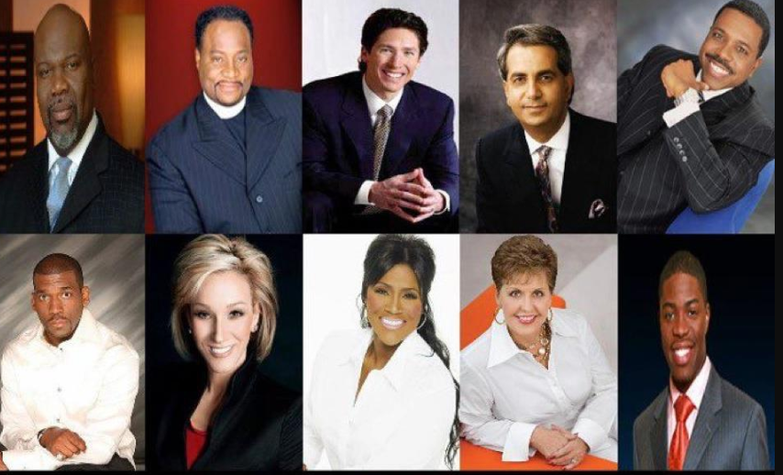
American Preachers

Slide 107
Test of a True Prophet of God
a. Prophesies as he/she is moved by the Holy Spirit, not by man’s will
b. Doesn’t give his/her own interpretation of prophecy.
c. Points out sins of people against God.
d. Warns of coming judgment.
e. Edifies, exhorts, comforts, in religious matters.
f. Recognizes the incarnation and deity of Jesus.
g. Works and lives in harmony with the Bible.
h. Will not be: astrologer, magician, witch, medium or clairvoyant.

Slide 108
Ellen G. White
Seventh-day Adventists believe that Mrs. White was more than a gifted writer; they believe she was appointed by God as a special messenger to draw the world's attention to the Holy Scriptures and help prepare people for Christ's second advent. From the time she was 17 years old until she died 70 years later, God gave her approximately 2,000 visions and dreams.

Slide 109
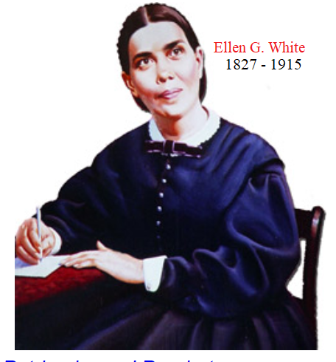

Slide 110
Ellen G. White
She was a woman of remarkable spiritual gifts who lived most of her life during the nineteenth century (1827-1915), yet through her writings she is still making a …

Slide 111
Ellen G. White
… revolutionary impact on millions of people around the world. During her lifetime she wrote more than 5,000 periodical articles and 40 books; but today, including ….

Slide 112
Ellen G. White
… compilations from her 50,000 pages of manuscript, more than 100 titles are available in English. She is the most translated woman writer in the entire history of literature, …

Slide 113
Ellen G. White
… and the most translated American author of either gender. Her writings cover a broad range of subjects, including religion, education, social relationships, evangelism, prophecy, publishing, nutrition, and management.

Slide 114

Ellen G. White

Slide 115
Seventh-day Adventist Church Movements
The denomination grew out of the Millerite movement in the United States during the mid-19th century and was formally established in 1863. Among its founders was Ellen G. White, whose extensive writings are still held in high regard by the church.

Slide 116
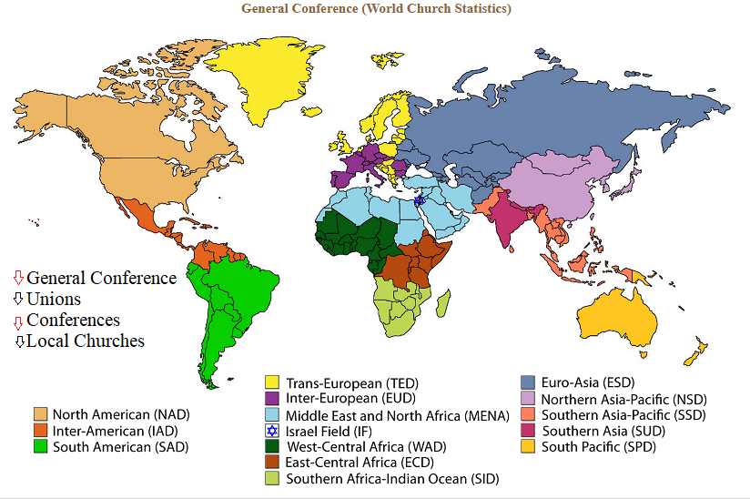
Impact on the World Since 1863

Slide 117
END -
I am ready to answer any question you may have.

Slide 118
Let us Pray to close the Bible study.

Slide 119
Don’t Be Afraid to Follow Jesus!
“If you love Him, keep His commandments”

