Slide 1
The study will begin at 7:30 PM
THE BOOK OF REVELATION
BIBLE STUDY

Slide 2
Let us Pray and then start the Bible study..

Slide 3
Let us start the Bible study..

Slide 4
Last Week Bible Study, we looked at:
Two Witnesses
of Revelation 11

Slide 5
The Two Witnesses
The two witnesses represent the Scriptures of the Old and the New Testament. Both are important testimonies to the origin and perpetuity of the law of God. Both are witnesses also to the plan of salvation. The types, sacrifices, and prophecies of the Old Testament point forward to a Saviour to come. The Gospels and Epistles of the New Testament tell of a Saviour who has come in the exact manner foretold by type and prophecy.
http://www.whiteestate.org/books/gc/gc15.html

Slide 6
The Bible and the French Revolution
The war against the Bible, carried forward for so many centuries in France, culminated in the scenes of the Revolution. That terrible out breaking was but the legitimate result of Rome's suppression of the Scriptures….

Slide 7
Tonight’s Bible Study:
Revelation’s Keys of Death

Slide 8
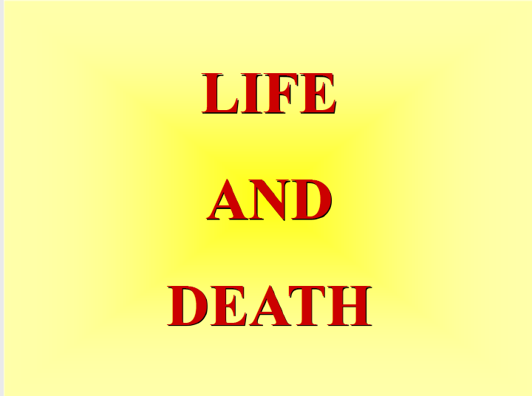

Slide 9
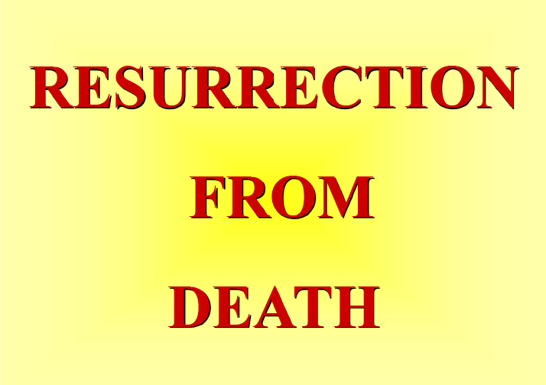

Slide 10
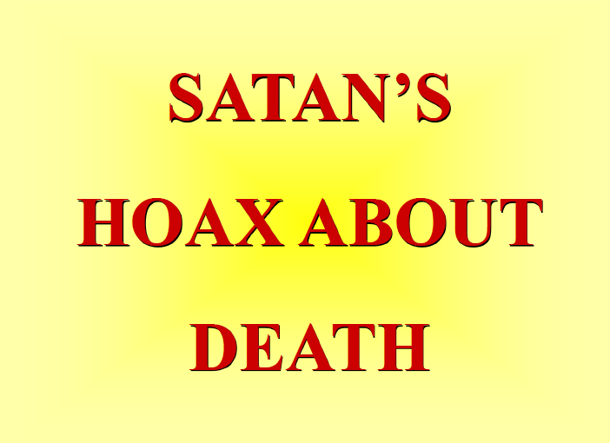

Slide 11


Slide 12
The first lesson for tonight:

Slide 14
Revelation 1:18 (NLT)
I am the living one. I died, but look—I am alive forever and ever! And I hold the keys of death and the grave.

Slide 15
Revelation 1:5 (NLT)
and from Jesus Christ. He is the faithful witness to these things, the first to rise from the dead, and the ruler of all the kings of the world. All glory to him who loves us and has freed us from our sins by shedding his blood for us.

Slide 16
1 Corinthians 15:20-22 (NLT)
But in fact, Christ has been raised from the dead. He is the first of a great harvest of all who have died.

Slide 17
1 Corinthians 15:20-22 (NLT)
21 So you see, just as death came into the world through a man, now the resurrection from the dead has begun through another man.

Slide 18
1 Corinthians 15:20-22 (NLT)
22 Just as everyone dies because we all belong to Adam, everyone who belongs to Christ will be given new life.

Slide 19
Genesis 2:7 (NLT)
Then the Lord God formed the man from the dust of the ground. He breathed the breath of life into the man’s nostrils, and the man became a living person.

Slide 20
Ecclesiastes 12:7 (NLT)
For then the dust will return to the earth, and the spirit will return to God who gave it.

Slide 21
James 2:26 (NLT)
Just as the body is dead without breath, so also faith is dead without good works.

Slide 22
Genesis 2:7 (NLT)
Then the Lord God formed the man from the dust of the ground. He breathed the breath of life into the man’s nostrils, and the man became a living person.

Slide 23
Ezekiel 18:4 (NLT)
For all people are mine to judge—both parents and children alike. And this is my rule: The person who sins is the one who will die.

Slide 24
Ezekiel 18:20 (NLT)
The person who sins is the one who will die. The child will not be punished for the parent’s sins, and the parent will not be punished for the child’s sins. Righteous people will be rewarded for their own righteous behavior, and wicked people will be punished for their own wickedness.

Slide 25
Ezekiel 18:4 (NLT)
For all people are mine to judge—both parents and children alike. And this is my rule: The person who sins is the one who will die.

Slide 26
Psalm 104:29-30 (NLT)
29 But if you turn away from them, they panic. When you take away their breath, they die and turn again to dust. 30 When you give them your breath, life is created, and you renew the face of the earth.

Slide 27
Job 21:32 (NLT)
When they are carried to the grave, an honor guard keeps watch at their tomb.

Slide 28
John 5:28-29 (NLT)
28 Don’t be so surprised! Indeed, the time is coming when all the dead in their graves will hear the voice of God’s Son, 29 and they will rise again. Those who have done good will rise to experience eternal life, and those who have continued in evil will rise to experience judgment.

Slide 29
Psalm 146:4 (NLT)
When they breathe their last, they return to the earth, and all their plans die with them.

Slide 30
Job 14:12 (NLT)
people are laid to rest and do not rise again. Until the heavens are no more, they will not wake up nor be roused from their sleep.

Slide 31
Job 14:21 (NLT)
They never know if their children grow up in honor or sink to insignificance.

Slide 32
Ecclesiastes 9:5-6 (NLT)
5 The living at least know they will die, but the dead know nothing. They have no further reward, nor are they remembered. 6 Whatever they did in their lifetime—loving, hating, envying—is all long gone. They no longer play a part in anything here on earth.

Slide 33
Ecclesiastes 9:10 (NLT)
Whatever you do, do well. For when you go to the grave, there will be no work or planning or knowledge or wisdom.

Slide 35
1 Corinthians 15:20, 23 (NLT)
20 But in fact, Christ has been raised from the dead. He is the first of a great harvest of all who have died.

Slide 36
1 Corinthians 15:20, 23 (NLT)
23 But there is an order to this resurrection: Christ was raised as the first of the harvest; then all who belong to Christ will be raised when he comes back.

Slide 37
1 Thessalonians 4:15-17 (NLT)
15 We tell you this directly from the Lord: We who are still living when the Lord returns will not meet him ahead of those who have died

Slide 38
1 Thessalonians 4:15-17 (NLT)
16 For the Lord himself will come down from heaven with a commanding shout, with the voice of the archangel, and with the trumpet call of God. First, the believers who have died will rise from their graves.

Slide 39
1 Thessalonians 4:15-17 (NLT)
17 Then, together with them, we who are still alive and remain on the earth will be caught up in the clouds to meet the Lord in the air. Then we will be with the Lord forever.

Slide 40
John 11:11-14 (NLT)
11 Then he said, “Our friend Lazarus has fallen asleep, but now I will go and wake him up.”12 The disciples said, “Lord, if he is sleeping, he will soon get better!” 13 They thought Jesus meant Lazarus was simply sleeping, but Jesus meant Lazarus had died.14 So he told them plainly, “Lazarus is dead.

Slide 41
1 Timothy 6:15-16 (NLT)
15 For, At just the right time Christ will be revealed from heaven by the blessed and only almighty God, the King of all kings and Lord of all lords. 16 He alone can never die, and he lives in light so brilliant that no human can approach him. No human eye has ever seen him, nor ever will. All honor and power to him forever! Amen.

Slide 42
1 Corinthians 15:51-55 (NLT)
51 But let me reveal to you a wonderful secret. We will not all die, but we will all be transformed! 52 It will happen in a moment, in the blink of an eye, when the last trumpet is blown. …

Slide 43
1 Corinthians 15:51-55 (NLT)
For when the trumpet sounds, those who have died will be raised to live forever. And we who are living will also be transformed. 53 For our dying bodies must be transformed into bodies that will…

Slide 44
1 Corinthians 15:51-55 (NLT)
… never die; our mortal bodies must be transformed into immortal bodies. 54 Then, when our dying bodies have been transformed into bodies that will never die, this Scripture will be fulfilled:

Slide 45
1 Corinthians 15:51-55 (NLT)
“Death is swallowed up in victory. 55 O death, where is your victory? O death, where is your sting?”

Slide 46
1 John 5:12 (NLT)
12 Whoever has the Son has life; whoever does not have God’s Son does not have life.

Slide 47
John 6:54 (NLT)
54 But anyone who eats my flesh and drinks my blood has eternal life, and I will raise that person at the last day.

Slide 49
Genesis 3:4 (NLT)
4 “You won’t die!” the serpent replied to the woman.

Slide 50
Revelation 16:14 (NLT)
14 They are demonic spirits who work miracles and go out to all the rulers of the world to gather them for battle against the Lord on that great judgment day of God the Almighty.

Slide 51
2 Thessalonians 2:9 (NLT)
9 This man will come to do the work of Satan with counterfeit power and signs and miracles.

Slide 52
Revelation 18:2 (NLT)
2 He gave a mighty shout: “Babylon is fallen—that great city is fallen! She has become a home for demons. She is a hideout for every foul spirit, a hideout for every foul vulture and every foul and dreadful animal.

Slide 53
Revelation 18:4-5 (NLT)
4 Then I heard another voice calling from heaven, “Come away from her, my people. Do not take part in her sins, or you will be punished with her. 5 For her sins are piled as high as heaven, and God remembers her evil deeds.

Slide 54
Revelation 16:13-14 (NLT)
13 And I saw three evil spirits that looked like frogs leap from the mouths of the dragon, the beast, and the false prophet. 14 They are demonic spirits who work miracles and go out to all the rulers of the world to gather them for battle against the Lord on that great judgment day of God the Almighty.

Slide 55
Revelation 18:23 (NLT)
23 The light of a lamp will never shine in you again. The happy voices of brides and grooms will never be heard in you again. For your merchants were the greatest in the world, and you deceived the nations with your sorceries.

Slide 56
Psychic Reading

Slide 57
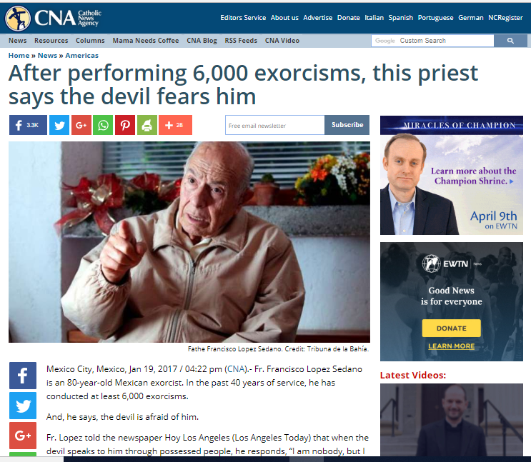

Slide 59
Isaiah 8:19-20 (NLT)
19 Someone may say to you, “Let’s ask the mediums and those who consult the spirits of the dead. With their whisperings and mutterings, they will tell us what to do.” But shouldn’t people ask God for guidance? Should the living seek guidance from the dead? 20 Look to God’s instructions and teachings! People who contradict his word are completely in the dark.

Slide 60
Revelation 22:15 (NLT)
15 Outside the city are the dogs—the sorcerers, the sexually immoral, the murderers, the idol worshipers, and all who love to live a lie.

Slide 61
Galatians 5:19-21 (NLT)
19 When you follow the desires of your sinful nature, the results are very clear: sexual immorality, impurity, lustful pleasures, 20 idolatry, sorcery, hostility, quarreling, jealousy, outbursts of …

Slide 62
Galatians 5:19-21 (NLT)
… anger, selfish ambition, dissension, division, 21 envy, drunkenness, wild parties, and other sins like these. Let me tell you again, as I have before, that anyone living that sort of life will not inherit the Kingdom of God.

Slide 63
Ephesians 5:11 (NLT)
11 Take no part in the worthless deeds of evil and darkness; instead, expose them.

Slide 64
Revelation 14:13 (NLT)
13 And I heard a voice from heaven saying, “Write this down: Blessed are those who die in the Lord from now on. Yes, says the Spirit, they are blessed indeed, for they will rest from their hard work; for their good deeds follow them!”.

Slide 65
Revelation 20:14 (NLT)
14 Then death and the grave were thrown into the lake of fire. This lake of fire is the second death.
(last death – eternal death)

Slide 66
1 Thessalonians 4:16-18 (NLT)
16 For the Lord himself will come down from heaven with a commanding shout, with the voice of the archangel, and with the trumpet call of God. First, the believers who have died will rise from their graves.

Slide 67
1 Thessalonians 4:16-18 (NLT)
17 Then, together with them, we who are still alive and remain on the earth will be caught up in the clouds to meet the Lord in the air. Then we will be with the Lord forever. 18 So encourage each other with these words.

Slide 68
Philippians 3:10 (NLT)
10 I want to know Christ and experience the mighty power that raised him from the dead. I want to suffer with him, sharing in his death.

Slide 69
END -
I am ready to answer any question you may have.

Slide 70
Let us Pray to close the Bible study.

Slide 71
Don’t Be Afraid to Follow Jesus!
“If you love Him, keep His commandments”

