Slide 1
The study will begin at 7:30 PM
THE BOOK OF REVELATION
BIBLE STUDY

Slide 2
Let us Pray and then start the Bible study..

Slide 3
Let us start the Bible study..

Slide 4
Last Week Bible Study, we looked at:
Sunday-Sabbath
Observance

Slide 5
Who or Which Organization is Behind The Change –
The Day of Worship?

Slide 7
Tonight’s Bible Study:
Two World-Wide
Movements Unveiled

Slide 8


Slide 9
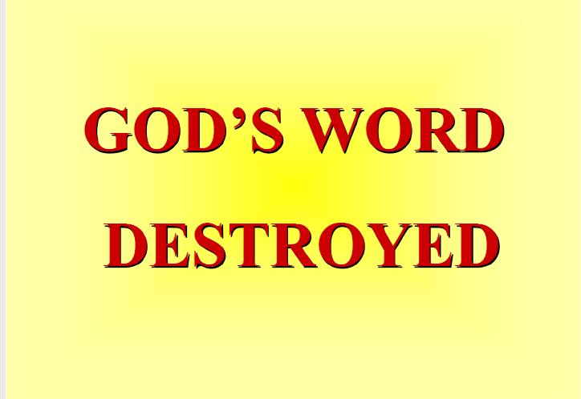

Slide 10
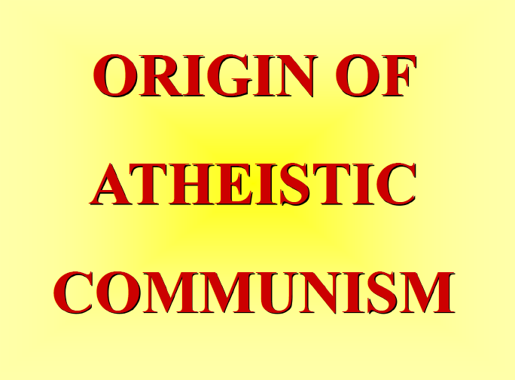

Slide 11
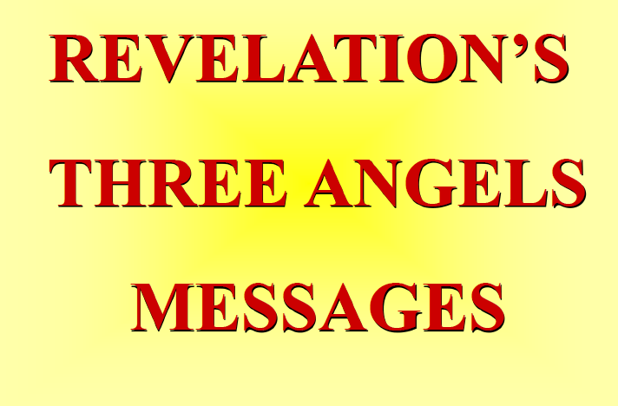

Slide 12


Slide 13
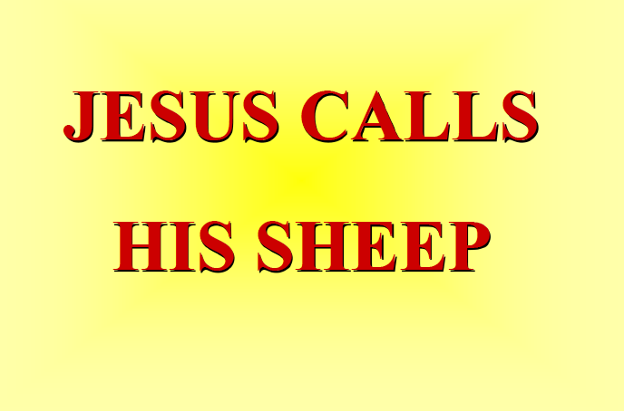

Slide 14
The first lesson for tonight:

Slide 16
Daniel 7:25 (NLT)
25 He will defy the Most High and oppress the holy people of the Most High. He will try to change their sacred festivals and laws, and they will be placed under his control for a time, times, and half a time.

Slide 17
1260 Years
The 1260 days prophecy appears several times in the Bible. What is this time period? It is a very important time period since it was mention over and over again by Daniel and John.
1260 days / 30 = 42 months = 3 ½ years;
1 time + 2 time + ½ time = 3 ½ times.

Slide 18
Revelation 11:1-3 (NLT)
Then I was given a measuring stick, and I was told, “Go and measure the Temple of God and the altar, and count the number of worshipers. 2 But do not measure the outer courtyard, for it has been turned …

Slide 19
Revelation 11:1-3 (NLT)
… over to the nations. They will trample the holy city for 42 months. 3 And I will give power to my two witnesses, and they will be clothed in burlap and will prophesy during those 1,260 days.”

Slide 20
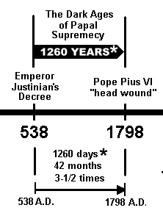
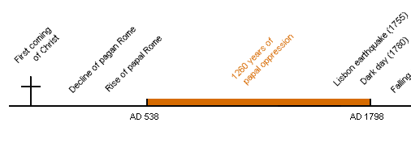
1260 Years

Slide 21
Revelation 11:3-4 (NLT)
3 And I will give power to my two witnesses, and they will be clothed in burlap and will prophesy during those 1,260 days.”4 These two prophets are the two olive trees and the two lampstands that stand before the Lord of all the earth.

Slide 22
The Two Witnesses
The two witnesses represent the Scriptures of the Old and the New Testament. Both are important testimonies to the origin and perpetuity of the law of God. Both are witnesses also to the plan of salvation. The types, sacrifices, and prophecies of the Old Testament point forward to a Saviour to come. The Gospels and Epistles of the New Testament tell of a Saviour who has come in the exact manner foretold by type and prophecy.
http://www.whiteestate.org/books/gc/gc15.html

Slide 23
Revelation 11:7 (NLT)
When they complete their testimony, the beast that comes up out of the bottomless pit will declare war against them, and he will conquer them and kill them.

Slide 24
Old and New Testament Banned
“Canon 14. We prohibit also that the laity should not be permitted to have the books of the Old or New Testament; we most strictly forbid their having any translation of these books.”
– The Church Council of Toulouse 1229 AD Source: Heresy and Authority in Medieval Europe, Scolar Press, London, England, copyright 1980 by Edward Peters, ISBN 0-85967-621-8, pp. 194-195

Slide 25
Old and New Testament Banned
“No one may possess the books of the Old and New Testaments, and if anyone possesses them he must turn them over to the local bishop within eight days, so that they may be burned…”
– The Church Council of Tarragona 1234 AD; 2nd Cannon – Source : D. Lortsch, Historie de la Bible en France, 1910, p.14.

Slide 26
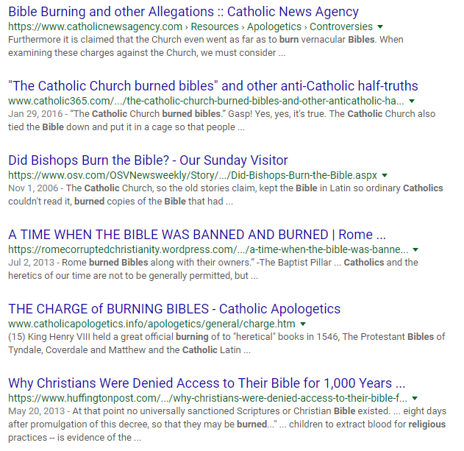

Slide 27
Revelation 11:9 (NLT)
And for three and a half days, all peoples, tribes, languages, and nations will stare at their bodies. No one will be allowed to bury them.

Slide 28
St. Bartholomew Massacre
August 24, 1572
The king of France, urged on by Romish priests and prelates, lent his sanction to the dreadful work. A bell, tolling at dead of night, was a signal for the slaughter. Protestants by thousands, sleeping quietly in their homes, trusting to the plighted honor of their king, were dragged forth without a warning and murdered in cold blood.

Slide 29
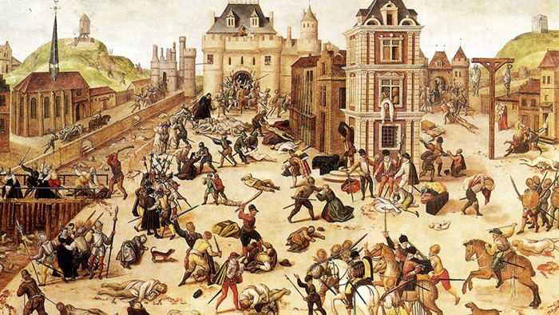
St. Bartholomew Massacre, August 24, 1572

Slide 30
Truth Was Casted Down
The same master spirit that urged on the St. Bartholomew Massacre led also in the scenes of the Revolution. Jesus Christ was declared to be an impostor, and the rallying cry of the French infidels was, "Crush the Wretch," meaning Christ. Heaven-daring blasphemy and abominable wickedness went hand in hand, and the basest of men, the most abandoned…

Slide 31
Truth Was Cast Down
… monsters of cruelty and vice, were most highly exalted. In all this, supreme homage was paid to Satan; while Christ, in His characteristics of truth, purity, and unselfish love, was crucified.
http://www.whiteestate.org/books/gc/gc15.html

Slide 32
Revelation 11:11-12 (NLT)
11 But after three and a half days, God breathed life into them, and they stood up! Terror struck all who were staring at them. 12 Then a loud voice from heaven called to the two prophets, “Come up here!” And they rose to heaven in a cloud as their enemies watched.

Slide 33
After Three and a Half Days
It was in 1793 that the decrees which abolished the Christian religion and set aside the Bible passed the French Assembly. Three years and a half later a resolution rescinding these decrees, thus granting toleration to the Scriptures, was adopted by the same body. The world stood aghast at the enormity of guilt which had resulted from a rejection of the Sacred Oracles, and men recognized the necessity of faith in God and His word as the foundation of virtue and morality.
http://www.whiteestate.org/books/gc/gc15.html

Slide 34
Daniel 4:22 (NLT)
That tree, Your Majesty, is you. For you have grown strong and great; your greatness reaches up to heaven, and your rule to the ends of the earth.

Slide 36
The Bible and the French Revolution
The war against the Bible, carried forward for so many centuries in France, culminated in the scenes of the Revolution. That terrible out breaking was but the legitimate result of Rome's suppression of the Scriptures….

Slide 37
The Bible and the French Revolution
It presented the most striking illustration which the world has ever witnessed of the working out of the papal policy-- an illustration of the results to which for more than a thousand years the teaching of the Roman Church had been tending.
http://www.whiteestate.org/books/gc/gc15.html

Slide 38
Revelation 11:13 (NLT)
At the same time there was a terrible earthquake that destroyed a tenth of the city. Seven thousand people died in that earthquake, and everyone else was terrified and gave glory to the God of heaven.

Slide 39
Spiritual Earthquake
France was shaken as if by an earthquake. Religion, law, social order, the family, the state, and the church--all were smitten down by the impious hand that had been lifted against the law of God.
http://www.whiteestate.org/books/gc/gc15.html

Slide 41
Galatians 5:9 (NLT)
This false teaching is like a little yeast that spreads through the whole batch of dough!

Slide 43
Revelation 14:6 (NLT)
And I saw another angel flying through the sky, carrying the eternal Good News to proclaim to the people who belong to this world—to every nation, tribe, language, and people.

Slide 44
Revelation 14:7 (NLT)
“Fear God,” he shouted. “Give glory to him. For the time has come when he will sit as judge. Worship him who made the heavens, the earth, the sea, and all the springs of water.”

Slide 45
Revelation 14:8 (NLT)
Then another angel followed him through the sky, shouting, “Babylon is fallen—that great city is fallen—because she made all the nations of the world drink the wine of her passionate immorality.”

Slide 46
Revelation 18:2 (NLT)
He gave a mighty shout: “Babylon is fallen—that great city is fallen! She has become a home for demons. She is a hideout for every foul spirit, a hideout for every foul vulture and every foul and dreadful animal.

Slide 47
Revelation 18:4 (NLT)
Then I heard another voice calling from heaven, “Come away from her, my people. Do not take part in her sins, or you will be punished with her.

Slide 48
Revelation 14:9-10 (NLT)
Then a third angel followed them, shouting, “Anyone who worships the beast and his statue or who accepts his mark on the forehead or on the hand…

Slide 49
Revelation 14:9-10 (NLT)
10 must drink the wine of God’s anger. It has been poured full strength into God’s cup of wrath. And they will be tormented with fire and burning sulfur in the presence of the holy angels and the Lamb.

Slide 51
Revelation 14:14 (NLT)
Then I saw a white cloud, and seated on the cloud was someone like the Son of Man. He had a gold crown on his head and a sharp sickle in his hand.

Slide 52
Romans 9:28 (NLT)
For the Lord will carry out his sentence upon the earth quickly and with finality.”

Slide 53
Hosea 4:6 (NLT)
My people are being destroyed because they don’t know me. Since you priests refuse to know me, I refuse to recognize you as my priests. Since you have forgotten the laws of your God, I will forget to bless your children.

Slide 55
John 10:27 (NLT)
My sheep listen to my voice; I know them, and they follow me.

Slide 56
John 15:11 (NLT)
I have told you these things so that you will be filled with my joy. Yes, your joy will overflow!

Slide 57
1 Corinthians 15:57 (NLT)
But thank God! He gives us victory over sin and death through our Lord Jesus Christ.

Slide 58
END -
I am ready to answer any question you may have.

Slide 59
Let us Pray to close the Bible study.

Slide 60
Don’t Be Afraid to Follow Jesus!
“If you love Him, keep His commandments”

