Slide 1
The study will begin at 7:30 PM
THE BOOK OF REVELATION
BIBLE STUDY

Slide 2
Let us Pray and then start the Bible study..

Slide 3
Let us start the Bible study..

Slide 4
Last Week Bible Study, we look at:
Revelation’s Seal of God

Slide 5
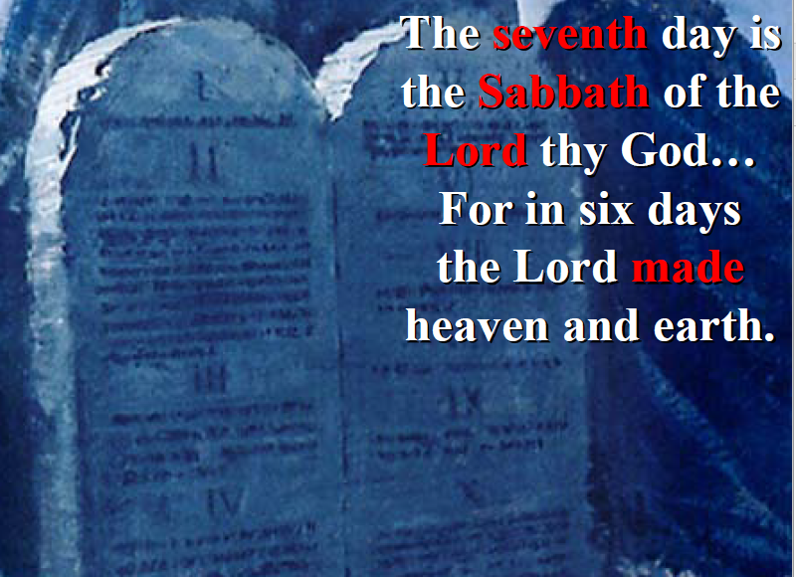
The 4th Commandment –
A Sign Between God and His People

Slide 6
Tonight’s Bible Study:
Sunday-Sabbath Observance

Slide 8
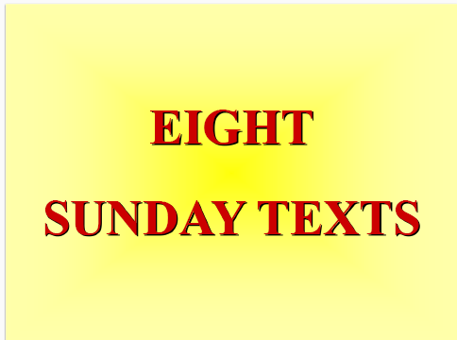

Slide 9
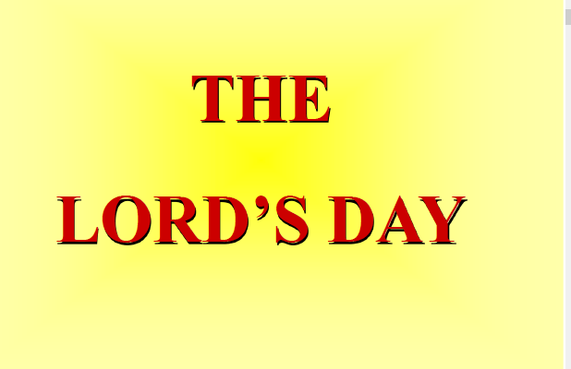

Slide 10
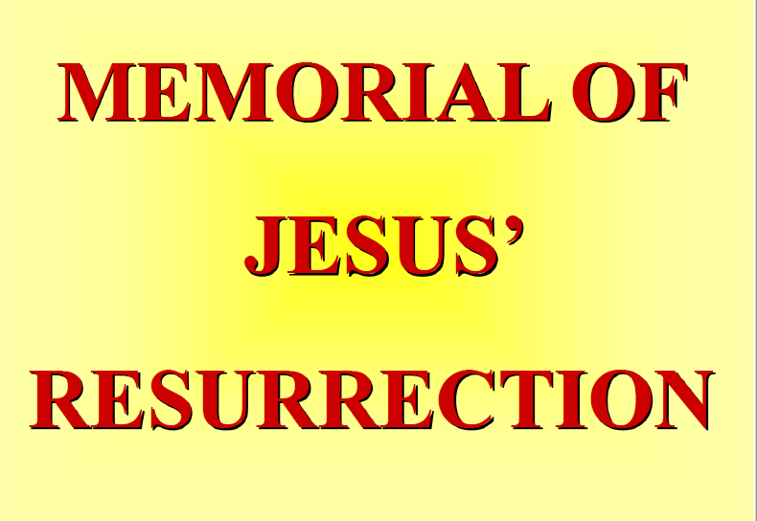

Slide 11


Slide 12
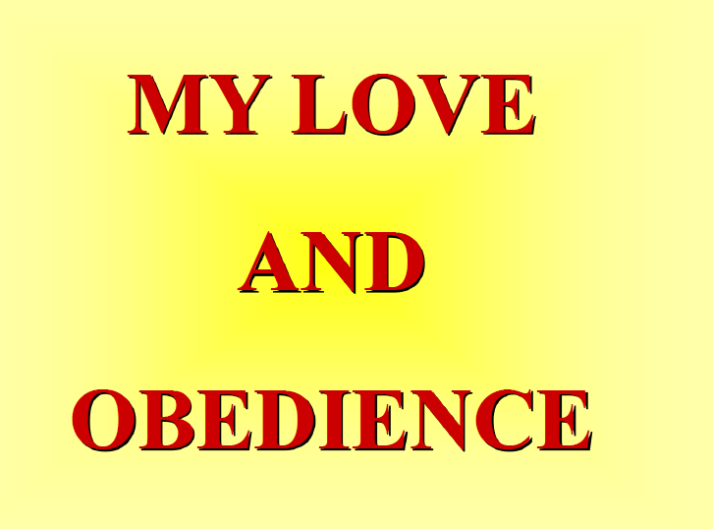

Slide 13
The first lesson for tonight:

Slide 15
Who or Which Organization is Behind The Change –
The Day of Worship?

Slide 17
Q & A - Catholic Priest
Question: Has the [Catholic] church power to make any alterations in the commandments of God?
Answer: ...Instead of the seventh day, and other festivals appointed by the old law, the church has prescribed the Sundays and holy days to be set apart for God’s worship; and these we are now obliged to keep in consequence of God’s commandment, instead of the ancient Sabbath. (The Catholic Christian Instructed in the Sacraments, Sacrifices, Ceremonies, and Observances of the Church By Way of Question and Answer, RT Rev. Dr. Challoner, p. 204)

Slide 18
Q & A - Catholic Priest
Question: Have you any other way of proving that the Church has power to institute festivals of precept?
Answer: Had she not such power, she could not have done that in which all modern religionists agree with her. She could not have substituted the observance of Sunday the first day of the week, for the observance of Saturday the seventh day, a change for which there is no Scriptural authority. –Rev. Stephen Keenan, (1851), p. 174.

Slide 19
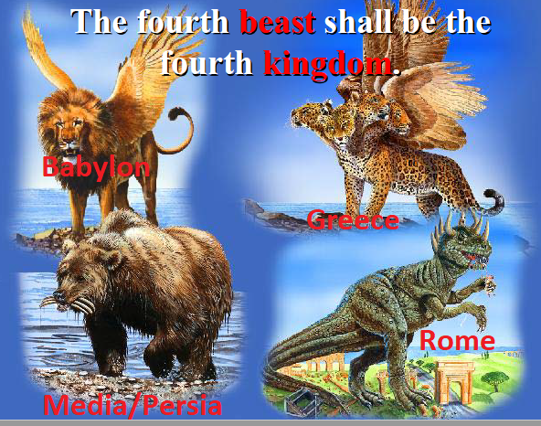

Slide 20
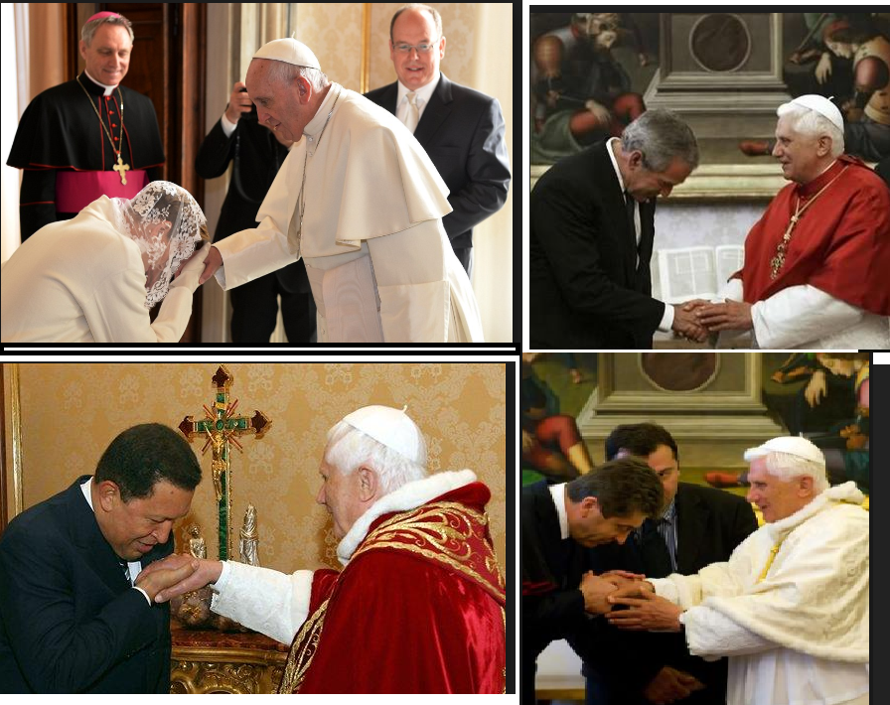

Slide 21
Mark 16:9 (NLT)
9 After Jesus rose from the dead early on Sunday morning, the first person who saw him was Mary Magdalene, the woman from whom he had cast out seven demons.

Slide 22
Matthew 28:1 (NLT)
Early on Sunday morning, as the new day was dawning, Mary Magdalene and the other Mary went out to visit the tomb.

Slide 23
John 20:1 (NLT)
Early on Sunday morning, while it was still dark, Mary Magdalene came to the tomb and found that the stone had been rolled away from the entrance.

Slide 24
Mark 16:1, 2 (NLT)
Saturday evening, when the Sabbath ended, Mary Magdalene, Mary the mother of James, and Salome went out and purchased burial spices so they could anoint Jesus’ body. 2 Very early on Sunday morning, just at sunrise, they went to the tomb.

Slide 25
Luke 24:1 (NLT)
But very early on Sunday morning the women went to the tomb, taking the spices they had prepared.

Slide 26
Acts 1:1-3 (NLT)
In my first book I told you, Theophilus, about everything Jesus began to do and teach 2 until the day he was taken up to heaven after giving his chosen apostles further instructions through the Holy Spirit.

Slide 27
Acts 1:1-3 (NLT)
3 During the forty days after he suffered and died, he appeared to the apostles from time to time, and he proved to them in many ways that he was actually alive. And he talked to them about the Kingdom of God.

Slide 28
John 20:19 (NLT)
That Sunday evening the disciples were meeting behind locked doors because they were afraid of the Jewish leaders. Suddenly, Jesus was standing there among them! “Peace be with you,” he said.

Slide 29
1-Corinthians 16:1, 2 (NLT)
Now regarding your question about the money being collected for God’s people in Jerusalem. You should follow the same procedure I gave to the churches in Galatia…

Slide 30
1-Corinthians 16:1, 2 (NLT)
2 On the first day of each week, you should each put aside a portion of the money you have earned. Don’t wait until I get there and then try to collect it all at once.

Slide 31
Passover – Lord’s Supper
The Jewish calendar date begins at sundown of the night beforehand. Thus all holiday observances begin at sundown on the secular dates listed, with the following day being the first full day of the holiday. (Thus, the first Passover seder is held on the evening of the first date listed.) Jewish calendar dates conclude at nightfall.
The first two days of Passover (from sundown of the first date listed, until nightfall two days later) are full-fledged, no-work-allowed holiday days. The subsequent four days are Chol Hamoed, when work is allowed, albeit with restrictions. Chol Hamoed is followed by another two full holiday days.

Slide 32
Passover – Lord’s Supper
The holiday of Pesach, or Passover, falls on the Hebrew calendar dates of Nissan 15-22.
Pesach 2018 (Passover) falls out at sundown on Friday, March 30, and ends at nightfall on Shabbat, April 7.
Passover in the Coming Years
2019: April 19-27 (Friday to next week Sabbath)
2020: April 8-16 (Wednesday to next week Thursday)
2021: March 27-April 4 (Sabbath to next week Sunday)

Slide 33
Acts 20:7-12 (NLT)
7 On the first day of the week, we gathered with the local believers to share in the Lord’s Supper. Paul was preaching to them, and since he was leaving the next day, he kept talking until midnight.

Slide 34
Acts 20:7-12 (NLT)
8 The upstairs room where we met was lighted with many flickering lamps. 9 As Paul spoke on and on, a young man named Eutychus, sitting on the windowsill, became very drowsy.

Slide 35
Acts 20:7-12 (NLT)
Finally, he fell sound asleep and dropped three stories to his death below. 10 Paul went down, bent over him, and took him into his arms. “Don’t worry,” he said, “he’s alive!”

Slide 36
Acts 20:7-12 (NLT)
11 Then they all went back upstairs, shared in the Lord’s Supper, and ate together. Paul continued talking to them until dawn, and then he left. 12 Meanwhile, the young man was taken home alive and well, and everyone was greatly relieved.

Slide 38
Acts 20:26-27 (NLT)
26 I declare today that I have been faithful. If anyone suffers eternal death, it’s not my fault, 27 for I didn’t shrink from declaring all that God wants you to know.

Slide 39
Matthew 5:18 (NLT)
I tell you the truth, until heaven and earth disappear, not even the smallest detail of God’s law will disappear until its purpose is achieved.

Slide 40
Deuteronomy 4:2 (NLT)
Do not add to or subtract from these commands I am giving you. Just obey the commands of the Lord your God that I am giving you.

Slide 41
James 2:10-12 (NLT)
10 For the person who keeps all of the laws except one is as guilty as a person who has broken all of God’s laws. 11 For the same God who said, “You must not commit adultery,” also said, “You must not murder.”

Slide 42
James 2:10-12 (NLT)
So if you murder someone but do not commit adultery, you have still broken the law. 12 So whatever you say or whatever you do, remember that you will be judged by the law that sets you free.

Slide 43
Revelation 1:10 (NLT)
It was the Lord’s Day, and I was worshiping in the Spirit. Suddenly, I heard behind me a loud voice like a trumpet blast.

Slide 44
Exodus 20:10 (NLT)
but the seventh day is a Sabbath day of rest dedicated to the Lord your God. On that day no one in your household may do any work. This includes you, your sons and daughters, your male and female servants, your livestock, and any foreigners living among you.

Slide 45
Isaiah 58:13 (NLT)
“Keep the Sabbath day holy. Don’t pursue your own interests on that day, but enjoy the Sabbath and speak of it with delight as the Lord’s holy day. Honor the Sabbath in everything you do on that day, and don’t follow your own desires or talk idly.

Slide 46
Mark 2:28 (NLT)
So the Son of Man is Lord, even over the Sabbath!”

Slide 47
Exodus 20:10 (NLT)
but the seventh day is a Sabbath day of rest dedicated to the Lord your God. On that day no one in your household may do any work. This includes you, your sons and daughters, your male and female servants, your livestock, and any foreigners living among you.

Slide 48
Isaiah 58:13 (NLT)
“Keep the Sabbath day holy. Don’t pursue your own interests on that day, but enjoy the Sabbath and speak of it with delight as the Lord’s holy day. Honor the Sabbath in everything you do on that day, and don’t follow your own desires or talk idly.

Slide 49
Matthew 12:8 (NLT)
For the Son of Man is Lord, even over the Sabbath!”

Slide 50
Mark 2:27, 28 (NLT)
27 Then Jesus said to them, “The Sabbath was made to meet the needs of people, and not people to meet the requirements of the Sabbath. 28 So the Son of Man is Lord, even over the Sabbath!”

Slide 51
Luke 6:5 (NLT)
And Jesus added, “The Son of Man is Lord, even over the Sabbath.”

Slide 53
Ezekiel 46:1 (NLT)
“This is what the Sovereign Lord says: The east gateway of the inner courtyard will be closed during the six workdays each week, but it will be open on Sabbath days and the days of new moon celebrations.

Slide 54
Matthew 15:3-9 (NLT)
3 Jesus replied, “And why do you, by your traditions, violate the direct commandments of God? 4 For instance, God says, ‘Honor your father and mother,’[a] and ‘Anyone who speaks disrespectfully…

Slide 55
Matthew 15:3-9 (NLT)
…of father or mother must be put to death.’ 5 But you say it is all right for people to say to their parents, ‘Sorry, I can’t help you. For I have vowed to give to God what I would have given to you.’

Slide 56
Matthew 15:3-9 (NLT)
6 In this way, you say they don’t need to honor their parents.[c] And so you cancel the word of God for the sake of your own tradition. 7 You hypocrites! Isaiah was right when he prophesied about you,…

Slide 57
Matthew 15:3-9 (NLT)
… for he wrote, 8 ‘These people honor me with their lips, but their hearts are far from me. 9 Their worship is a farce, for they teach man-made ideas as commands from God.’”

Slide 58
Romans 6:3-6 (NLT)
3 Or have you forgotten that when we were joined with Christ Jesus in baptism, we joined him in his death? 4 For we died and were buried with Christ by baptism. And just as Christ was raised from the …

Slide 59
Romans 6:3-6 (NLT)
… dead by the glorious power of the Father, now we also may live new lives. 5 Since we have been united with him in his death, we will also be raised to life as he was.

Slide 60
Romans 6:3-6 (NLT)
6 We know that our old sinful selves were crucified with Christ so that sin might lose its power in our lives. We are no longer slaves to sin.

Slide 61
Colossians 2:12 (NLT)
For you were buried with Christ when you were baptized. And with him you were raised to new life because you trusted the mighty power of God, who raised Christ from the dead.

Slide 62
Gregorian Calendar - 1582
The Gregorian calendar is the most widely used civil calendar in the world. It is named after Pope Gregory XIII, who introduced it in October 1582. The calendar spaces leap years to make the average year 365.2425 days long, approximating the 365.2422 day tropical year that is determined by the Earth's rotation around the Sun. The rule for leap years is as follows:
Every year that is exactly divisible by four is a leap year, except for years that are exactly divisible by 100, but these centurial years are leap years if they are exactly divisible by 400. For example, the years 1700, 1800, and 1900 are not leap years, but the year 2000 is.
The calendar was developed as a refinement of the Julian calendar, shortening the average year by 0.0075 days to stop the drift of the calendar with respect to the equinoxes. To deal with the 10 days of accumulated drift, the date was advanced so that 4 October 1582 was followed by 15 October 1582. There was no discontinuity in the cycle of weekdays. (https://en.wikipedia.org/wiki/Gregorian_calendar)

Slide 64
Colossians 2:14-17 (NLT)
14 He canceled the record of the charges against us and took it away by nailing it to the cross. 15 In this way, he disarmed the spiritual rulers and authorities. He shamed them publicly by his victory over …

Slide 65
Colossians 2:14-17 (NLT)
… them on the cross. 16 So don’t let anyone condemn you for what you eat or drink, or for not celebrating certain holy days or new moon ceremonies or Sabbaths.

Slide 66
Colossians 2:14-17 (NLT)
17 For these rules are only shadows of the reality yet to come. And Christ himself is that reality.

Slide 67
Shadow Sabbaths
"In the seventh month, in the first day of the month, shall ye have a Sabbath." Lev. 23:24.
(Rest from work – make holy)

Slide 68
Shadow Sabbaths
"Also the tenth day of the seventh month there shall be a day of atonement... It shall be unto you a Sabbath of rest, and ye shall afflict your souls." Lev. 23:27-32.

Slide 69
Leviticus 23:37-38 (NLT)
37 “These are the Lord’s appointed festivals. Celebrate them each year as official days for holy assembly by presenting special gifts to the Lord—burnt offerings, grain offerings, sacrifices, and liquid offerings—each on its proper day.

Slide 70
Leviticus 23:37-38 (NLT)
38 These festivals must be observed in addition to the Lord’s regular Sabbath days, and the offerings are in addition to your personal gifts, the offerings you give to fulfill your vows, and the voluntary offerings you present to the Lord.

Slide 71
Ceremonial Laws
Ceremonial Laws -- -- > Jesus’ Sacrifice on The Cross.
Ceremonial Laws ended when Jesus was crucified. They were “nailed to the cross”.

Slide 73
Revelation 12:17 (NLT)
And the dragon was angry at the woman and declared war against the rest of her children—all who keep God’s commandments and maintain their testimony for Jesus.

Slide 74
Revelation 14:12 (NLT)
This means that God’s holy people must endure persecution patiently, obeying his commands and maintaining their faith in Jesus.

Slide 75
Revelation 22:14 (NLT)
Blessed are those who wash their robes. They will be permitted to enter through the gates of the city and eat the fruit from the tree of life.

Slide 76
Hebrews 5:9 (NLT)
In this way, God qualified him as a perfect High Priest, and he became the source of eternal salvation for all those who obey him.

Slide 77
Matthew 15:3 (NLT)
Jesus replied, “And why do you, by your traditions, violate the direct commandments of God?

Slide 78
John 14:15 (NLT)
“If you love me, obey my commandments.

Slide 79
END -
I am ready to answer any question you may have.

Slide 80
Let us Pray to close the Bible study.

Slide 81
Don’t Be Afraid to Follow Jesus!
“If you love Him, keep His commandments”

