Slide 1
The study will begin at 7:30 PM
THE BOOK OF REVELATION
BIBLE STUDY

Slide 2
Let us Pray and then start the Bible study..

Slide 3
Let us start the Bible study..

Slide 4
Last Week Bible Study, we look at:
Mystic Babylon
The Great Harlot of the Beast

Slide 5
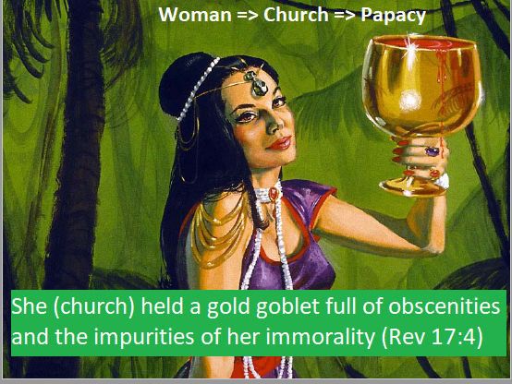

Slide 6
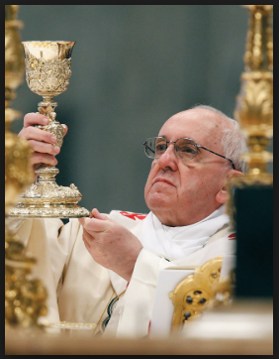
The Church (she) Held a Gold Goblet

Slide 7
The Church (woman) wore purple and scarlet
Rev 17:4 The woman wore purple and scarlet clothing and beautiful jewelry made of gold and precious gems and pearls. In her hand she held a gold goblet full of obscenities and the impurities of her immorality.

Slide 8
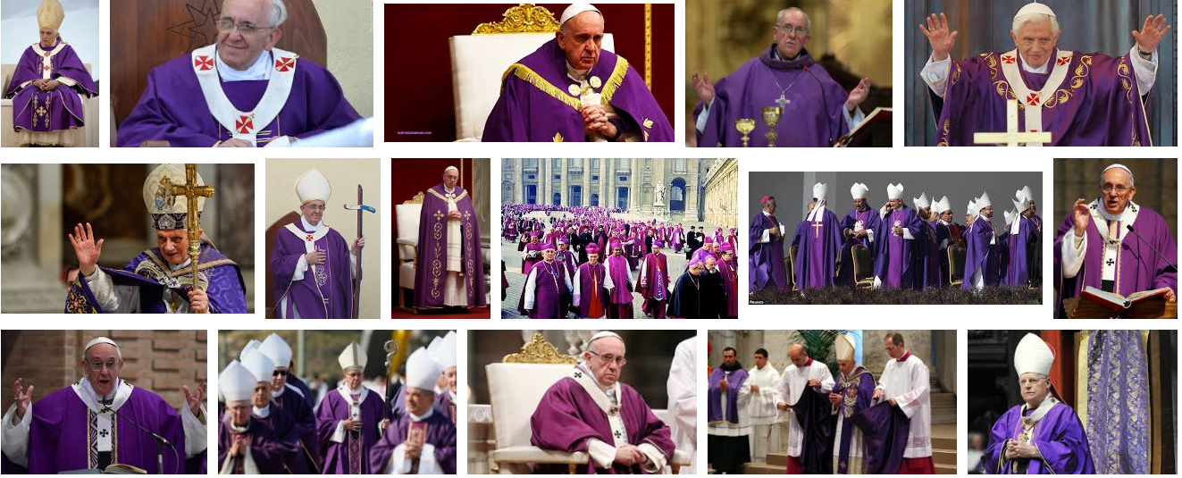
Church (woman) Wore Purple and Scarlet Clothing

Slide 9
Tonight’s Bible Study:
Revelation’s Seal of God

Slide 10
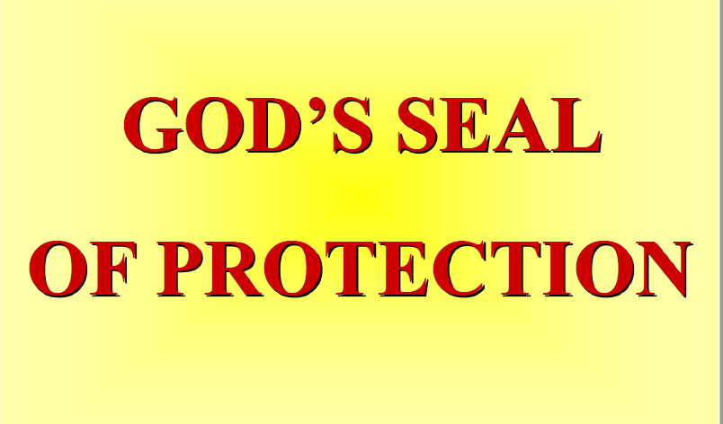

Slide 11
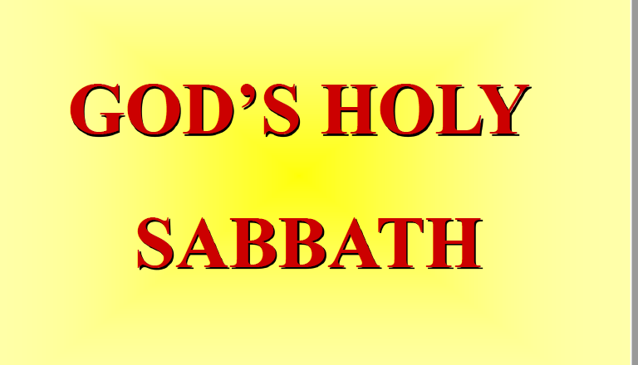

Slide 12
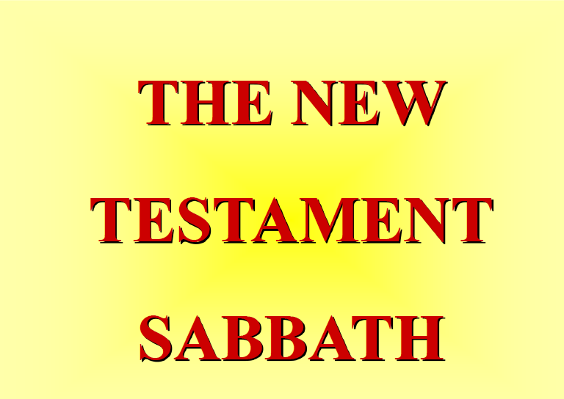

Slide 13
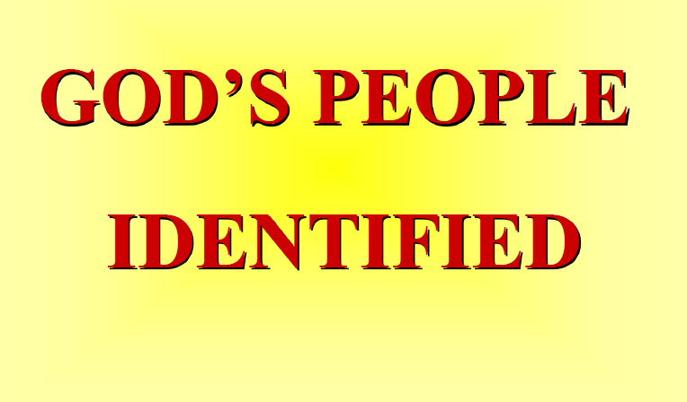

Slide 14
The first lesson for tonight:

Slide 16
Revelation 7:1-3 (NLT)
7:1 Then I saw four angels standing at the four corners of the earth, holding back the four winds so they did not blow on the earth or the sea, or even on any tree.

Slide 17
Revelation 7:1-3 (NLT)
7:2 And I saw another angel coming up from the east, carrying the seal of the living God. And he shouted to those four angels, who had been given power to harm land and sea,

Slide 18
Revelation 7:1-3 (NLT)
7:3 “Wait! Don’t harm the land or the sea or the trees until we have placed the seal of God on the foreheads of his servants.”

Slide 19
Revelation 14:6 (NLT)
6 And I saw another angel flying through the sky, carrying the eternal Good News to proclaim to the people who belong to this world—to every nation, tribe, language, and people.

Slide 20
Romans 4:11 (NLT)
11 Circumcision was a sign that Abraham already had faith and that God had already accepted him and declared him to be righteous—even before he was circumcised…

Slide 21
Romans 4:11 (NLT)
… So Abraham is the spiritual father of those who have faith but have not been circumcised. They are counted as righteous because of their faith.

Slide 22
Ephesians 1:13 (NLT)
13 And now you Gentiles have also heard the truth, the Good News that God saves you. And when you believed in Christ, he identified you as his own by giving you the Holy Spirit, whom he promised long ago.

Slide 23
Ephesians 4:30 (NLT)
30 And do not bring sorrow to God’s Holy Spirit by the way you live. Remember, he has identified you as his own, guaranteeing that you will be saved on the day of redemption.

Slide 24
Exodus 20:8-11 (NLT)
8 “Remember to observe the Sabbath day by keeping it holy. 9 You have six days each week for your ordinary work, 10 but the seventh day is a Sabbath day of rest dedicated to the Lord your God.

Slide 25
Exodus 20:8-11 (NLT)
On that day no one in your household may do any work. This includes you, your sons and daughters, your male and female servants, your livestock, and any foreigners living among you.

Slide 26
Exodus 20:8-11 (NLT)
11 For in six days the Lord made the heavens, the earth, the sea, and everything in them; but on the seventh day he rested. That is why the Lord blessed the Sabbath day and set it apart as holy.

Slide 27
Revelation 4:10, 11 (NLT)
10 the twenty-four elders fall down and worship the one sitting on the throne (the one who lives forever and ever). And they lay their crowns before the throne and say,.

Slide 28
Revelation 4:10, 11 (NLT)
11 “You are worthy, O Lord our God, to receive glory and honor and power. For you created all things, and they exist because you created what you pleased.”

Slide 29
Revelation 5:9 (NLT)
9 And they sang a new song with these words: “You are worthy to take the scroll and break its seals and open it. For you were slaughtered, and your blood has ransomed people for God from every tribe and language and people and nation.

Slide 30
Exodus 31:16, 17 (NLT)
16 The people of Israel must keep the Sabbath day by observing it from generation to generation. This is a covenant obligation for all time.

Slide 31
Exodus 31:16, 17 (NLT)
17 It is a permanent sign of my covenant with the people of Israel. For in six days the Lord made heaven and earth, but on the seventh day he stopped working and was refreshed.’”

Slide 32
Ezekiel 20:12 (NLT)
And I gave them my Sabbath days of rest as a sign between them and me. It was to remind them that I am the Lord, who had set them apart to be holy.

Slide 33
Revelation 7:3 (NLT)
7:3 “Wait! Don’t harm the land or the sea or the trees until we have placed the seal of God on the foreheads of his servants.”

Slide 35
Genesis 2:1-4 (NLT)
So the creation of the heavens and the earth and everything in them was completed. 2 On the seventh day God had finished his work of creation, so he rested from all his work.

Slide 36
Genesis 2:1-4 (NLT)
3 And God blessed the seventh day and declared it holy, because it was the day when he rested from all his work of creation. 4 This is the account of the creation of the heavens and the earth.

Slide 37
Exodus 20:10 (NLT)
10 but the seventh day is a Sabbath day of rest dedicated to the Lord your God. On that day no one in your household may do any work. This includes you, your sons and daughters, your male and female servants, your livestock, and any foreigners living among you.

Slide 38
Genesis 2:2-3 (NLT)
2 On the seventh day God had finished his work of creation, so he rested from all his work. 3 And God blessed the seventh day and declared it holy, because it was the day when he rested from all his work of creation.

Slide 39
1 Chronicles 17:27 (NLT)
27 And now, it has pleased you to bless the house of your servant, so that it will continue forever before you. For when you grant a blessing, O Lord, it is an eternal blessing!”

Slide 40
Mark 2:27, 28 (NLT)
27 Then Jesus said to them, “The Sabbath was made to meet the needs of people, and not people to meet the requirements of the Sabbath. 28 So the Son of Man is Lord, even over the Sabbath!”

Slide 41
Exodus 20:8-11 (NLT)
8 “Remember to observe the Sabbath day by keeping it holy. 9 You have six days each week for your ordinary work, 10 but the seventh day is a Sabbath day of rest dedicated to the Lord your God.

Slide 42
Exodus 20:8-11 (NLT)
On that day no one in your household may do any work. This includes you, your sons and daughters, your male and female servants, your livestock, and any foreigners living among you.

Slide 43
Exodus 20:8-11 (NLT)
11 For in six days the Lord made the heavens, the earth, the sea, and everything in them; but on the seventh day he rested. That is why the Lord blessed the Sabbath day and set it apart as holy.

Slide 45
Luke 16:17 (NLT)
17 But that doesn’t mean that the law has lost its force. It is easier for heaven and earth to disappear than for the smallest point of God’s law to be overturned.

Slide 46
Luke 4:16 (NLT)
16 When he came to the village of Nazareth, his boyhood home, he went as usual to the synagogue on the Sabbath and stood up to read the Scriptures.

Slide 47
Acts 17:2 (NLT)
2 As was Paul’s custom, he went to the synagogue service, and for three Sabbaths in a row he used the Scriptures to reason with the people.

Slide 48
1 Peter 2:21 (NLT)
21 For God called you to do good, even if it means suffering, just as Christ suffered for you. He is your example, and you must follow in his steps.

Slide 49
Acts 13:42 (NLT)
42 As Paul and Barnabas left the synagogue that day, the people begged them to speak about these things again the next week.

Slide 50
Matthew 24:20 (NLT)
20 And pray that your flight will not be in winter or on the Sabbath.

Slide 52
Revelation 14:12 (NLT)
12 This means that God’s holy people must endure persecution patiently, obeying his commands and maintaining their faith in Jesus.

Slide 53
Revelation 12:17 (NLT)
17 And the dragon was angry at the woman and declared war against the rest of her children—all who keep God’s commandments and maintain their testimony for Jesus.

Slide 54
1 John 3:4 (NLT)
4 Everyone who sins is breaking God’s law, for all sin is contrary to the law of God.

Slide 55
Romans 6:23 (NLT)
23 For the wages of sin is death, but the free gift of God is eternal life through Christ Jesus our Lord .

Slide 56
Isaiah 58:1 (NLT)
“Shout with the voice of a trumpet blast. Shout aloud! Don’t be timid.
Tell my people Israel[a] of their sins!.

Slide 57
Isaiah 58:13 (NLT)
“Keep the Sabbath day holy. Don’t pursue your own interests on that day, but enjoy the Sabbath and speak of it with delight as the Lord’s holy day. Honor the Sabbath in everything you do on that day, and don’t follow your own desires or talk idly.

Slide 58
Isaiah 66:22, 23 (KJV)
22 For as the new heavens and the new earth, which I will make, shall remain before me, saith the Lord, so shall your seed and your name remain. 23 And it shall come to pass, that from one new moon to another, and from one Sabbath to another, shall all flesh come to worship before me, saith the Lord.

Slide 59
John 14:15 (NLT)
15 “If you love me, obey my commandments.

Slide 60
Revelation 14:6 (NLT)
6 And I saw another angel flying through the sky, carrying the eternal Good News to proclaim to the people who belong to this world—to every nation, tribe, language, and people.

Slide 61
Revelation 14:7 (NLT)
7 “Fear God,” he shouted. “Give glory to him. For the time has come when he will sit as judge. Worship him who made the heavens, the earth, the sea, and all the springs of water.”

Slide 62
Revelation 14:12 (NLT)
12 This means that God’s holy people must endure persecution patiently, obeying his commands and maintaining their faith in Jesus.

Slide 63
Revelation 14:14 (NLT)
14 Then I saw a white cloud, and seated on the cloud was someone like the Son of Man. He had a gold crown on his head and a sharp sickle in his hand.

Slide 64
Exodus 20:8-10 (NLT)
8 “Remember to observe the Sabbath day by keeping it holy. 9 You have six days each week for your ordinary work, 10 but the seventh day is a Sabbath day of rest dedicated to the Lord your God.

Slide 65
Mark 2:28 (NLT)
28 So the Son of Man is Lord, even over the Sabbath!”

Slide 66
Isaiah 58:13 (NLT)
“Keep the Sabbath day holy. Don’t pursue your own interests on that day, but enjoy the Sabbath and speak of it with delight as the Lord’s holy day. Honor the Sabbath in everything you do on that day, and don’t follow your own desires or talk idly.

Slide 67
Isaiah 58:14 (NLT)
Then the Lord will be your delight. I will give you great honor and satisfy you with the inheritance I promised to your ancestor Jacob. I, the Lord, have spoken!”

Slide 68
END -
I am ready to answer any question you may have.

Slide 69
Let us Pray to close the Bible study.

Slide 70
Don’t Be Afraid to Follow Jesus!
“If you love Him, keep His commandments”

